Slide 1
Optimizing Pathways and Market Systems for Enhanced Competitiveness of Sustainable Bioenergy and Technologies in Europe
The Cost-Effectiveness of Bio-Energy Support Schemes
BIOTEAM project
Germany, the Netherlands and Poland
Novi Sad - 15 march 2016
Eise Spijker – JIN Climate & Sustainability

Slide 2
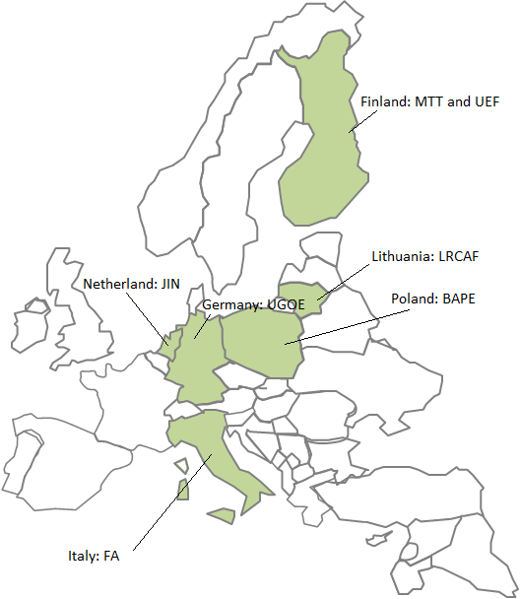
ABOUT BIOTEAM
Title: BIOTEAM - Optimizing Pathways and Market Systems for enhanced competitiveness of sustainable bio-energy and technologies in Europe
Start: 1 April 2013 (3-year duration)
Who: Six countries & seven partners
www.sustainable-biomass.eu
Project partners
JIN Climate & Sustainability
LUKE, Natural Resources Institute Finland
Lithuanian Research Centre for Agriculture and Forestry
Georg August University Göttingen
Fondazione per l’ambiente – Teobaldo Fenoglio Onlus
Baltic Energy Conservation Agency
University of Eastern Finland

Slide 3
EFFECT OF SUPPORT POLICIES ON BIOENERGY
Source: Eurostat, 2015

Slide 4
COST-EFFECTIVE SUPPORT POLICIES NEEDED
Key observations
Share of biomass in EU RES portfolio is large, mainly solids and biogas
We had a good kick-start of RES support, but it is becoming expensive
Quest for cost-effective support schemes
But, what is cost-effectiveness?
Some case examples:
Germany (RES-Electricity)
Netherlands (RES-Heat/Gas/Electricity)
Germany (RES-Heat)
Extra – Poland (RES-Electricity)

Slide 5
GERMANY FEED-IN SUBSIDY (EEG)
Key features
Specific feed-in support for all RES-E categories
Network operators purchase green electricity at feed-in price
Losses on energy sales by network operators ‘socialized’ to electricity consumers (‘Umlage’ = about 20% of household electricity bill)
2016 = 6,353 ct/kWh
2010 = 2,047 ct/kWh
No overall budget limit (open ended scheme)
“It is estimated that by 2030, Germany will have spent more than 300 billion Euros on green electricity.”
COST-EFFECTIVE?

Slide 6
SUPPORT FOR BIOGAS IN GERMANY: EEG REFORM
2012
Plant Capacity (kW_{el}) | Basic feed-in tariff (ct/kWh) | Input class I (ct/kWh) | Input class II (ct/kWh)
≤ 75 | 14,30 | 6,00 | 8,00
≤ 150
≤ 500 | 12,30
≤ 750 | 11,00 | 5,00 | 8,00
≤ 5.000 |  | 4,00
≤ 20.000 | 6,0 | 0,00 | 0,00
Up to 28 ct/kWh support!!
2014
Plant Capacity (kW_{el}) | Feed-in tariff (ct/kWh)
≤ 75 | 13,66
≤ 150
≤ 500 | 11,78
≤ 5.000 | 10,55
≤ 20.000 | 5,85
In 2015, almost 9000 biogas plants in Germany
Very small plants in the south-east, slightly larger ones in the north-west
Up to 14 ct/kWh support!!

Slide 7
MAIN DRIVERS FOR BIOGAS SUPPORT IN GERMANY
EEG 2012
Renewable energy target
Climate change mitigation
Rural development / income for farmers
EEG 2014
Need for increasing cost-effectiveness of EEG (e.g. lowering costs)
Flexibility premium for biogas (to balance grid for wind/solar)

Slide 8
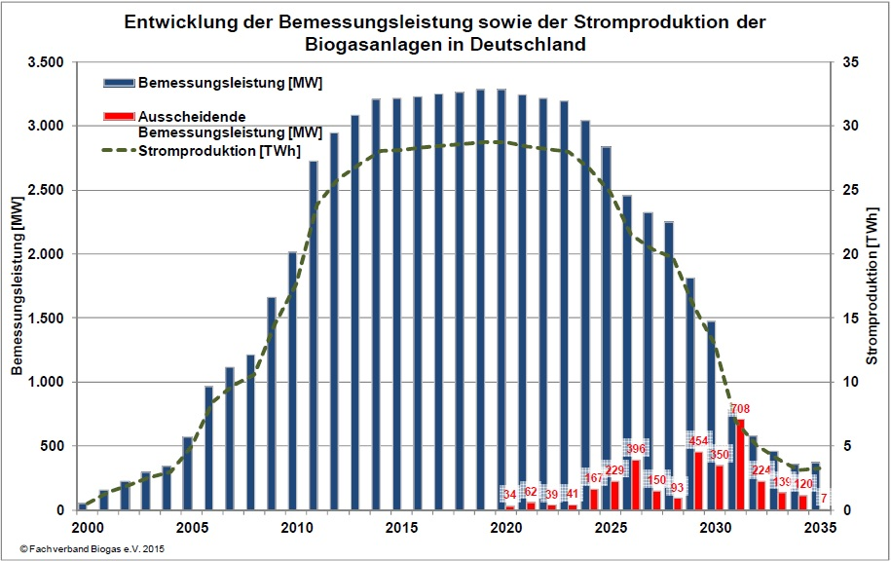
EEG REFORM: STAGNATION AND DE-INSTALLATION
Construction of biogas plants has come to a standstill (‘stop-go’ policy)
Expected reduction of electricity from biogas by 85 % until 2035
Installed Capacity of Biogas Plants in Germany
Installed Capacity [MW]
De-installed Capacity [MW]
Electricity Production [TWh]
Installed Capacity [MW]
Electricity Production [TWh]

Slide 9
SMALL-SCALE IS NOT COST-EFFECTIVE
Small-scale biogas plants cost-effective?
- High subsidy costs (EUR/kWh)
Income for farmers?
Source: http://www.nawaro.ag/de/unternehmen/projekte/bioenergiepark-guestrow/

Slide 10
SMALL-SCALE IS VERY COST-EFFECTIVE co-benefits & trade-offs
Sustainability indicator | Biogas benefits | Fossil electricity benefits
Greenhouse Gas Emissions | +
Acidification |  | +
Chemicals use | +
Water use | +
Nutrient losses |  | +
Energy balance |  | +
IRR / Repayment period |  | +
Effect on local economy | +
Employment | +
Effect on environmental status | +
More data on sustainability performance of German bioenergy pathways - link

Slide 11
THE NETHERLANDS FEED-IN SUBSIDY (SDE+)
AUCTION
Budget
Key features
Feed-in support open for all RES
Heat
Electricity
Renewable gas
Auctions in phases (competitive bidding)
Mark-up on energy bill for gas and electricity consumers funds the scheme
Annual budget limit (‘closed’ scheme)
EUR 3 bln. (2013)
EUR 3,5 bln. (2014)
EUR 3,5 bln. (2015)
EUR 8 bln. (2016) + separate offshore wind budget
Base rate EUR/kWh
Phase 1
Phase 2
Phase 3
Time

Slide 12
MANURE DIGESTION IS NOT COST-EFFECTIVE Expressed in EUR/kWh
RES Category | Max. subsidy EUR per kWh | SDE+ auction phase 2016
All digestion (heat) | 0,035 | Phase 1
All digestion (biomethane) | 0,04 | Phase 1
Manure co-digestion (heat) | 0,053 | Phase 1
Wind on land (av. different wind speed zones) | 0,0545 | Phase 1
Manure co-digestion (biomethane) | 0,056 | Phase 1
All digestion (chp) | 0,058 | Phase 1
Existing capacity for co-firing (25PJ) | 0,068 | Phase 1
New capacity for co-firing | 0,075 | Phase 1
Solar thermal >200m² | 0,078 | Phase 1
Digestion of >95% animal manure (heat) | 0,084 | Phase 1
Manure co-digestion (chp) | 0,085 | Phase 1
Photovoltaic panels >15 kWp & connection >3*80A | 0,093 | Phase 2
Solar thermal >100m² | 0,096 | Phase 2
Wind offshore | 0,132 | Phase 4
Digestion of >95% animal manure (biomethane) | 0,161 | >Phase 4
Digestion of >95% animal manure (chp) | 0,266 | >Phase 4

Slide 13
MANURE DIGESTION IS VERY COST-EFFECTIVE Expressed in EUR/tCO₂-eq. avoided
With different denominator manure digestion becomes cost-competitive!!!
INDICATIVE | Costs | Costs
 | EUR / tCO₂ | EUR / tCO₂
Mono manure >95% manure (gas) – pig slurry | - | 39
Mono manure >95% manure (gas) – pig slurry | 63 | -
Wind onshore | 65 – 112 | 65 – 112
Co-firing biomass (existing capacity) | 88 | 88
Solar PV | 150 | 150
Wind offshore | 209 | 209
Mono manure >95% manure (gas) – no CH₄ cred. | 361 | 361
Solar Thermal | 370 | 370
 | 50% CH₄ capture efficiency | 95% CH₄ capture efficiency

Slide 14
WHAT IS THE COST-EFFECTIVENESS OF MANURE DIGESTION? Expressed in EUR / ‘unit of sustainability’
What is the added value of the investment in bioenergy?
€ ?
Kwh
produced
NH₃ avoided
CO_{2-eq} avoided
ANIMAL
Welfare improved
NPK
Recycled
JOBS created
SOC RECYCLED

Slide 15
SUPPORT FOR WOOD PELLETS IN GERMANY
WOOD RESIDUE COLLECTION
-
INDIRECT SUPPORT – High EEG Feed-in support electricity & heat ‘subsidized’ by-product for drying
WOOD PELLET PRODUCTION
About 2 ct fiscal support per kWh
DISTRIBUTION
-
VAT RATE – Lower VAT category
(7% instead of 19% ≈ 0,6 cts kWh)
ENERGY TAX – Exemption for wood pellets
(=1,39 cts / kWh)
END-USE

Slide 16
SUPPORT FOR WOOD PELLETS IN GERMANY
Support:
≈ 2-3 EURct fiscal support per kWh cost-effective?
Cost-effectiveness defined as:
EUR support per kWh

Slide 17
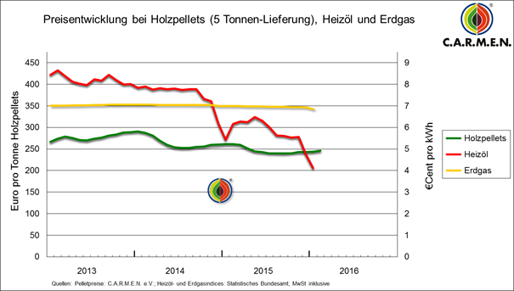
SUPPORT FOR WOOD PELLETS IN GERMANY
2 ct

Slide 18
RATIONALE FOR SUPPORT co-benefits & trade-offs
Sustainability indicator | Wood pellets benefits | Natural gas Benefits
Greenhouse Gas Emissions | +
Air quality |  | +
Chemicals use | +
Water use | +
Nutrient losses |  | +
Energy balance |  | +
IRR / Repayment period |  | +
Product price end user | +
Effect on local economy | +
Employment | +
Effect on environmental status | +
More data on sustainability performance of German bioenergy pathways - link

Slide 19
RATIONALE FOR SUPPORT
Co-benefits:
What do we get ‘extra’ for the 2-3 EURct fiscal support per kWh?
Trade-offs:
And what are we ‘paying’ in addition?
Cost-effectiveness defined as:
EUR support per unit of employment
EUR support per unit of ‘air quality’
…
EUR support per ‘unit of sustainability’

Slide 20
For information on POLAND
Andrzej Szajner
aszajner@bape.com.pl
Baltic Energy Conservation Agency
For information on GERMANY
Lars Lauven
Lars.lauven@wiwi.uni-goettingen.de
University of Göttingen
For information on the NETHERLANDS
Eise Spijker
eise@jin.ngo
Joint Implementation Network
www.jin.ngo

Slide 21
POLAND GREEN CERTIFICATES
Key features
Obligation to supply x-% RES-E
Tradable certificates
One equilibrium price for all RES-E, thus competition between all RES-E

Slide 22
POLAND GREEN CERTIFICATES (GC)
P
Demand (inelastic) – x% of supply
GC price
Supply
Costs – agro-pellets
Support for agro-pellets
Conversion efficiency?
Support for co-firing
Costs – co-firing wood chips
Costs – old hydro
Q

Slide 23
POLAND GREEN CERTIFICATES
Key effects
Competition between all forms of RES-E
GC price volatility
Potential overstimulation of (older / inefficient) low-cost RES-E options
≈70% of support went to wood chips co-firing at low efficiencies and large hydro
Banking overproduction of GCs enabled wood co-firing utilities to influence GC price and thereby influence / affect revenues and profits from competition
Cost-effective?
Could same result be achieved with less support?

Slide 24
BIOTEAM KEY OBJECTIVES
Improve sustainability performance of biomass use
Understanding market system dynamics with respect to biomass use
Provide input public and private strategic decision making (e.g. policies and investments)

Slide 25
DIVERSITY OF BIOENERGY SUPPORT SCHEMES
HARVESTING
FINLAND – Subsidy for harvesting – for heating
NETHERLANDS – Feed-in for heat, gas, electricity
POLAND – Electricity Quota (GC)
PRODUCTION
Policies
Subsidies
Fiscal support
Quota Obligations
Standards
GERMANY – Purchase obligation at feed-in prices for electricity
DISTRIBUTION
GERMANY – Energy tax exemption (pellets)
GERMANY – Low VAT (pellets)
END-USE

