Slide 1
The Neustadt-Glewe Geothermal Plant: From Exploration to Successful Operation
Peter Seibt
Geothermie Neubrandenburg GmbH
“Geothermal Energy Days” in Vojvodina (SRB), 2015

Slide 2
General Data
Status: Private limited company (Gesellschaft mit beschränkter Haftung; GmbH)
Taken into private
ownership on: 6 September 1991
Shareholders: Mannvit GmbH 55 %
Dr Frank Kabus 22,5 %
Dr Peter Seibt 22,5 %
Number of employees: 20
Offices: Neubrandenburg,
Munich (Unterhaching),
Berlin,
Santiago de Chile
Register of companies: HRB 1249,
Amtsgericht (court) Neubrandenburg

Slide 3

Mannvit at a glance
An international consultancy offering a wide range of services in the fields of engineering, consulting, management and operations
Founded in 1963, 400 Employees
Turnover 2012: 44 million EUR
Employee-owned by over 100 shareholders
Geothermal and Hydro more than 40 years
Management Systems certified:
ISO 9001, ISO 14001, OHSAS 18001
FS 551557
EMS 567779
OHS 567778

Slide 4
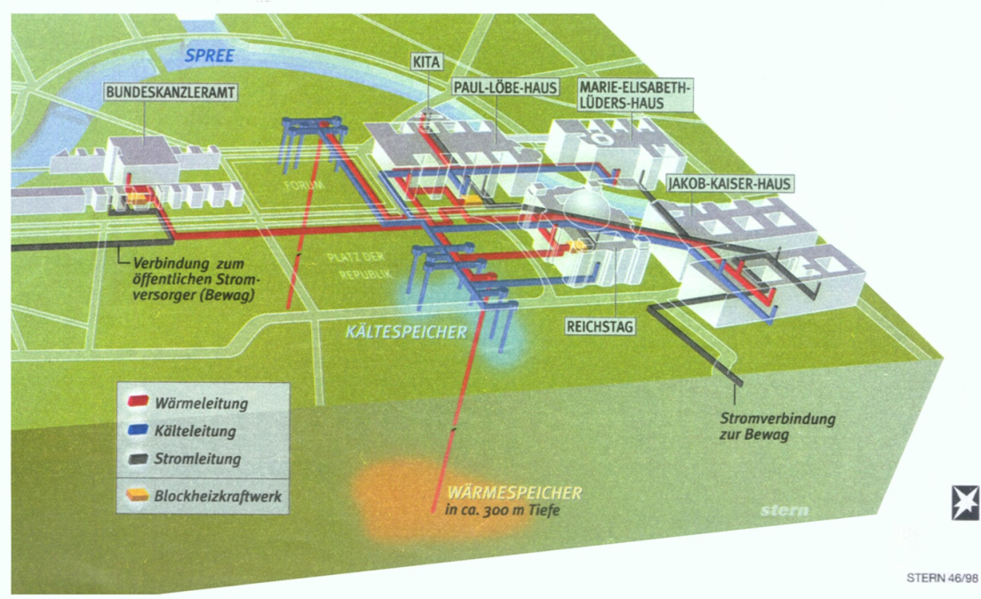
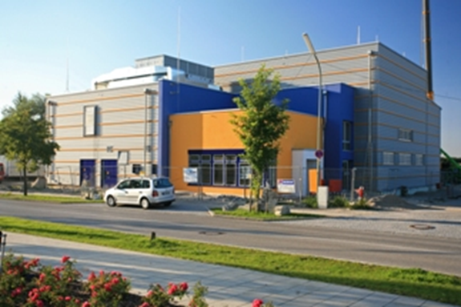
Our Fields of Work
Expertise
Studies and concepts
Basic engineering
Detailed engineering
Calls for Tender
Site supervision
R&D
Monitoring

Slide 5
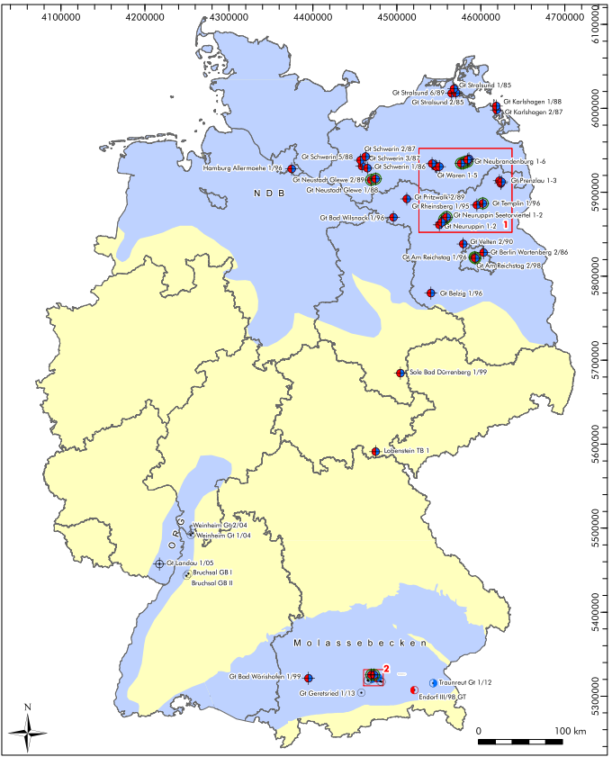
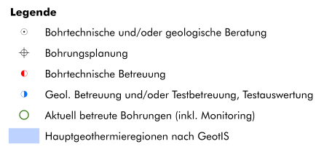
Geothermal wells in Germany
Geothermal wells with GTN participation

Slide 6
Contents
  Exploration of the site
  Drilling engineering and well completion
  Geothermal heating plant
  Monitoring of plant operation
  Current activities in Serbia
  Summary

Slide 7
Exploration of the Neustadt-Glewe site
  Analysis of the existing stock of data
  (wells, tests, cores, seismics)
  Geophysical exploration
  Exploratory well / test
Determination of the reservoir parameters

Slide 8
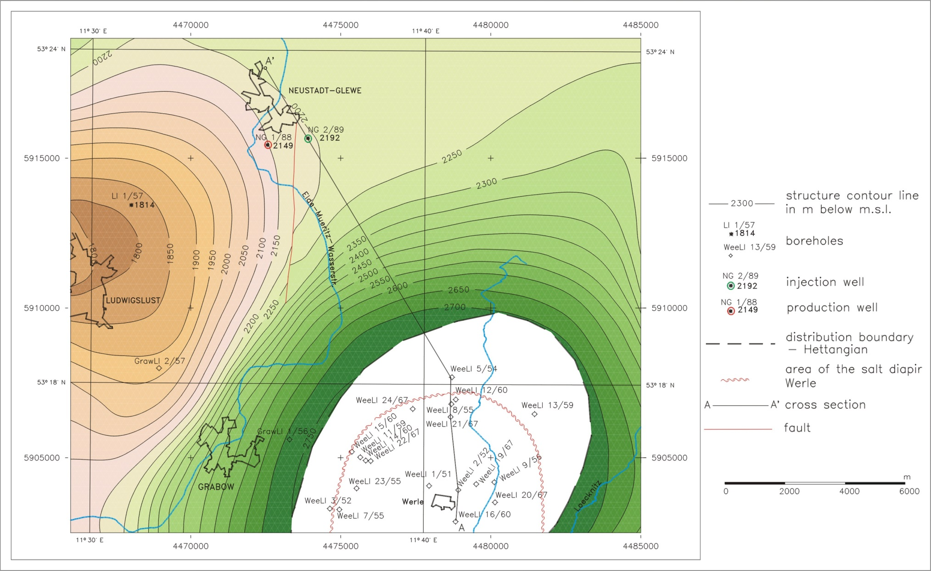
Exploration of the Neustadt-Glewe site
Structural map of the top reservoir:
Base – seismics and existing wells

Slide 9
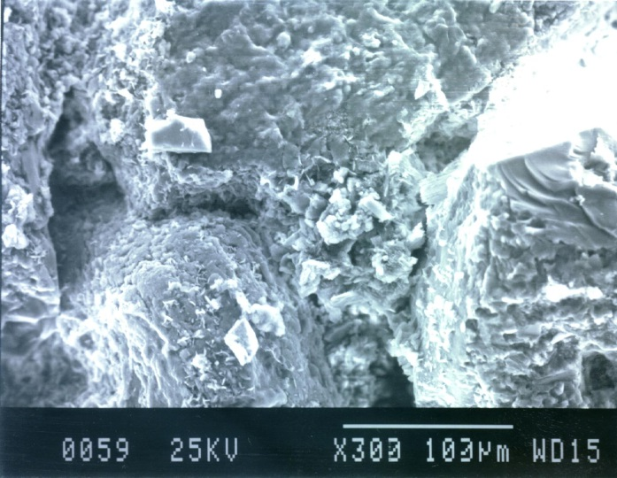
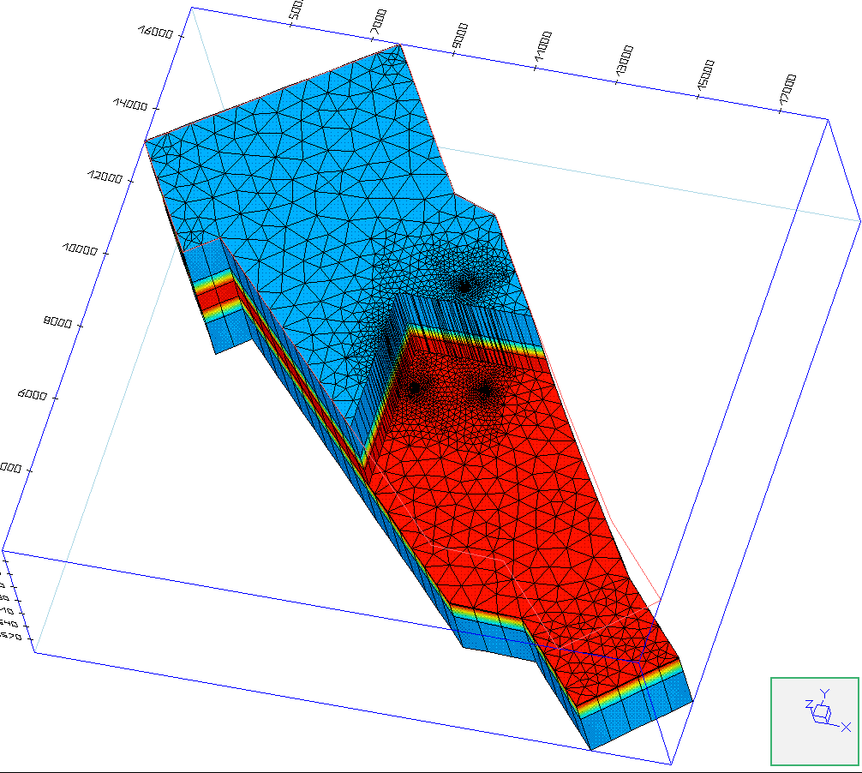
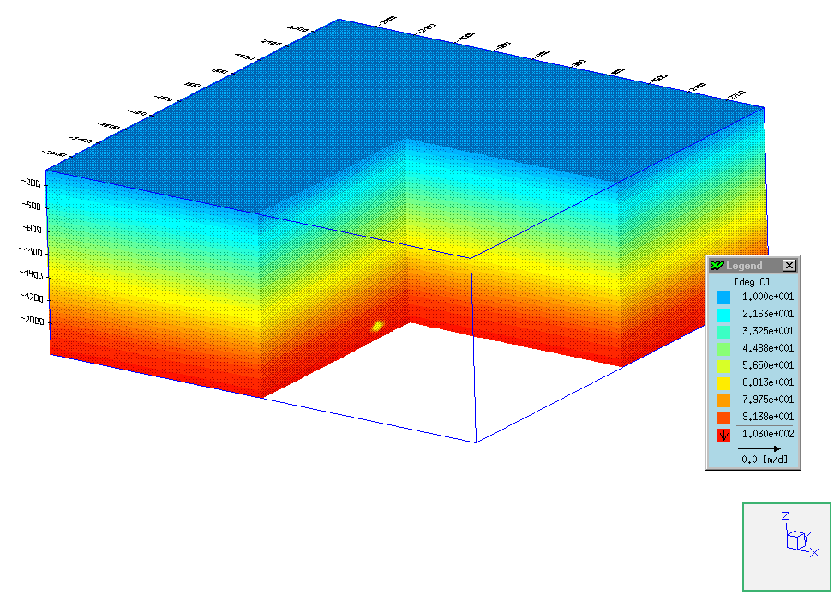
Exploration of the Neustadt-Glewe site
Reservoir characteristics Temperature level
  microscopic macroscopic
  Productivity & Injectivity Heat content
  (Production/reinjection flow rate
  referred to required pumping pressure)
110 m³/h
99°C ➔ 63°C

Slide 10
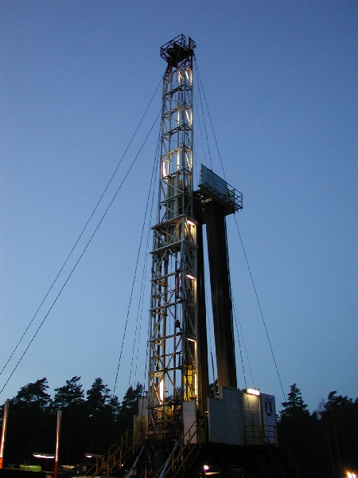
Exploration of the Neustadt-Glewe site
Reservoir development by
drilling –
rotary drilling rig

Slide 11
Drilling and completion
Secondary loop
Production well
GHZ
Injection well
Classical doublet
(vertical)
Minimum distance in the aquifer
Internal distance of the wells: about 1,000 m

Slide 12
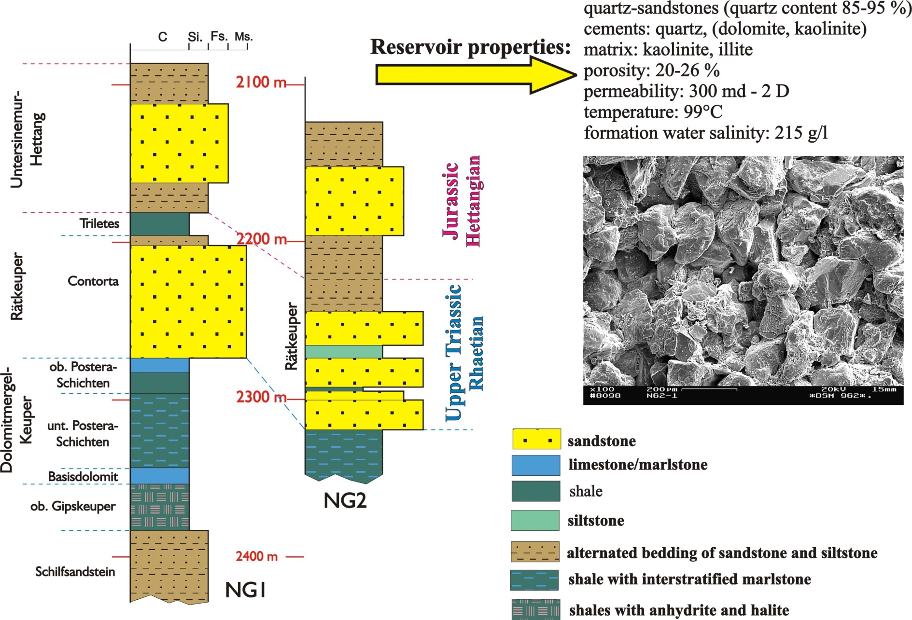
Exploration of the Neustadt-Glewe site
Well logs, core investigations, formation tests

Slide 13
Drilling and completion
Underreaming and screen completion – injection well

Slide 14
Exploration of the Neustadt-Glewe site
Chemical properties of the thermal brine at the Neustadt-Glewe site

Slide 15
Exploration of the Neustadt-Glewe site
stratigraphy Keuper/Rhaetian (Contorta)
depth 2,217 m – 2,274 m
temperature gradient 4.06 K/100 m
effective porosity 22 %
permeability 0.5 - 0.8 x 10¹² m²
aquifer temperature 98 °C
mineralisation 220 g/l
productivity 183 m³ / (h . MPa)
injectivity 265 m³ / (h . MPa)
Reservoir characteristics and well parameters

Slide 16
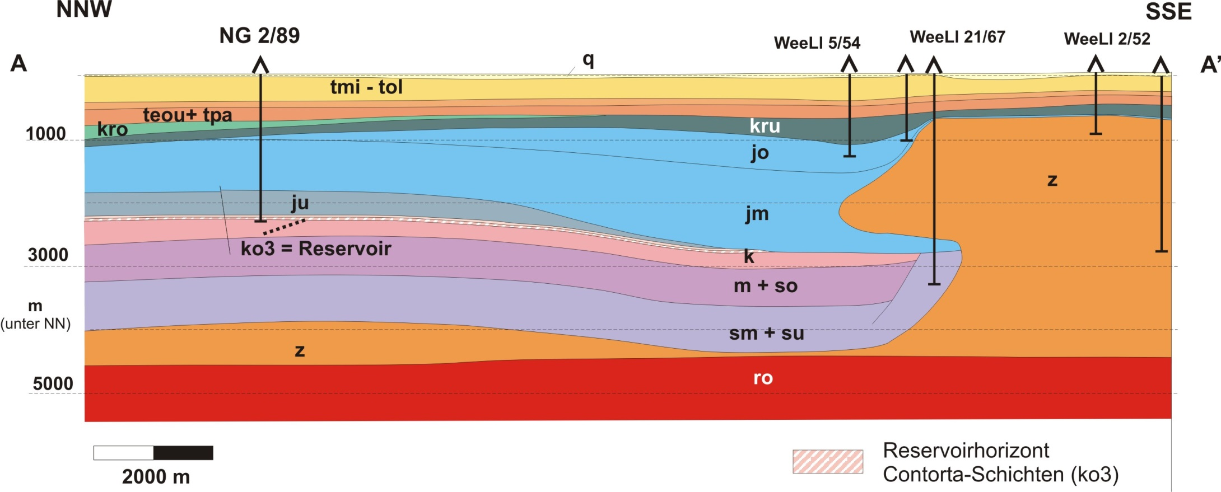
Exploration of the Neustadt-Glewe site
Geological cross-section through the explored region

Slide 17
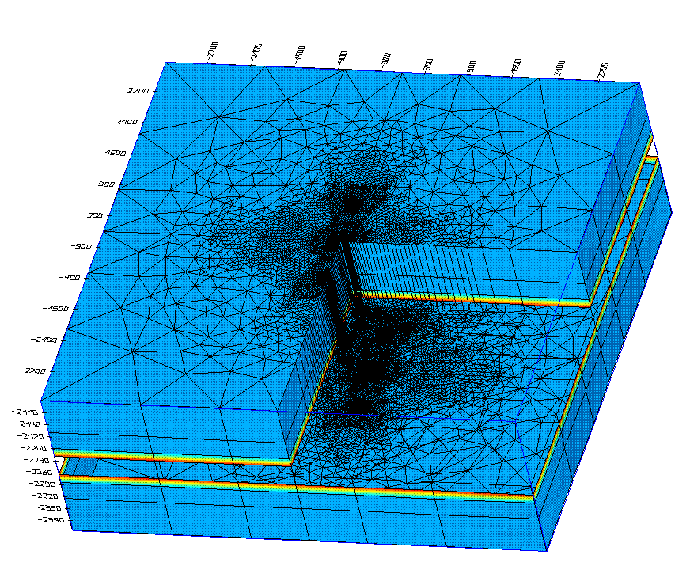
Exploration of the Neustadt-Glewe site
3-dimensional model area with 7 layers;
axes in m;
total height 325 m, transparent centre of the aquifer layer

Slide 18
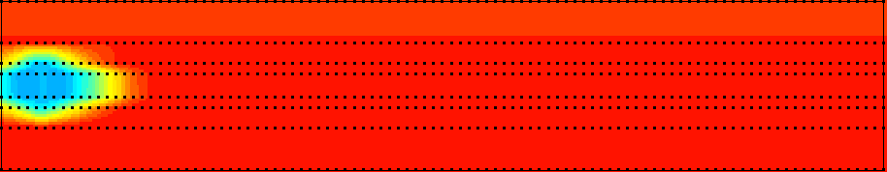
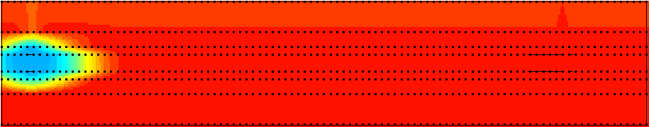
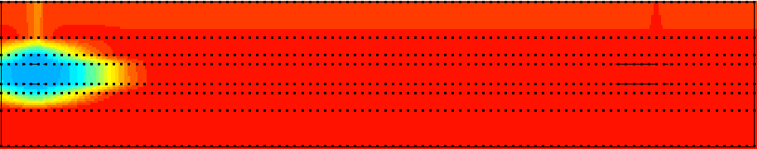
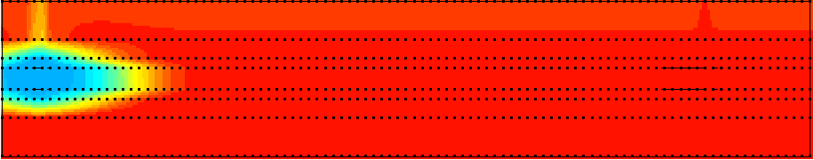
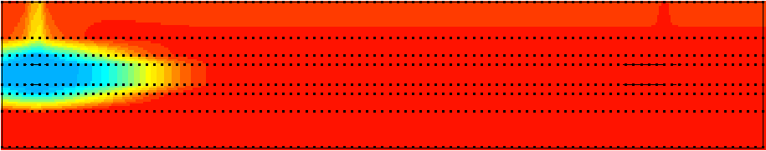
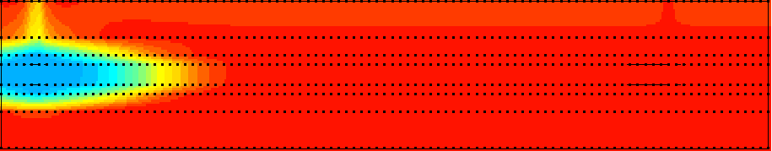
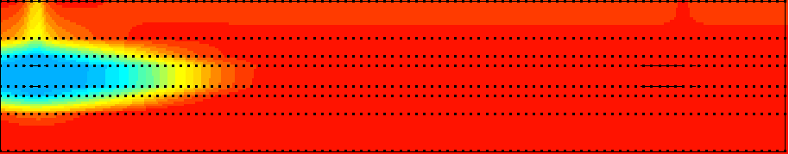
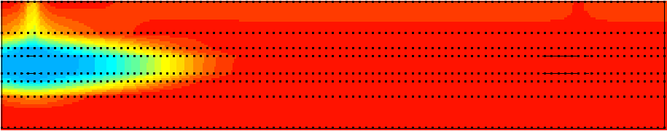
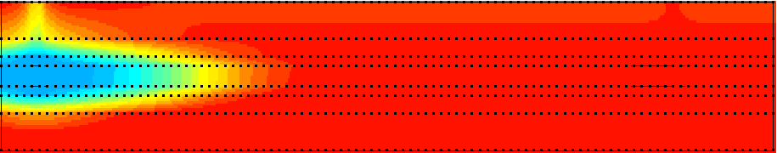
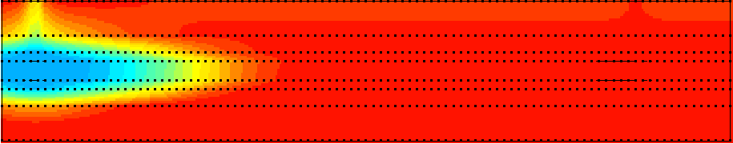
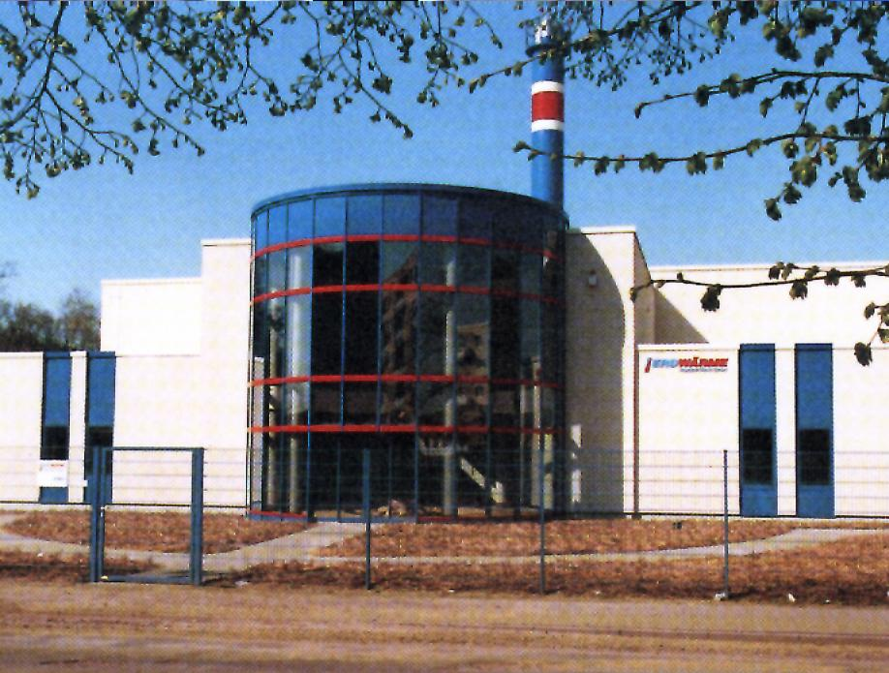
Exploration of the Neustadt-Glewe site
Geohydro- and -thermodynamic modeling
110 m³/h
99°C ➔ 63°C
production
injection
after 30 years of power
generation
Mai 2002
20 Jahre
10 Jahre
1 year

Slide 19
Designing geothermal plants
Energy engineering
Demand
Distribution
networks
General political,
economic, and
legal framework
Concept - Exploratory well - Design
Offer
Geological conditions

Slide 20
Neustadt-Glewe Geothermal Heating Plant
rated heating capacity 10 MW
heat supply 15,600 MWh/a
thereof geothermal > 95 %
heating network temperatures 90 °C / 70 °C
Heating network parameters

Slide 21
Neustadt-Glewe Geothermal Heating Plant
Foundation of the project company
Erdwärme Neustadt - Glewe GmbH
for implementation of the overall project with the shareholders:
Municipality of Neustadt-Glewe 47 %
WEMAG (energy supplier) 45 %
Geothermie Neubrandenburg GmbH 8 %
Project company

Slide 22
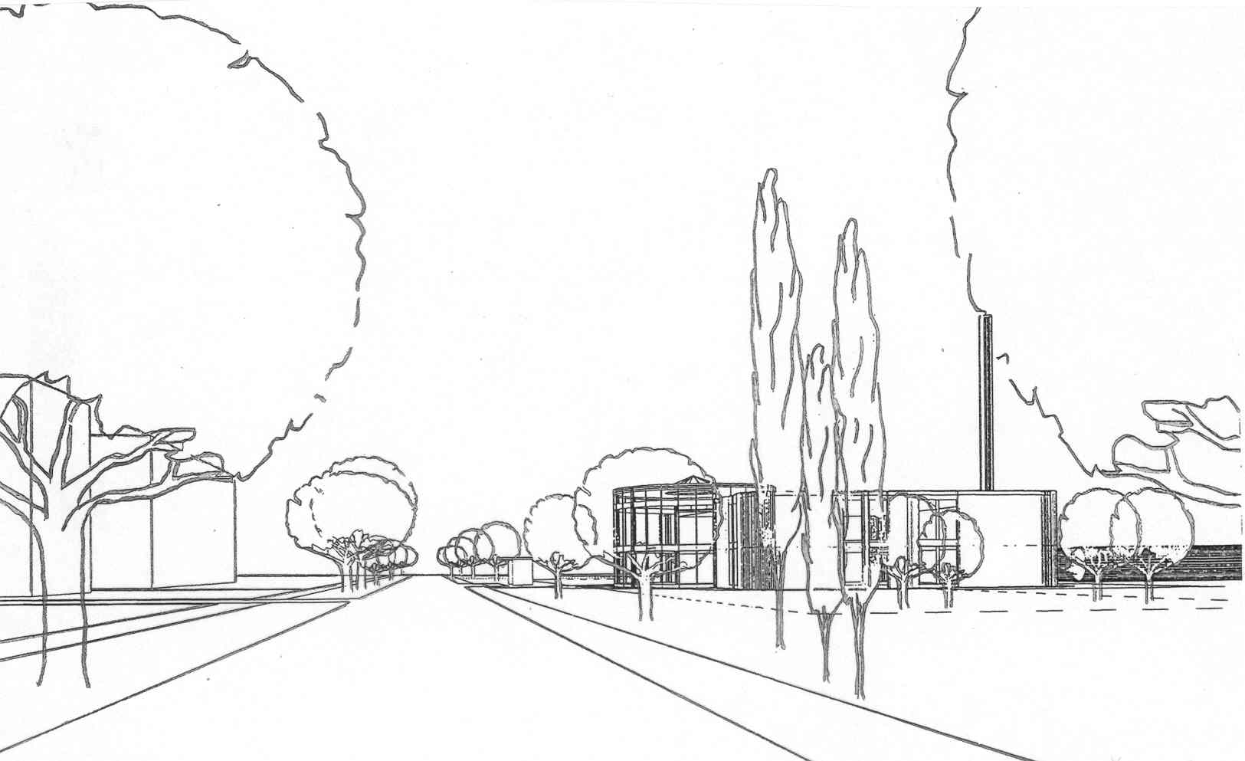
Neustadt-Glewe Geothermal Heating Plant
Design

Slide 23
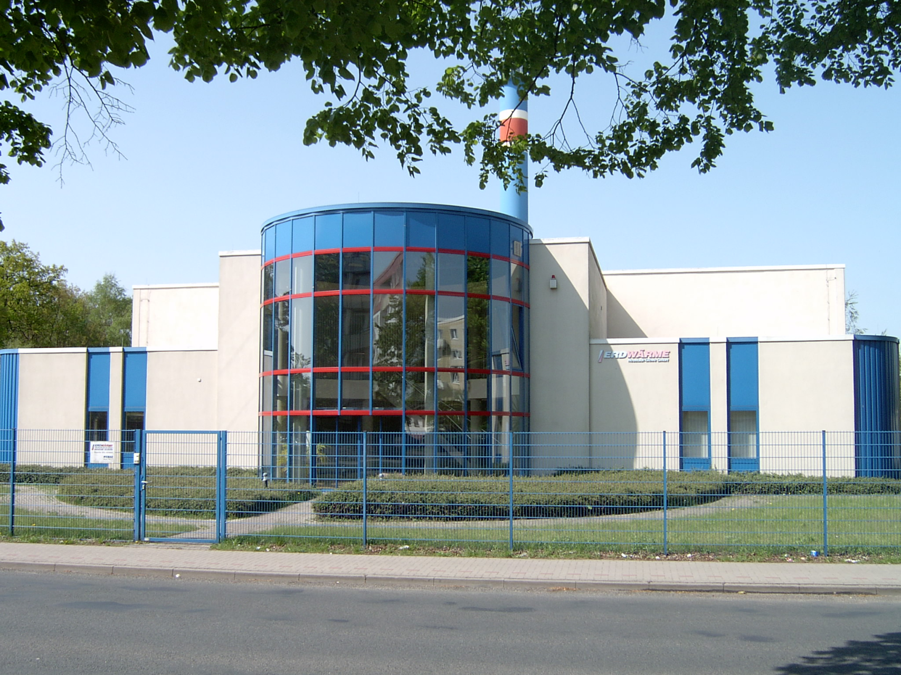
Neustadt-Glewe Geothermal Heating Plant
Main building

Slide 24
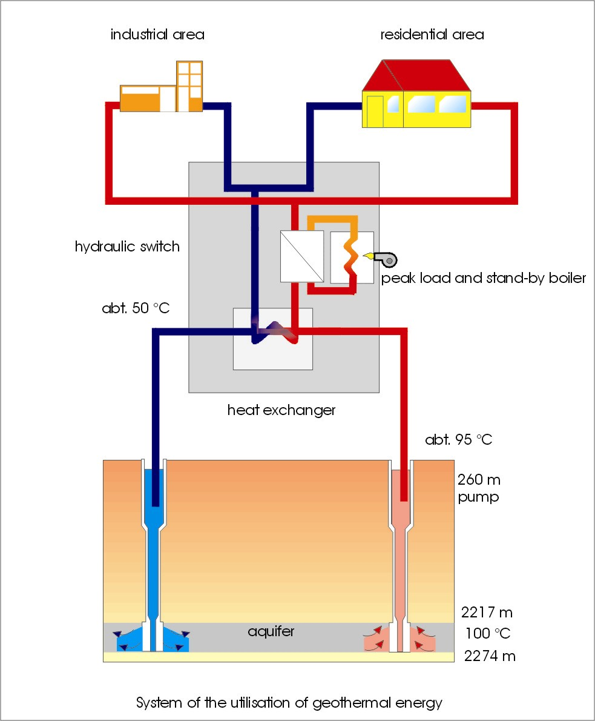
Neustadt-Glewe Geothermal Heating Plant

Slide 25

Neustadt-Glewe Geothermal Heating Plant
Pressure maintenance
Heat exchanger for direct
heat transition and heat
pump source
Coarse filter
Fine filter
Slop tank
Production welll
Geothermal Heating Plant
Injection welll
Principle scheme of the surface installation

Slide 26
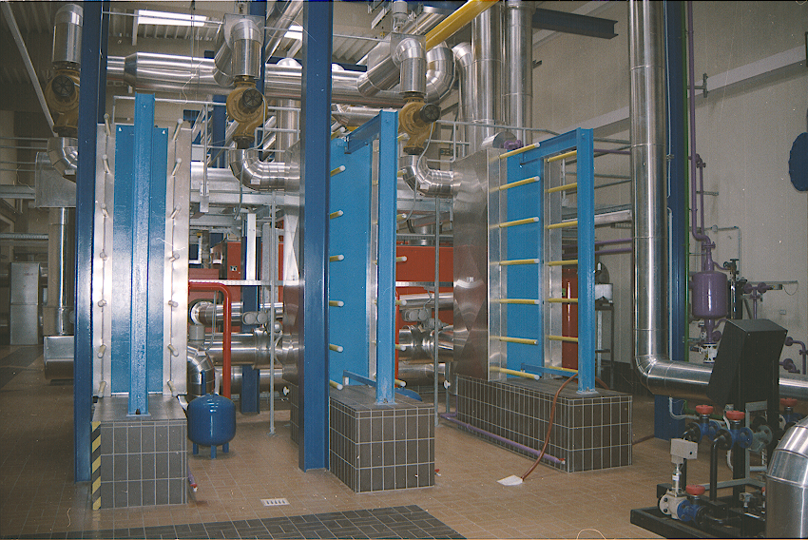
Neustadt-Glewe Geothermal Heating Plant
Heat exchanger

Slide 27
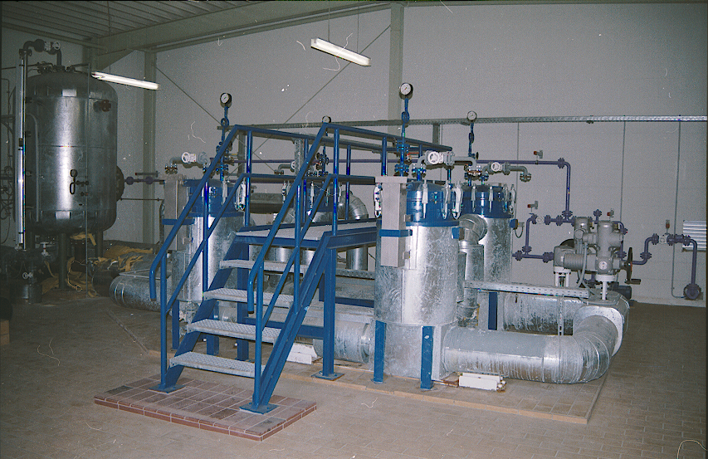
Neustadt-Glewe Geothermal Heating Plant
Filter house 2

Slide 28
Neustadt-Glewe Geothermal Heating Plant
Percentage of the individual primary energy sources relative to the total production of heat

Slide 29
Neustadt-Glewe Geothermal Heating Plant
Reduction of emission

Slide 30
Monitoring of plant operation
Interactions

Slide 31
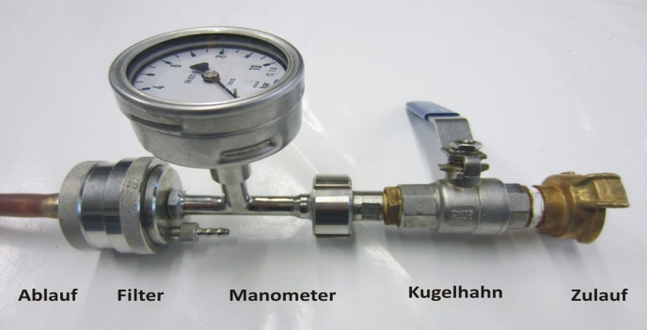
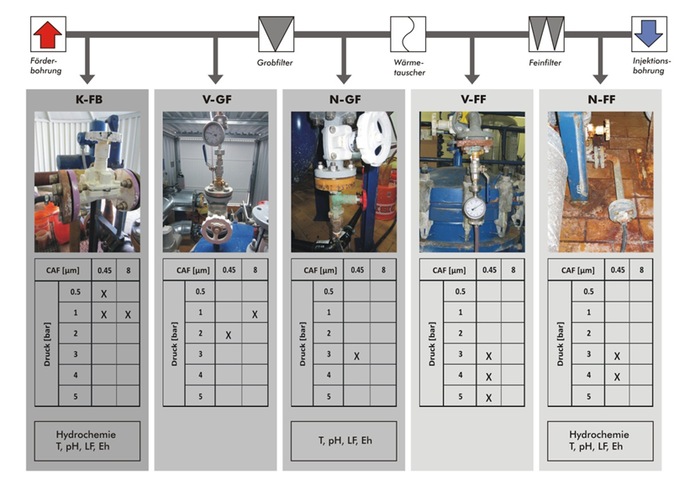
Monitoring of plant operation
Control of the particle load in the thermal water
Concentration of the solids
Kind of solids
Size and form of the solids
Control of the water chemistry
Sensors
Electrical conductivity
pH
Redox potential
Control of the injection pressure
Filter unit for control of the particle load
Sampling points in the Neustadt-Glewe geothermal plant
Monitoring program

Slide 32
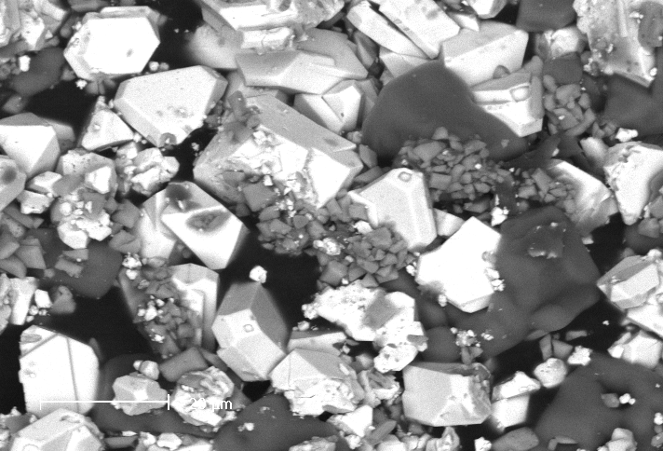
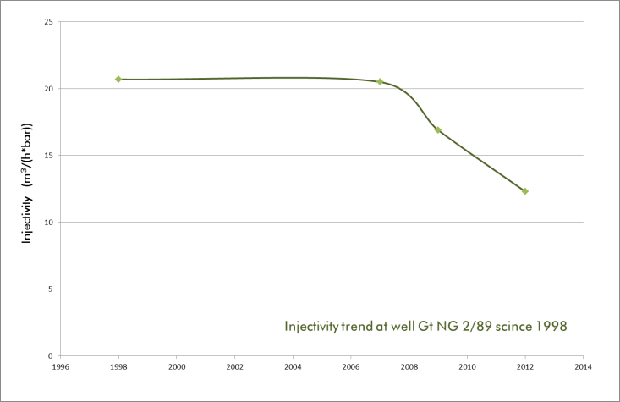
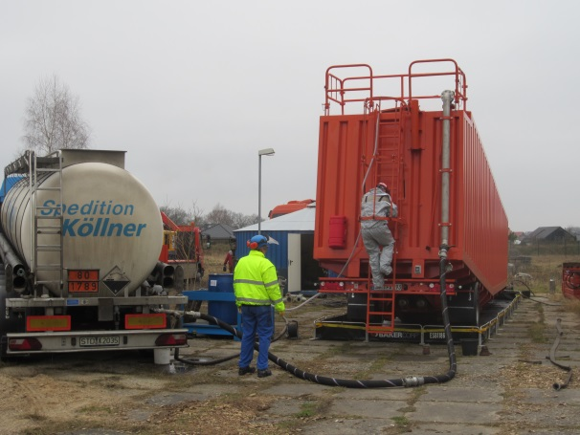
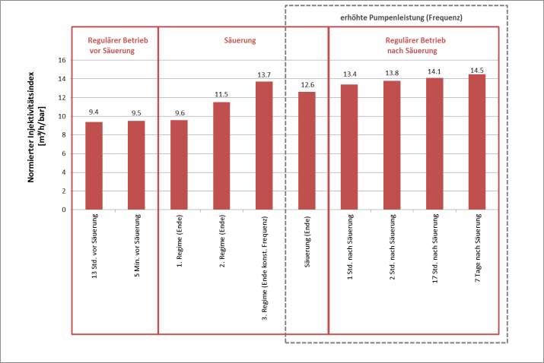
Monitoring of plant operation
Mineral precipitation due to cooling/pressure degrease
Degreasing injectivity due to
filter screen clogging
Injectivity
m³/(h*bar)
14.5 - after
9.4 - before
Soft acidzing
Significant injectivity rise
Filter screen clogging - Soft Acidizing
Notes:
Filter screen clogging due to precipitation of carbonates (dolomite, calcite, aragonite) and metal compounds (iron hydroxides or oxides, galenite) can be successfully removed by applying soft acidizing.

Slide 33
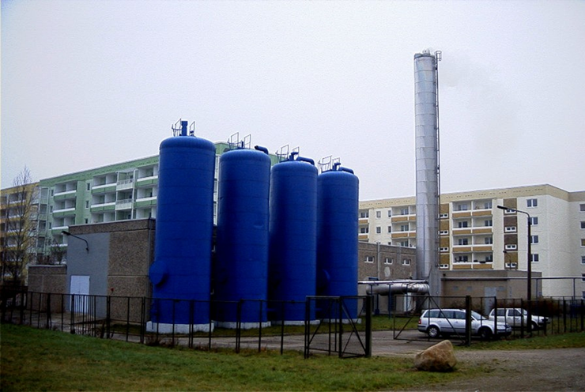
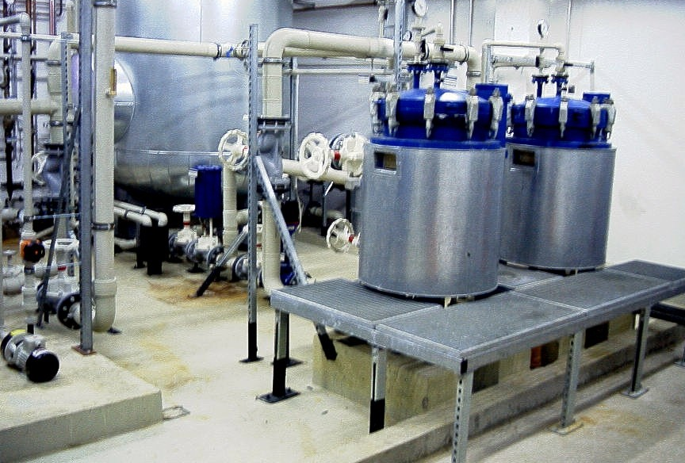
Waren Geothermal Heating Plant
Injection well: in operation since1986!
Geological formation Hettangian
Depth: 1,470 m
Production temperature : 61 °C
Injection temperature: 20 to 40°C
Mineralisation: 158 g/l
Porosity: 25 %
Permeability: 0.6 µm²
Injection flowrates: up to 60 m³/h
Reservoir characteristics and well parameters

Slide 34

Current activities in Serbia
Cooperative Project:
Serbia – Identification of pilot sites for the application of modern geothermal exploration techniques incl. financial and economic considerations
Identification of pilot sites for geothermal energy use
Evaluation of the geothermal reservoirs and elaboration of a prospection strategy
Elaboration of a synopsis including
  statements on the geological conditions,
  the plant concept,
  economic considerations as the basis of decisions on investment
Public relations and transfer of know-how
Funding by &

Slide 35
Current activities in Serbia
Project Partners
UNIVERSITY OF BELGRADE - Faculty of Mining and Geology
Center for renewable hydro sources of energy
Prof. Dr Dejan Milenic
MANNVIT kft.
Dr Laszlo Adams
NIS GAZPROM NEFT - Block Energy
Dept. for renewable energy sources
Bojan Nikolic
TOPLANA Bečej & Municipality of Bečej
Dejan Vuković
TOPLANA Priboj & Municipality of Priboj
Saša Vasilić
Municipality of Raška
Ignjat Rakitić

Slide 36
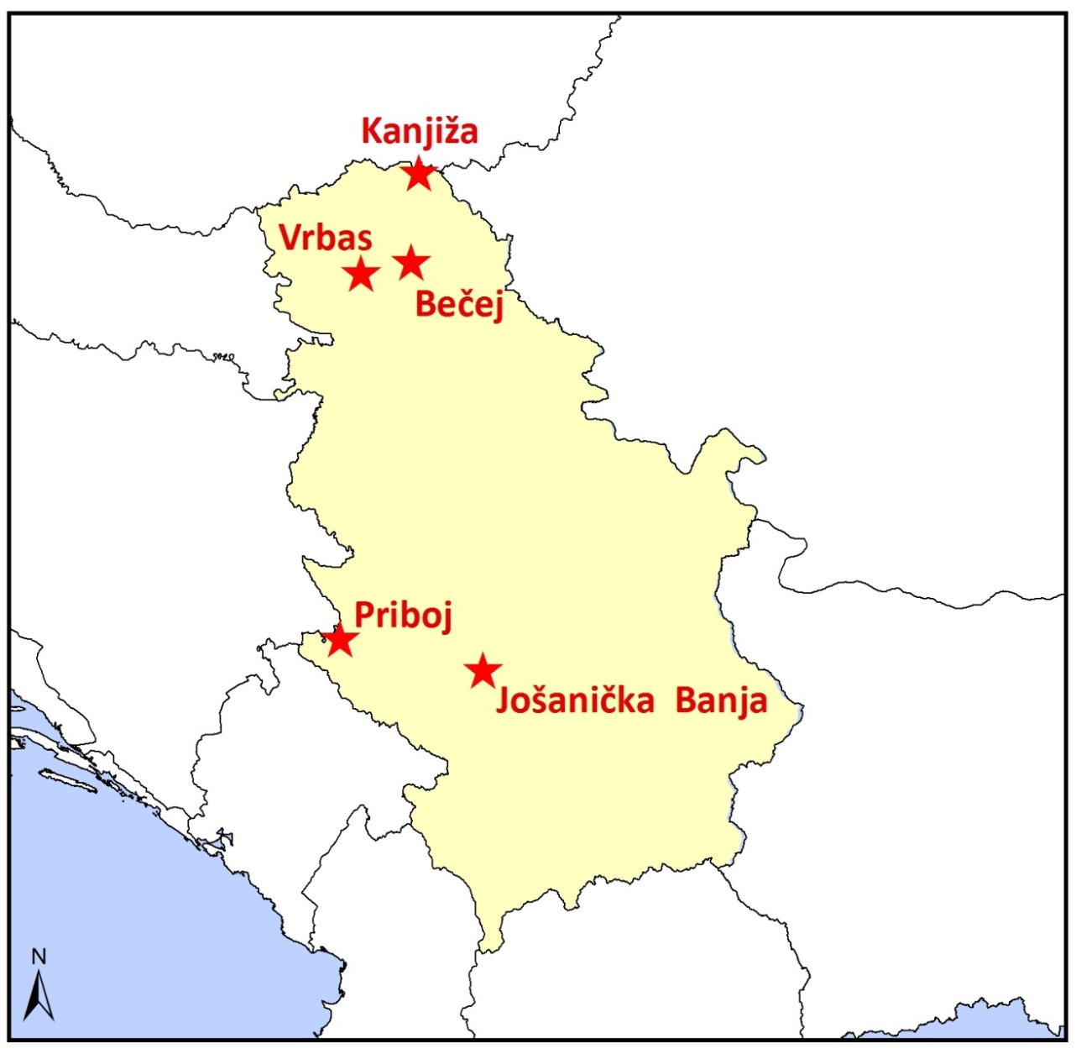
Current activities in Serbia
Investigated pilot sites

Slide 37
Current Activities in Serbia
Parameter - Property | Vrbas | Kanjiža | Bečej | Waren | Neustadt-Glewe
Depth of reservoir | 750 … 1000 | 900 … 1150 | 750 … 1100 | 1500 … 1570 | 2220 … 2275
(m below ground)
Lithology | Fine sand | Fine sand | (Fine)sand | Medium – fine sandstone | Medium – fine sandstone
Effective thickness (m) | 60…120…180 | 70…80…90 | 70…100…120 | 25 … 29 | 48 … 54
Porosity (%) | 20…25…30 | 20…35…40 | 25…30…35 | 25 … 28 ... 31 | 20 … 21 … 22
Productivity (m³/(h*MPa)) | 50…250…450 | 160…180…200 | 250…300…350 | 250 | 180
Reservoir temperature (°C) | 50…55…60 | 65…72…80 | 55…65…70 | 64 | 98
TDS (g/l) | 3.6…3.8…4.0 | 2.0…3.5…4.0 | 4.0…5.0…6.0 | 158 | 220
Reservoirparameters

Slide 38
Parameter - Property | Vrbas | Kanjiža | Bečej | Waren | Neustadt-Glewe
Depth of reservoir | 750 … 1000 | 900 … 1150 | 750 … 1100 | 1500 … 1570 | 2220 … 2275
(m below ground)
Litholo | Fine sand | Fine sand | (Fine)sand | Medium – fine sandstone | Medium – fine sandstone
Effective thickness (m) | 60…120…180 | 70…80…90 | 70…100…120 | 25 … 29 | 48 … 54
Porosity (%) | 20…25…30 | 20…35…40 | 25…30…35 | 25 … 28 ... 31 | 20 … 21 … 22
Productivity (m³/(h*MPa)) | 50…250…450 | 160…180…200 | 250…300…350 | 250 | 180
Reservoir temperature (°C) | 50…55…60 | 65…72…80 | 55…65…70 | 64 | 98
TDS (g/l) | 3.6…3.8…4.0 | 2.0…3.5…4.0 | 4.0…5.0…6.0 | 158 | 220
Current Activities in Serbia
IRR
Comparison of economic parameters

Slide 39
Summary
The geological and economical parameters of the sites investigated by us in the Vojvodina are similar to those of the North German Basin.
The for decades successful operation of geothermal systems in the North German Basin shows that this technology can be applied in a technically and economically sustainable way.
The experience gained from the operation of the geothermal systems in the North German Basin can be very helpful in the implementation of geothermal projects in Serbia.
.

Slide 40
Summary
The exact knowledge of the geological parameters is essential for the successful implementation of a project.
Planning requires close interlinking of technical and geological know-how (communication).
The solutions are site – specific.
Monitoring is a must for stable plant operation.

