Slide 1
Experiences of the Danube Region Geothermal Concept
Geothermal Energy Days
Novi Sad, 22 May 2015
Szilárd Árvay
Ministry of Foreign Affairs and Trade of Hungary

Slide 2
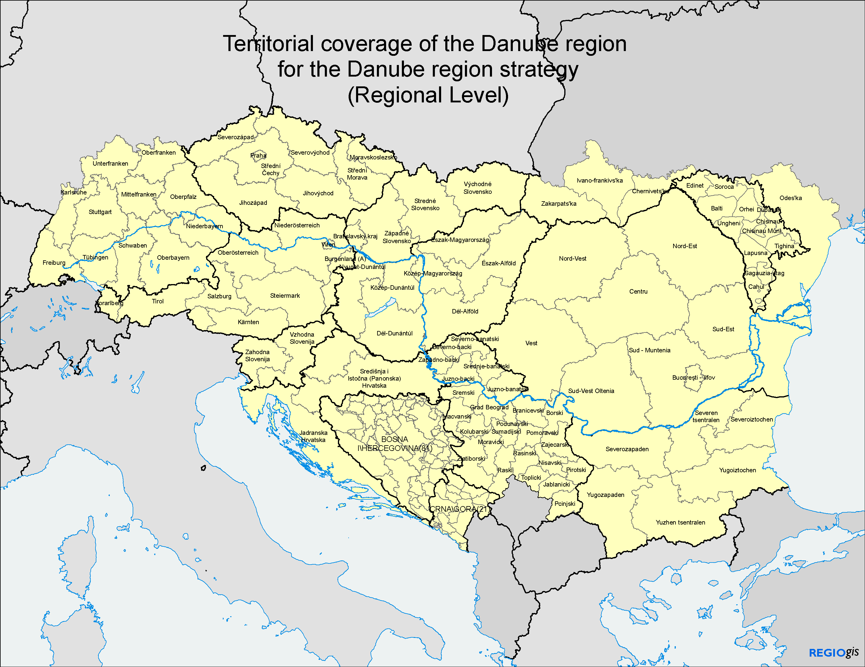
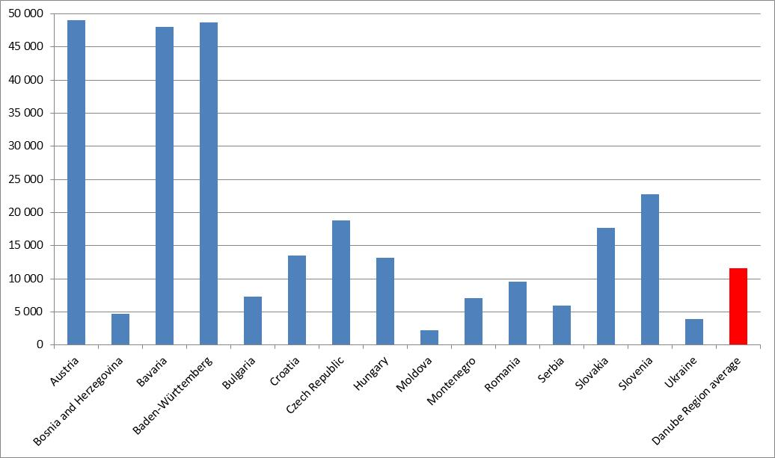
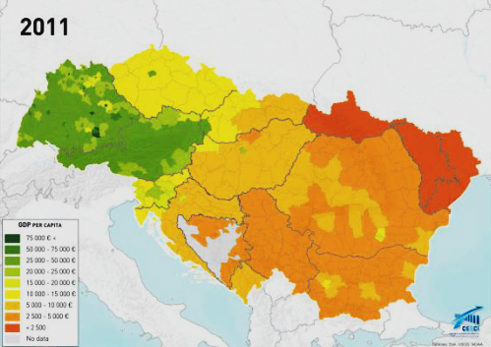
Danube Region – A heterogeneous macroregion
Key features:
9 EU + 5 non-EU countries;
More than 100 million inhabitants;
One-fifth of EU total area;
Significant regional disparities;
GDP per capita in the Danube Region (2013, USD)
GDP/capita
Source: World Bank

Slide 3
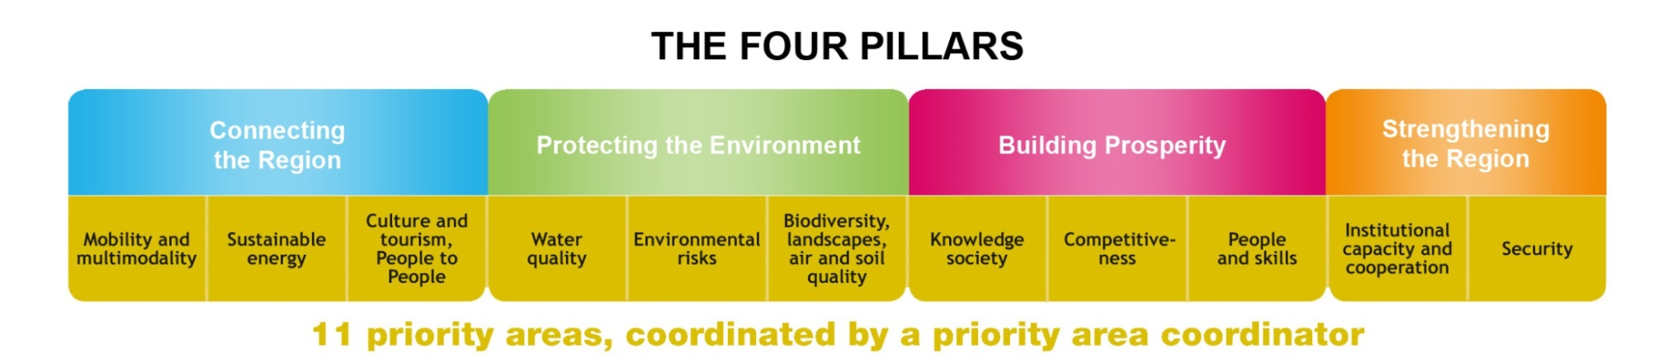
The energy priority area is coordinated by CZ and HU
The EU Strategy for the Danube Region (EUSDR) is a macro-regional strategy of the European Union, endorsed by the European Council in June 2011.
Driving force ⇨ the one-size-fits-all approach is not working in an EU of 27 Member States (Croatia joined on 1 July 2013) and 271 regions.
The Strategy was jointly developed by the European Commission, the Danube Region countries and stakeholders in order to jointly address common challenges.
The Strategy seeks to create synergies and coordination between existing policies and initiatives taking place across the Danube Region.
The strategy tackles these various topics in a structured way through 4 pillars and 11 priority areas.
Priority Area 2 – Sustainable Energy (PA2) is jointly coordinated by Hungary (Ministry of Foreign Affairs and Trade) and the Czech Republic (Office of the Government);
The decision making bodies are the Steering Groups, consisting of representatives of the Danube Region countries appointed from the line ministries.
11 priority areas, each coordinated by two priority area coordinators

Slide 4
All countries are actively involved in the Strategy
Priority Area | Countries in charge of coordination
P1 | Mobility and intermodality | Inland waterways: Austria, Romania Rail, road and air: Slovenia, Serbia
P2 | More sustainable energy | Hungary, Czech Republic
P3 | Culture and tourism, people to people | Bulgaria, Romania
P4 | Water Quality | Hungary, Slovakia
P5 | Environmental risks | Hungary, Romania
P6 | Biodiversity, landscapes, quality of air and soils | Germany (Bavaria), Croatia
P7 | Knowledge society (research, education and ICT) | Slovakia, Serbia
P8 | Competitiveness of enterprises | Germany (Baden-Württemberg), Croatia
P9 | People and skills | Austria, Moldova
P10 | Institutional capacity and cooperation | Austria (Vienna), Slovenia
P11 | Security and organized crime | Germany, Bulgaria

Slide 5
From policy coordination to fundable projects
EUSDR PA2 applied the following working method:
  After completing initiatives that had significant policy impact on the final list of the Projects of Common Interest (PCIs), namely the Danube Region Gas Market Model and the Gas Storage Analysis in 2012, the emphasis was put on renewables and electricity in 2013.
  The same approach was applied that was already successfully used for the gas market by initiating a joint thinking of the countries with the help of regional studies to summarize and present the current status and suggest further steps to promote the development of these renewable energy sources.
  Taking into account the limited financial resources, we prioritized and focused on those renewable sources of energy first, which still offer significant untapped potential for the Region, i.e. biomass and geothermal energy. The integration of renewables to the existing electric power grid was also analysed by initiating a discussion on the ‘smarting‘ of power grids. The “Renewable Electricity Market Monitoring Report in the countries of the Danube Region” provided an up-to-date evaluation of the RES-E development.
  In 2014 we turned to project development with our geothermal (DanReGeotherm) and biomass (REPLAN & DANUBIOM) project concepts and consortia being in place, but also continued policy coordination.
These initiatives were aimed to result in more investment, more competitiveness and more jobs in the whole Danube Region in the middle term.

Slide 6
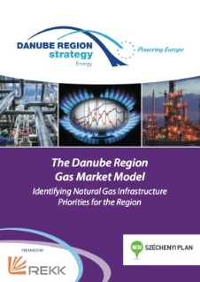
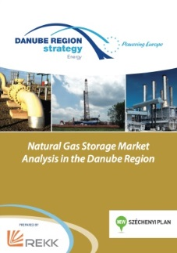

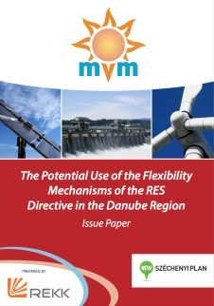
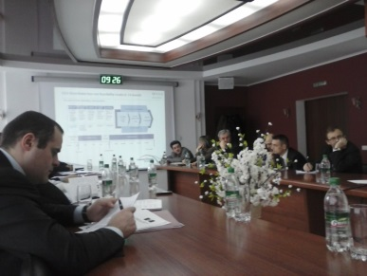
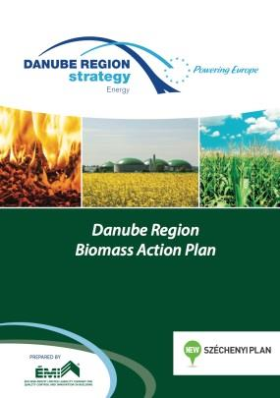
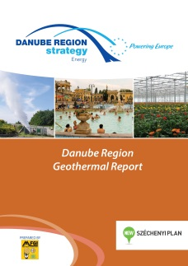
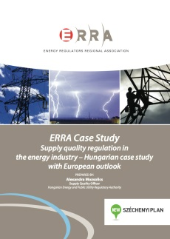
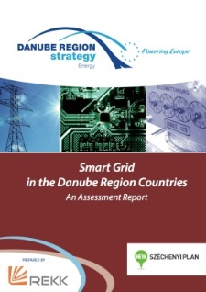
Promoting cooperation through common goals
Threefold approach of PA2:
  Coordinating regional energy policies
    DR Gas Market Model – Oct 2012;
    DR Gas Storage Market Analysis – March 2013;
    Renewable Electricity Market Monitoring in the Countries of the DR – Nov 2013;
    The Potential Use of the Flexibility Mechanisms of the RES Directive in the DR – Feb 2014;
    DR Biomass Action Plan (DRBAP) –Feb 2014;
    DR Geothermal Report – June 2014;
  Enhancing the energy market integration of non-EU countries
    Training Program of the PA2 in the Republic of Moldova – February-July 2013;
    ERRA Case Study - Supply quality regulation in the energy industry – Hungarian case study with European outlook (ENG+RUS) – Feb 2014.
  Facilitating cutting edge technology developments
    DR Smart Grid Concept – Jan 2014.

Slide 7
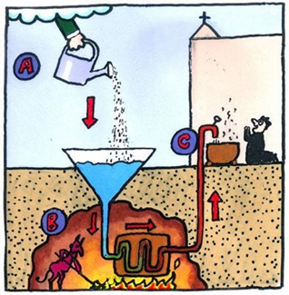
Danube Region Geothermal Concept (DanReGeotherm)

Slide 8
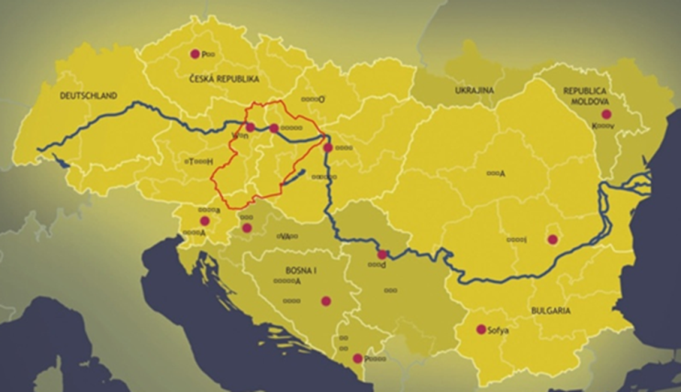


Implementation of the geothermal concept has started
Major milestones
  PA2 Steering Group (SG) meeting approved the implementation of the geothermal concept based on the TRANSENERGY project (2010-13) results. The aim of TRANSENERGY was to create a common geothermal information system in four central European countries.
  Overview of the deep geothermal potential and utilization of the Danube Region countries - result: geothermal potential is high in many areas of the Region, however, in the majority of the countries the most common way of thermal water utilization is balneology, with direct-heat applications being subordinate and practically no power generation.
  Organization of a workshop (November 2013), with 19 interested institutions/organisations from 10 DR countries. Most participants committed themselves to continue with the project as part of the project consortium.
Territorial coverage of TRANSENERGY project
DanReGeotherm

Slide 9
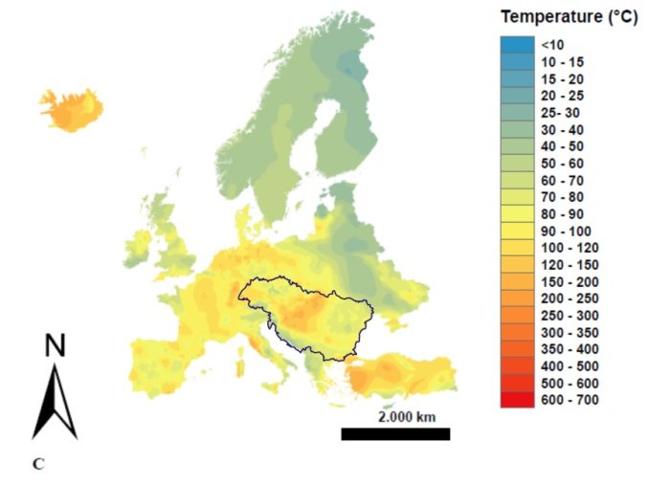
Aim is to promote sustainable use of deep geothermal
Details of the DanReGeotherm concept
  Two basic conditions for successful geothermal projects, both addressed by this project:
    available geothermal resources (supply side) and their in-depth geoscientific knowledge on both local and regional scale;
    investment-friendly political and economical environment
  The type and details of requested information are quite different:
    project developer needs site-specific, mostly technical information at a local (reservoir) scale
    policy makers, licensing authorities require a more general and regional overview on the geothermal resources and the limits for sustainable use
  In general the knowledge and availability of technical and non-technical data related to geothermal energy is fairly poor and fragmented in the countries of the Danube Region.
  The specific goal of the project is to provide harmonized, publicly available information on the use and potential of deep geothermal energy. This information will be utilized mainly at regional, national and international level.
Temperature at a depth of 2 km in Europe
Project content:
  Overview and assessment of current thermal water utilization
  Cross-border hydrogeothermal models
  Transnational data management through metadata queries
  Analysis of non-technical barriers

Slide 10
Project structure
WP2 – Overview and assessment of current thermal water utilization
WP3 – Transnational data management
WP4 – Pilot actions
WP4A – Transboundary
WP4B – Risk mitigation
WP6. – Communication & dissemination
WP4C – Local development plans
WP5 – Non -technical barriers
WP1 – MANAGEMENT

Slide 11
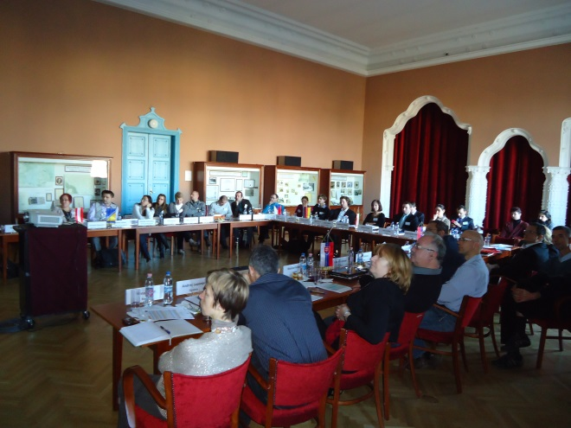
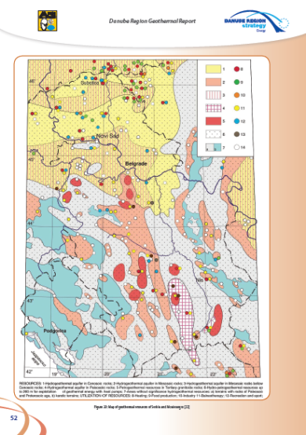
Geothermal Report & DanReGeotherm Project Consortium
Project workshop organised on November 2013 to finalise the project concept and establish the project consortium;
The main output of the macro-regional project will be a uniform and transparent pool of geothermal database for the entire Danube Region which will contain all necessary geological and geothermal data, as well as information on the regulatory, economic, social and environmental aspects of geothermal utilization in the DRS countries;
The project received EUR 25.000 consultancy support from PA10 Technical Assistance Facility in November 2013 to finalise the project concept;
The Danube Region Geothermal Report was published in June 2014 by compiling inputs of workshop participants;
The project concept was also discussed in the PA2 panel at the Danube Region Strategy Annual Forum on June 2014 in Vienna;
The project was voted 1st out of 45 submitted projects of the START call by the Steering Group in November 2014, therefore preparatory work with EUR 44.000 budget has started in 6 countries (CZ, BA, HR, HU, RO, RS) in April 2015;
Serbian partner: University of Belgrade, Faculty of Mining and Geology - Department of Hydrogeology
The DanReGEotherm project will be submitted to the Danube Transnational Programme in September 2015

Slide 12

Danube Transnational Programme

Slide 13
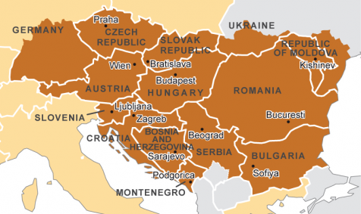
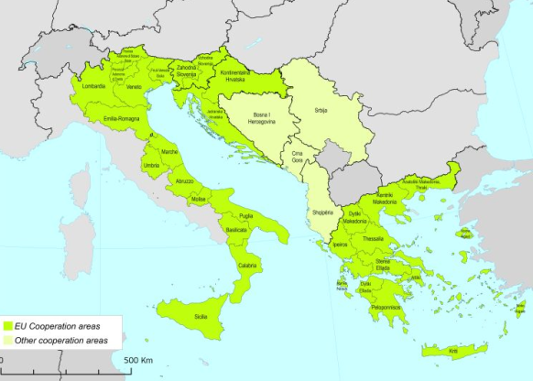
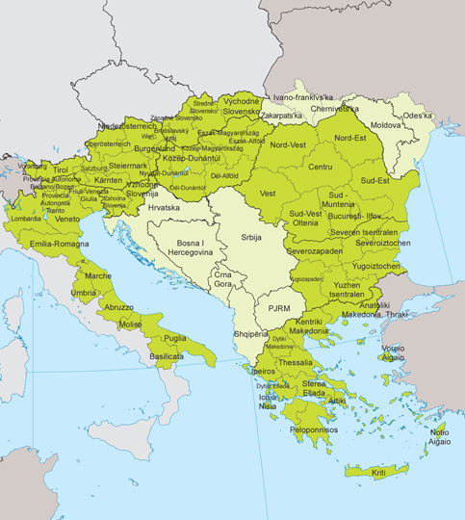
Transnational Programmes in the Danube area 2014-2020
2014-2020: ETC II.
2007-2013: ETC I.
SOUTH-EAST EUROPE
DANUBE
Adriatic Ionian
Albania; Bosnia and Herzegovina; Croatia; Cyprus; Fyrom; Greece; Italy; Malta; Montenegro; Serbia; Slovenia; Austria (not whole territory)
Balkan-Mediterranean
Albania, Bulgaria, Cyprus, The former Yugoslav Republic of Macedonia and Greece
13

Slide 14
Transnational cooperation - basic characteristics
PROGRAMME
PROJECT
Number
13 overlapping programme areas; 6-15 countries per programme
10-15 project partners and observers
Roughly 100 project per program (SEE)
Monitoring Committee (representatives of the partner states) is the main decision-making body of the programme
„Lead partner” principle: one partner takes legal responsibility for the partnership. Partners certify their costs at national level and report together to the programme
Structure
Finances
100-300 million euro programme budget for 7 year programme periods; 94 % spent on projects, 6 % on programme implementation
1-5 million euro project budget
spent in 2-3 year long cooperation projects
Topics/
type
Programme priorities defined by partner states based on EU directives and needs of the programme area
„Soft” projects: joint development of ideas, concepts, plans, solutions, preparation of future investments – no direct infrastructure development
14

Slide 15
The final DANUBE Transnational Programme document
Programme strategy
The strategic vision is “policy integration” below the EU-level (not duplicating efforts in policy integration at the EU-level e.g. TEN-T) and above the national level in specific fields of action. Transnational projects should influence national, regional and local policies.
Policy framework
In order to achieve a higher degree of territorial integration of the Danube region the DTP will act as a policy driver and pioneer to tackle common challenges and needs in specific policy fields where transnational cooperation is expected to deliver good results through the development and practical implementation of policy frameworks, tools and services and concrete pilot investments whereby strong complementarities with the broader EUSDR will be sought.
15

Slide 16
The final DANUBE Transnational Programme document
Types of actions supported by the programme
Development of common orientations, frameworks and strategies in fields of transnational relevance where early policy development is needed (i.e. in fields which until now have not been touched by significant projects in the previous programming periods);
Development and practical implementation of transnational tools and services (e.g. analytical tools, management tools, technical tools, software tools, monitoring tools);
Preparation of transnational investments (infrastructure, equipment) to be subsequently financed through other sources;
Pilot activities including small-scale fixed investments (of testing or demonstration nature);
Development and practical implementation of training and capacity building (e.g. training seminars and courses, study visits, peer reviews);
Accompanying information, dissemination, capitalisation and publicity measures to inform stakeholders and/or the general public about project activities and outcomes.
16

Slide 17
Priority axes and specific objectives
17

Slide 18
3.2 - Improve energy security and energy efficiency
Specific objective:
Contribute to the energy security and energy efficiency of the region by supporting the development of joint regional storage and distribution solutions and strategies for increasing energy efficiency and renewable energy usage.
Examples of action
Contribute to the transnational integration of different energy networks and explore the development opportunities for a joint energy infrastructure in the Danube region.
Contribute to the development of Smart Grids in the Danube Region by supporting smart grid policy integration and joint action plans.
Contribute to regional energy planning and -coordination of transnational relevance across the Danube region within the wider context of EU energy policy in order to diversify energy sources and contribute to the security of energy supplies; improve policy learning and develop practical strategies and solutions to increase the use of renewable energy sources such as biomass, hydro-power, solar/photovoltaic energy, geothermal and wind energy.
Contribute to practical transnational coordination of developing energy efficiency concepts.
Promote joint efforts to comprehensive spatial planning in order to position adequately generation and transmission capacities;
Support human resource development and the exchange of related knowledge and experience accompanying policy and technology development.
18

Slide 19
Programme budget dedicated to different priority axes
Priority axis | Total funding (MEUR)
1. Innovative and socially responsible Danube region | 72,8
2. Environment and culture responsible Danube region | 83,2
3. Better connected and energy responsible Danube region | 54,7
4. Well governed Danube region | 33,8
5. Technical Assistance | 18,5
Total | 263
Maximum EU funding rate: 85%

Slide 20
Recent developments of the Danube Transnational Programme
First call of DTP is expected in September 2015;
40% of the total budget will be offered;
All priorities (1, 2, 3, 4) will be opened in the first call;
Extent of involvement of EUSDR and the Priority Areas is still under negotiation;
Two-step application procedure is planned;
Maximum duration of the projects is 30 months;
In the first phase 40 points total, 30 for strategic relevance, 10 for operational relevance;
Project with minimum 30 points automatically go to second phase, under 24 points rejection;
Projects with 24-30 points are considered based on the available remaining funds;
DTP kick-off conference: Budapest, 22-24 September 2015.

Slide 21
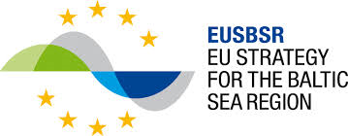

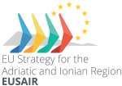
Macro-Regional Strategies of the EU

Slide 22
EU Strategy for the Adriatic and Ionian Region
Countries of the Strategy:
Albania
Bosnia and Herzegovina
Croatia
Greece
Italy
Serbia
Montenegro
Slovenia
  Launched in November 2014
  Thematic Steering Groups (TSG) per pillar are in charge of management and implementation of the Action Plan of the Strategy
  First meeting of TSG for pillar 2 was in Trieste in April 2015.
  Second meeting of TSG will be in July in Belgrade
The pillars:
Blue growth – coordinated by Greece and Montenegro
Connecting the region (transport and energy networks)- coordinated by Italy and Serbia
Environmental quality- coordinated by Slovenia and Bosnia and Hercegovina
Sustainable tourism- coordinated by Croatia and Albania

Slide 23
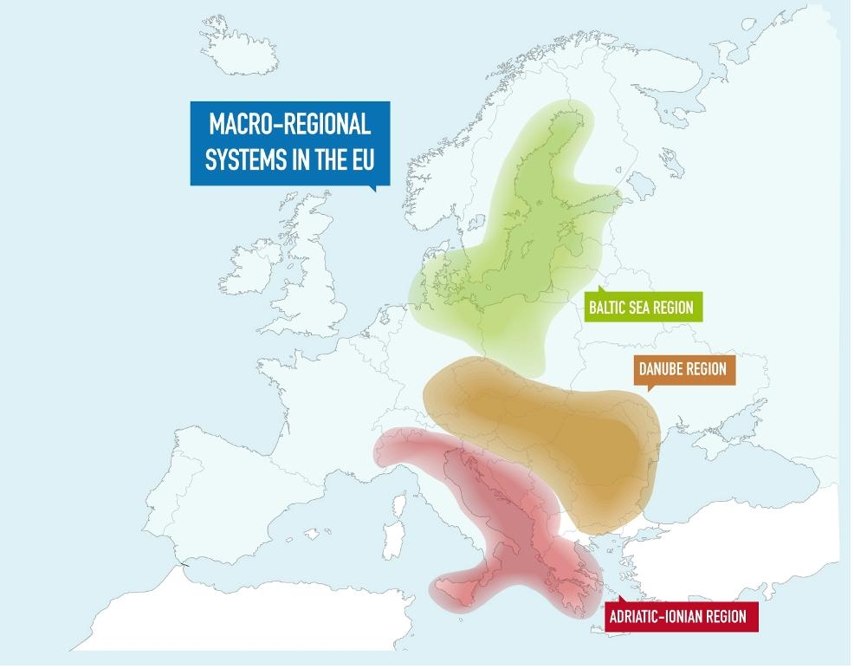
Contacts of EUSDR with other macroregional strategies
EUSBSR
  PA2 organised a seminar to 2 April 2014 in Stockholm: On the experiences of the implementation of the EU Baltic Sea and the Danube Region Strategies– Sharing best practices;
  Presentation by Ms Rota ŠŅUKA, Priority Area Coordinator, Priority Area Energy of the Baltic Sea Region Strategy, Ministry of Economics of the Republic of Latvia.
EUSAIR
  Communication started with the ’Connecting the Region’ Working Group of EUSAIR after the 18 November 2014 Launch Conference of EUSAIR;
  The Serbian Co-Chair (Ministry of Mining and Energy) of the Connecting the Region Working Group accepted our invitation to the Steering Group Meeting of PA2 (19 May 2015 in Brussels).

Slide 24
For more information please visit: www.danube-energy.eu
Thank you for your attention! szilard.arvay@mfa.gov.hu

