Slide 1
Geothermal Energy Projects in Vojvodina
From a French business point of view
Graff J.J, General manager of ES-Géothemie and vice-president of French Geothermal Association
Novi Sad, May 22nd 2015

Slide 2
Outline
Quick overview of ES Géothermie
French expertise in geothermal energy
Why we are interested by Vojvodina
French support for geothermal development in Vojvodina

Slide 3



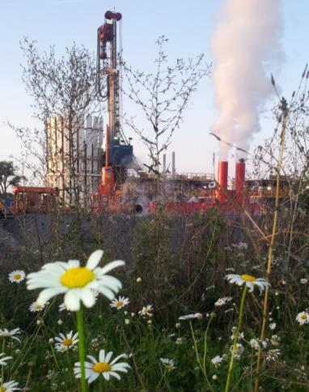
ES Géothermie
Engineering company in deep geothermal energy
  Creation in 2008
  Turn-over 2014 : 1,7 M€
  Effectif : 12 people
  A subsidiary of ES Group, itself owned by EDF
Main skills
  Exploration of geothermal resources
  3D Modeling, geophysical logging, production tests, seismological monitoring
  Permitting et mining claims
  Technical assistance to project owner
  Surface facilities conception
  Exploitation monitoring

Slide 4
French expertise in geothermal energy

Slide 5
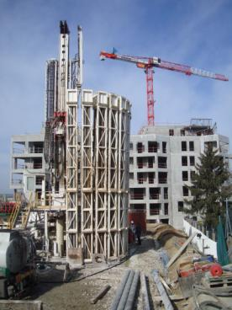
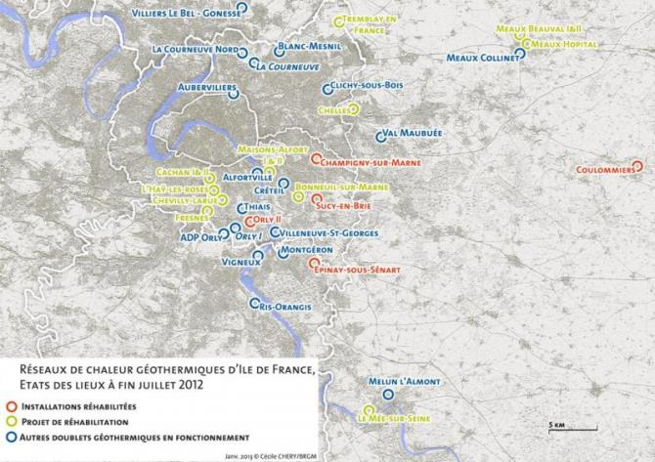
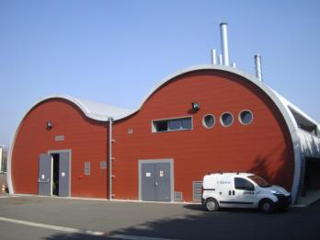
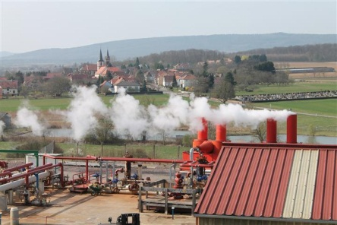

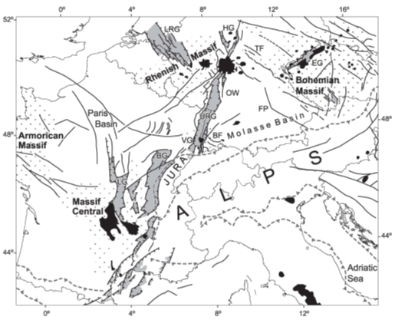
French know-how for medium-high temperature
2 main geothermal regions developped in France
  Paris Basin, largest district heating network density in continental Europe
    34 doublets in activity, temperature ~70°C
    22 doublets are operated by Dalkia
    Heat production >1100 MWh/y
    Supply heat for the equivalent of 300 000 homes
    Over 40 years operating
  Alsace, pilot for Enhanced Geothermal System technology targeting fractured reservoir
    Soultz-sous-Forêts European EGS pilot plant for power generation (~2,1 MWe)
    ECOGI project, providing local high temperature heat for local industry (~25 MWth)
Geothermal distric heatings in Paris area, by end of July 2012
Refurbished facility
Work-over planned
Other operating doublets

Slide 6
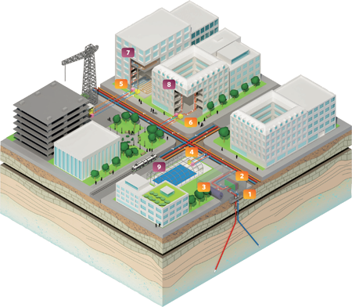

Typical French geothermal District Heating profile
① Pumps, production well (in red), injection well (in blue), welllheads.
② Geothermal power plant.
③ Natural Gas power plant for peaks or backups.
④ District heating underground network distribution pipes.
⑤ Heat exchanger for heating (sub-station separating primary & secondary distribution networks).
⑥ Heat exchanger for hot water dedicated to sanitary use.
⑦ Building equiped with high temperature radiators.
⑧ Building equiped with low temperature heat emitters.
⑨ Public equipement using low temperature (i.e. swiming pool).
  DALKIA operates 45% of the total district heating using geothermal energy in France :
    More than 20 Geothermal Plants and District Heating Networks
    Supply District heating for more than 250 000 inhabitants
    Nearly 10 new implementations or rewamping since 2011, and going on…

Slide 7
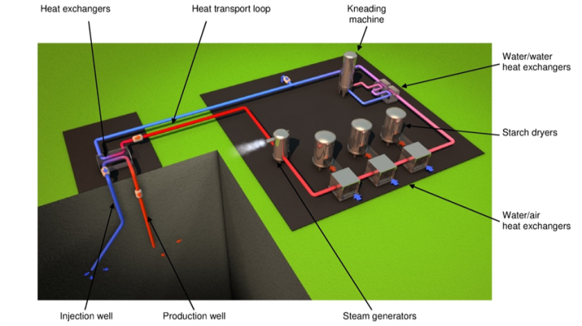



ECOGI project, an innovative business model
2 wells | 2500-3000 m
Operating | 8 000 h/year
Wellhead Temperature | 170°C
Transport loop | 15 km
Thermal power by the refinery | 24 MW
Ownership | 40% ES Group 40% Roquette 20% CDC
Investment | 55 M€
French incentive from Fonds Chaleur | 25 M€
  Providing high temperature heat to the industry, example of Roquette bio-refinery
    Maximizing energy use
      Operating nearly 24h/d 365d/y
      No energy loss compared to electricity conversion
    Investment of the industrial client into the project company
    Secure the industrial’s local presence
    Transform local resources (crops) locally

Slide 8
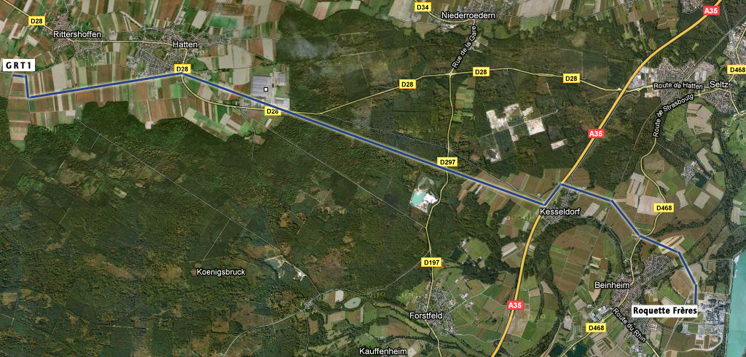
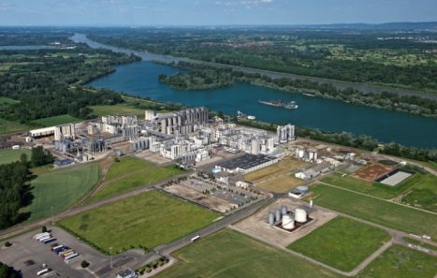
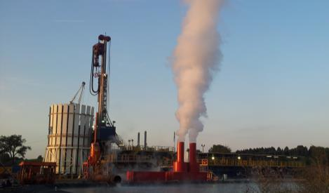
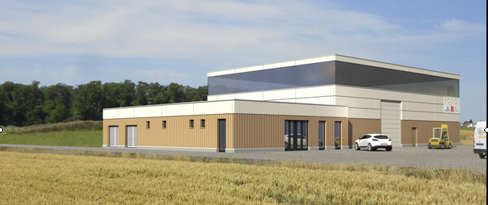
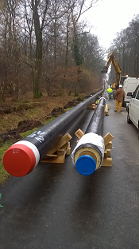
ECOGI, a technical challenge
2 wells targeting fractures at 2500m TVD
COMPLETED (177°C at the well bottom)
Plant construction
Started beginning of this month
15 km pipes
Losses less than 5°C
Commissionning planned for early 2016
On going : 8 on 15 km

Slide 9
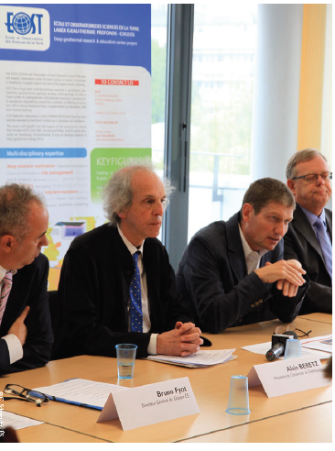












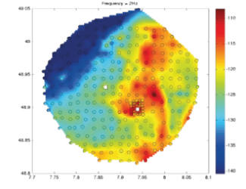


A close cooperation with University for R&D
EGS Alsace
LabEX
COGEOS
Industrial chair
  Many academic and industrial players
  Public and private funding, a total amount up to ~10 M€
Missions
  Research (phD, post-docs…)
  Training
  Communication
© EOST, Vergne et al, 2014
Main research areas
  Development of exploration tools (seismic noise)
  Understanding reservoir behaviour
  Optimizing operations
  Social acceptance

Slide 10
Why are we interested by Vojvodina ?

Slide 11
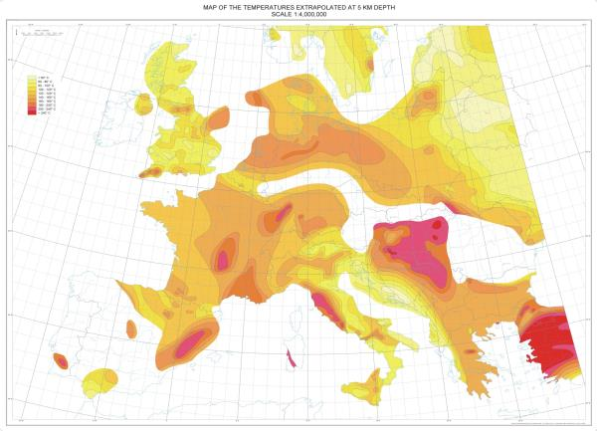
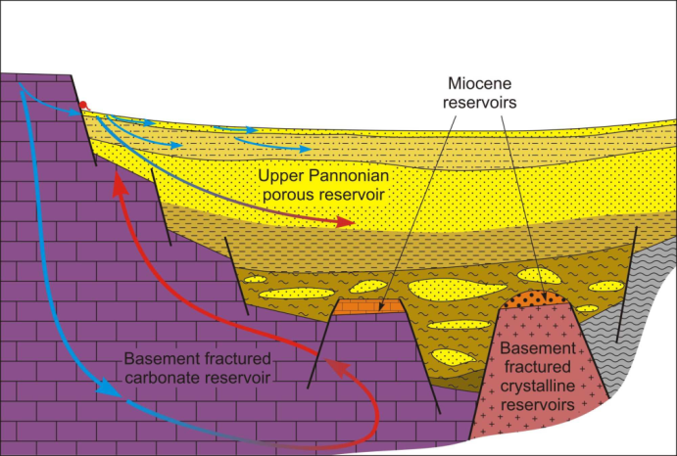
Vojvodina, a promising underground
< 60°C
Southern part of Pannonian basin
  High temperature area
  Various geological settings ⇨ full range of geothermal use
Pre-existing data on subsurface
  Geothermal wells already existing
  Atlas of geothermal resources
  Oil & Gaz exploration
60 - 80°C
80 - 120°C
120 - 140°C
140 - 160°C
160 - 180 °C
180 - 200°C
200 - 220°C
220 - 240°C
> 240°C
Map of extrapolated temperature at 5km depth, Source : Hurtig, 1991
Shallow geothermal with heat pumps
Direct use of geothermal heat from porous reservoirs
Similar to Paris Basin
Heat direct use or combined with power generation from deep fractured reservoirs
Similar to Alsace
Conceptual cross-section of Pannonian Basin,
source : Transenergy project

Slide 12
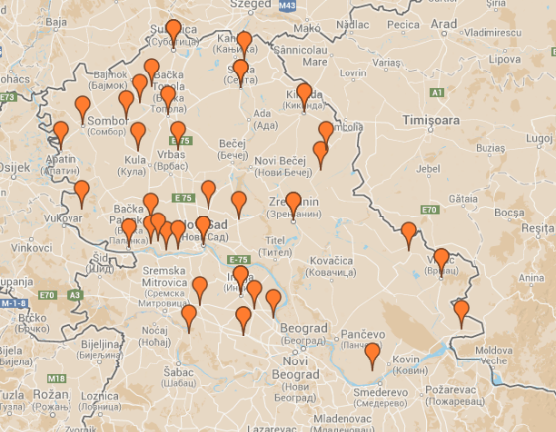


Vojvodina, a favorable economical context
Political context
  Serbia candidate to European Union
  Commitment on 27% of renewable energy consumption by 2020
Heat consumption
  Well developped agro-industry
  Existing district heating networks (ex : Kikinda)
Electricity policy
  Feed-in tariff between 6,92 et 9,67 c€/kWhe for geothermal energy
Map of agrobusiness foreign companies in Vojvodina, source : VIP

Slide 13
French support for geothermal development in Vojvodina

Slide 14






Studies state funded to export french know-how
Goals of the study carried by ES Geothermie
  Study on geothermal Serbian Potential
    Focus on most promizing areas (Vojvodina Province including Bogatic)
  Bring out 3 tangible projects
    Heat production (district heating and industries)
    Electricity production
  Export French know-how
Status
  Proposal submitted to French autorities in February 2015
  On-going instruction, answer expected in summer

Slide 15

Study details
Step 1 : Geothermal potential at Serbian scale
⇨ Delineation of 3 zones of interest
  Favorable zones considering subsurface aspects
  Main energy consummers
  Understanding Serbian energy market, especially for heat
  Understanding Serbian regulatory framework (environmental and mining policies, social acceptance… )
Step 2 : Pre-feasibility on tangible projects
⇨ Technico-economical recommandations and business plan
  2 heat projects, 1 electricity or combined
Step 3 : Geotechnologies
  Coproduction Oil and Gaz / geothermal energy
  Primary loop technology in Serbian context
Step 4 : Communication and Serbian-French cooperation
Federate a consortium to launch projects
  Organization of a workshop with investors, industrial clients, French geothermal cluster, Serbian scientists…

Slide 16














GEODEEP, a cluster of experienced French companies
Cluster composition
Energy multinationale companies with a total turn-over greater than 119 Billions €: EDF-ES, EIFFAGE-CLEMESSY, VINCI – ENTREPOSE, VINCI-CEGELEC
Specialized companies with a long history:
  Geothermal sciences: Antea Group, CFG SERVICES, TERANOV, Brgm, GPC-IP
  Plant equipment manufacturers: CRYOSTAR
  Operating & Maintenance: EDF-DALKIA
Developers / integrators specialized in geothermal energy:
  EGS France , FONROCHE, ELECTERRE, EDF-ES
  Volcanic Export : TERANOV, CFG SERVICES
And more than 50 listed companies with activity in the geothermal sector

Slide 17
GEODEEP initiative
Develop a performant offer abroad based on French experiences
Cluster offer
Financial solutions for geological risk coverage
Secure projects from beginning to end with:
  A reliable project management (budget, quality, cost, time)
  A clear Business model, the cluster, which takes on the role of integrator or developer, offers and guarantees a comprehensive range of services
An acknowledged French know-how: EPC, construction of turn-key plants, geothermal studies
World-class international partnerships for drilling, surface networks, investment and project development
Local partnerships to promote local economic development
The guarantee of sustainable projects, taking into account:
  Environmental, ethical and social aspects to preserve local ecosystem
  Geothermal reservoir caracteristics to offer tailored solutions that enhance reservoir longetivity and productivity

Slide 18
Conclusion for the FASEP Project
Coordination between :
State institutions
Local representatives
Investors
Academic partners
Geothermal expertise
Mining policies
Local interest
Social acceptance
Research
Training
French cluster
Local experts
Environemental policies
Financial incentives
Heat consumers
Operators (EDF/Dalkia,…)
Public and private funding
Geothermal energy development in Vojvodina

Slide 19
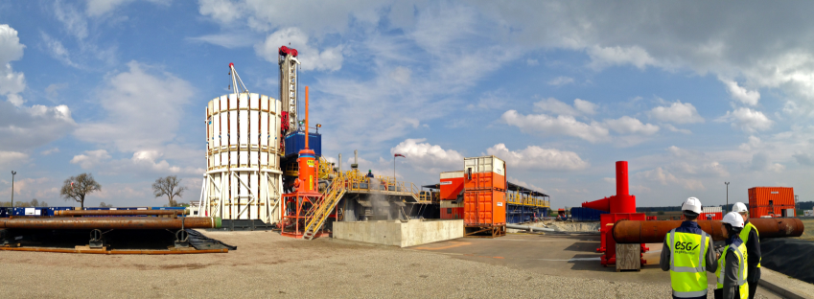
Thank you for your attention

