Slide 1
Geothermal Resources of Vojvodina and Application of Geothermal Systems
May 2015
Novi Sad

Slide 2
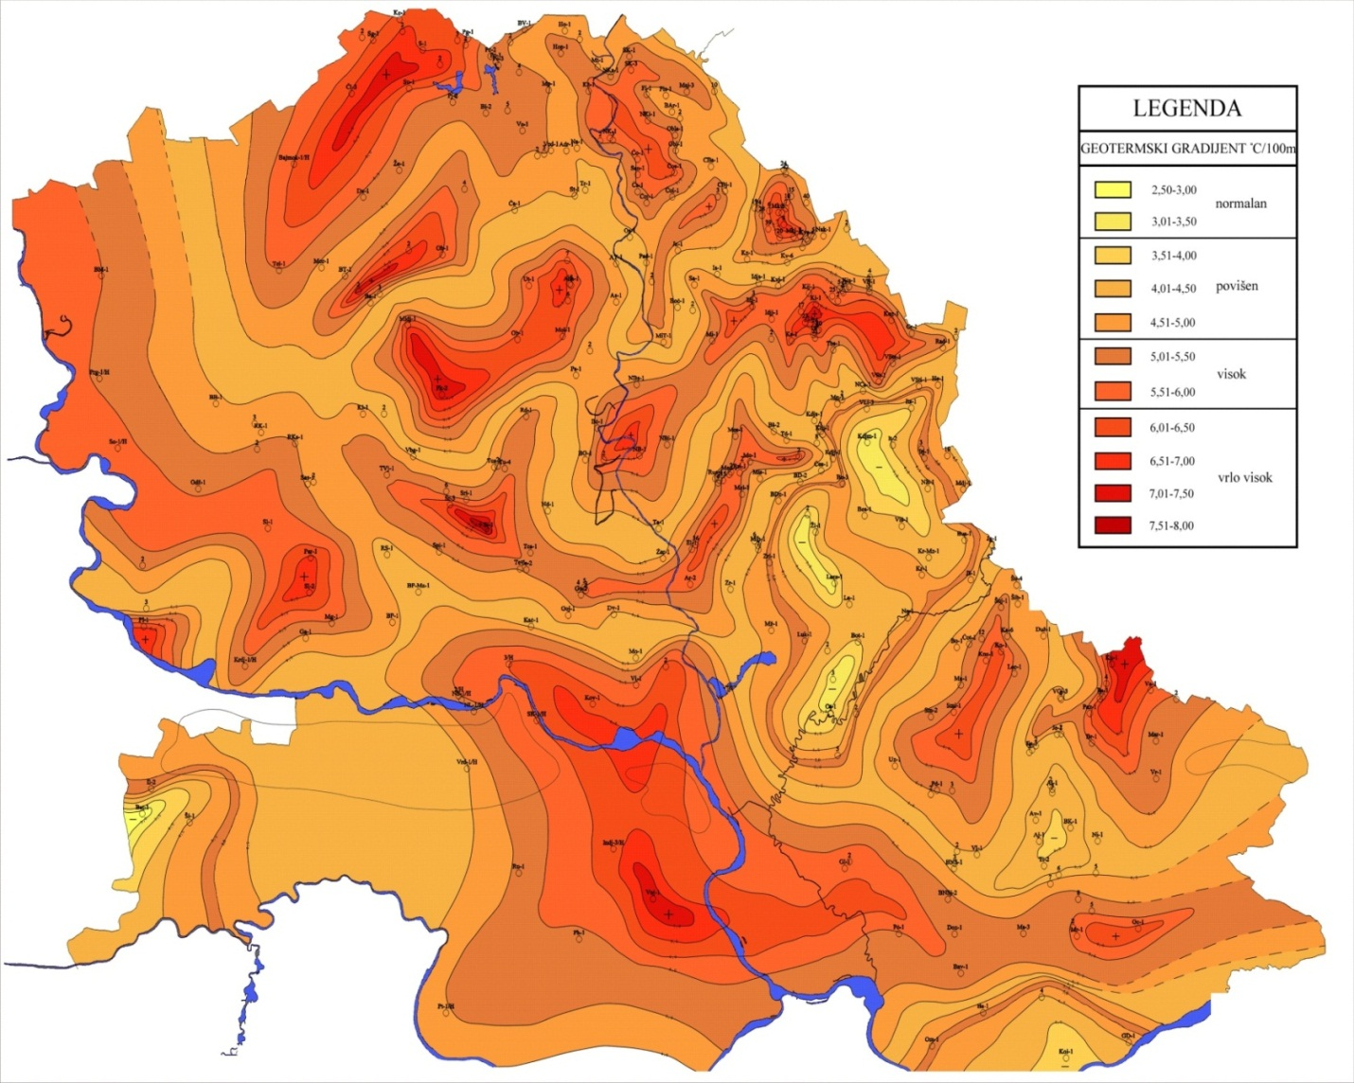
Geothermal Gradient Map of Vojvodina
Natural geological conditions of Vojvodina are very favourable in terms of geothermal resource utilization
The average geothermal gradient in Europe ranges from 3 to 5 ˚C/100m
Zones with high and very high gradients exceeding 5-10 ° C / 100m are prevalent in Vojvodina

Slide 3
Geothermal Resurce Estimate Map

Slide 4
Geothermal Potential of Hydrothermal Wells and Main Areas of Geothermal Energy Utilization in Vojvodina
Total yield per well: 9.5 l/s.
The average water outlet temperature: 48.8 °C
Total heat capacity (power)
of all wells ~50 MW
Utilization of all wells in power generation
potential savings of fuel oil in a heating season: 22. 700 t
Spa and spa resorts (heating and balneology): 43.6%
Facility heating: 38.8%
Technological needs of the industry: 11.5%
Recreation (outdoor and indoor pools): 6.1%

Slide 5
GT Resource Utilization Dynamics
Well Catalogue
Location
Construction and design
Capacity, temperature
Water analysis and potential use
Drilling and equipping of wells
Providing the required documentation
Concluding contracts with clients
Construction of surface systems
Well maintenance and workover
Utilization strategy
Criteria and value assessment of wells and systems
Analysis of the new GTE utilization options
NIS j.s.c. is affirmed to
Drill, equip and explore the wells
Design and draft the required documents
Construct facilities based on a “turn key” system
Maintain the wells and systems

Slide 6
HYDROGEOTHERMAL RESOURCES IN VOJVODINA
Current Status Overview
12 producing
with constructed systems which are not producing
(2 technically defective)
In total 75 hydrothermal wells were drilled
25 can be used
14 technically defective or showing poor results
11 killed
+
7 negative for CH where hydrothermal testing was conducted and which can be used

Slide 7
For the Investor’s needs, NIS j.s.c. can prepare:
Prospectivity Study
Well– drilling and exploration
Results/ Reserves Study
Design of detailed hydrogeological investigations
SMP– Well Detailed Design
Design and Surface System
Production Feasibility Study
Other required documents and approvals

Slide 8
Wells with the Highest Geothermal Potential
 | Geothermal wells | Location | Flow rate (l/s) | Temperature (C) | Status
1 | Vbc - 1/H | Vrbica | 17 | 82 | Does not produce. Killed.
2 | Cr - 5 | Srpska Crnja | 19 | 75 | Does not produce. Mothballed.
3 | Kps-1/H | Kupusina | 4 | 72 | Does not produce. Mothballed.
4 | Bm - 1/H | Bački Monoštor | 15 | 72 | Does not produce. Mothballed.
5 | Nk - 1/H | Novi Kneževac | 7 | 69 | Does not produce. Mothballed.
6 | Kž - 3/H | Kanjiža | 18.9 | 70 | Producing
7 | Kž - 2/H | Kanjiža | 10 | 68 | Producing
8 | Bč – 1/H | Bečej | 25 | 68 | Producing
9 | Sr - 1/H | Srbobran | 12 | 60 | Does not produce. Temporary production possible.
10 | Dp – 1/H | Bačko Dobro polje | 15 | 57 | Does not produce. Mothballed.
11 | Inđ – 1/H | Inđija | 14 | 57 | Does not produce. Mothballed.
12 | Vrb – 1/H | Vrbas | 12 | 56 | Does not produce. Mothballed.
13 | Pb – 1/H | Prigrevica | 22 | 56 | Producing
14 | Kp – 1/H | Kupinovo | 40 | 51 | Does not produce. Mothballed.
15 | Kp – 1/H | Kupinovo | 16 | 51 | Does not produce. Mothballed.

Slide 9
Options for Wells which are Out of Production
 | NIS’ obligations | Client’s obligations
The client wants hot water | Prepare the well for production | Provide water receipt infrastructure
Joint venture | Contractual relationship with the Client | Contractual relationship with NIS
Well sale | Assess the well value Prepare the well for production | Well buyout

Slide 10
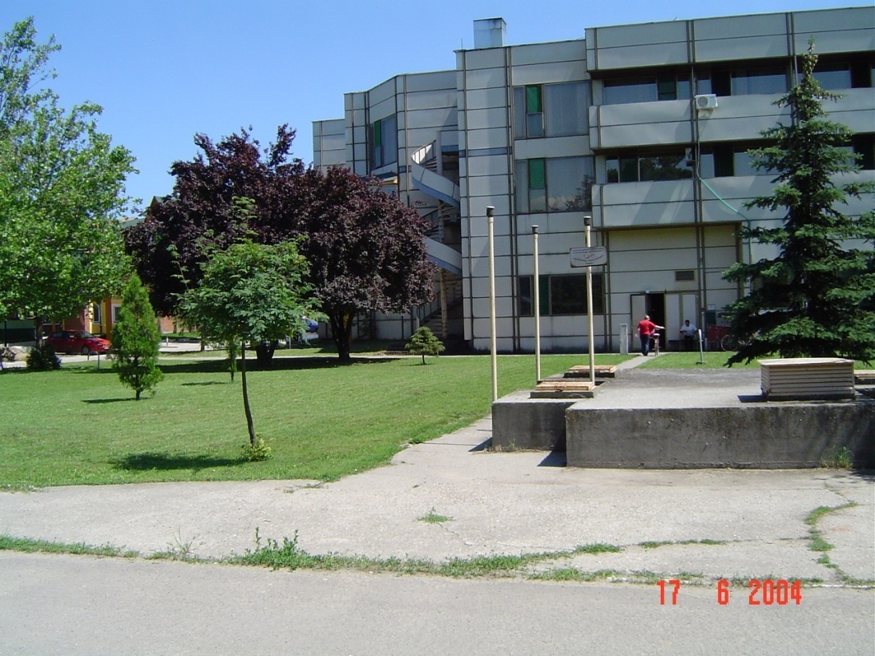
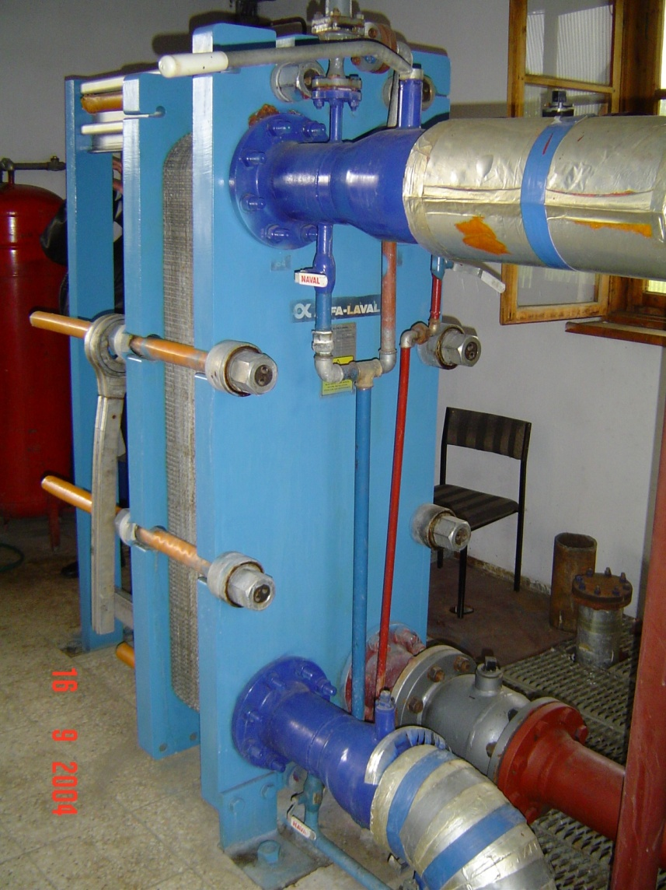
Examples of Geothermal Energy Use in Vojvodina
“Banja-Kanjiža” 2.5 MWt
Facility heating (air, radiators)
Domestic hot water
Indoor recreational pools
Balneology

Slide 11
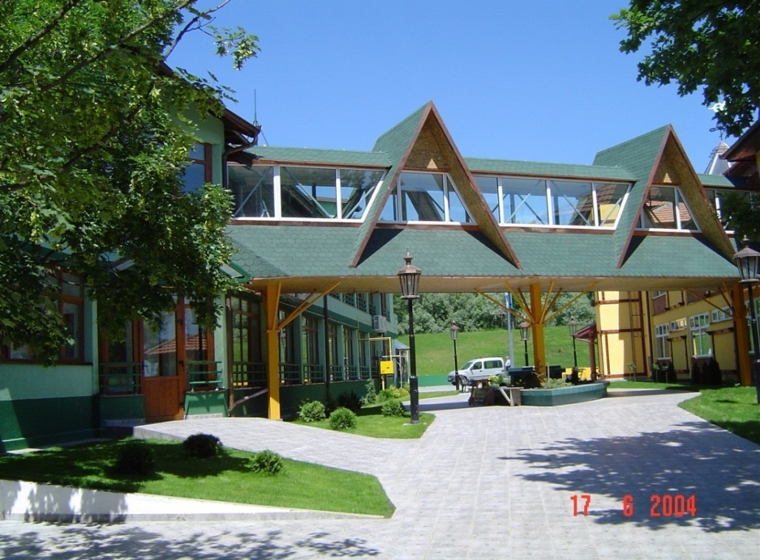
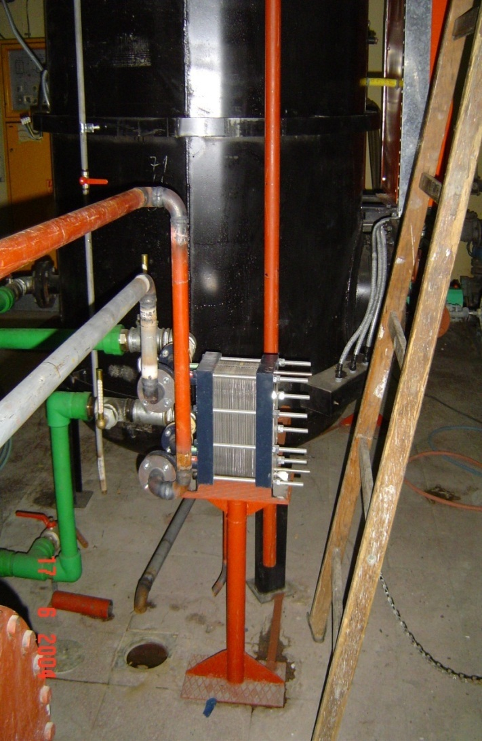
Examples of Geothermal Energy Use in Vojvodina
“АNА”,“LUPUS” and AQVA-PANON apartments
Floor heating
Heating of domestic hot water
Indoor recreational pools

Slide 12
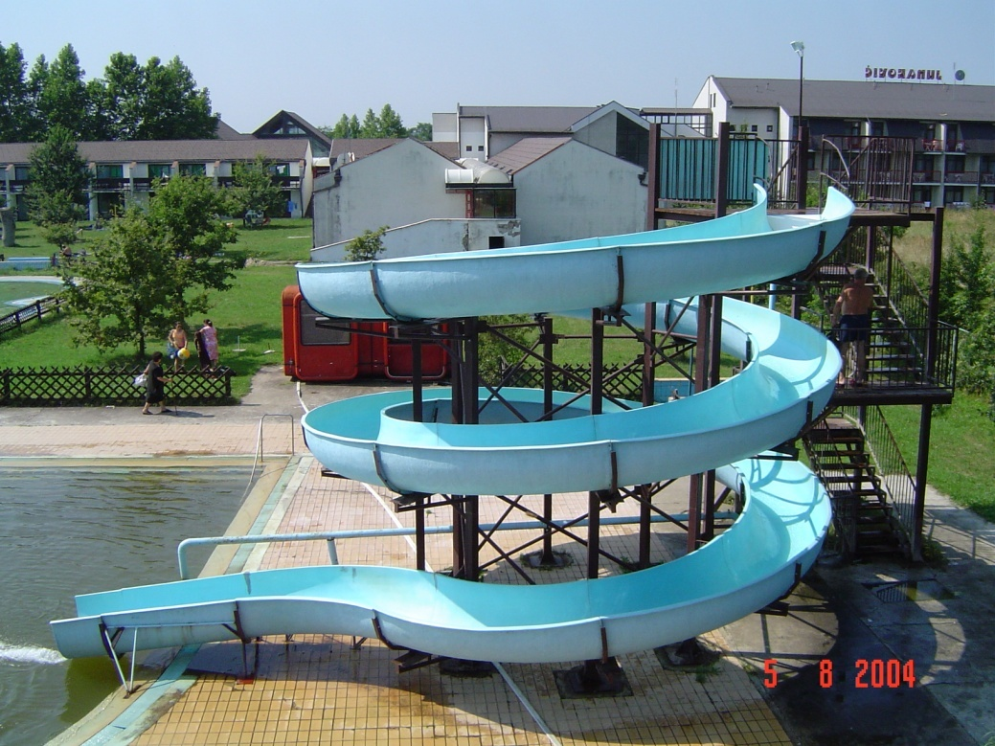
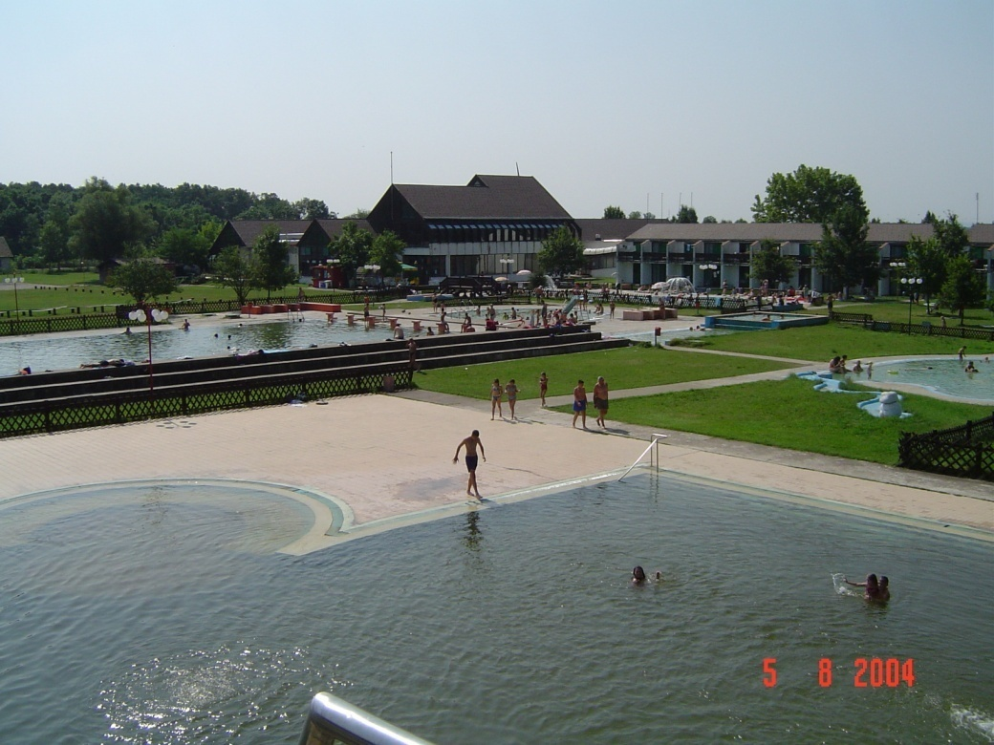
Examples of Geothermal Energy Use in Vojvodina
“Junaković” Spa
Facility heating (heat pumps – air and radiator heating)
Domestic hot water
Outdoor and indoor recreational pools and therepeutic pools
Balneology

Slide 13
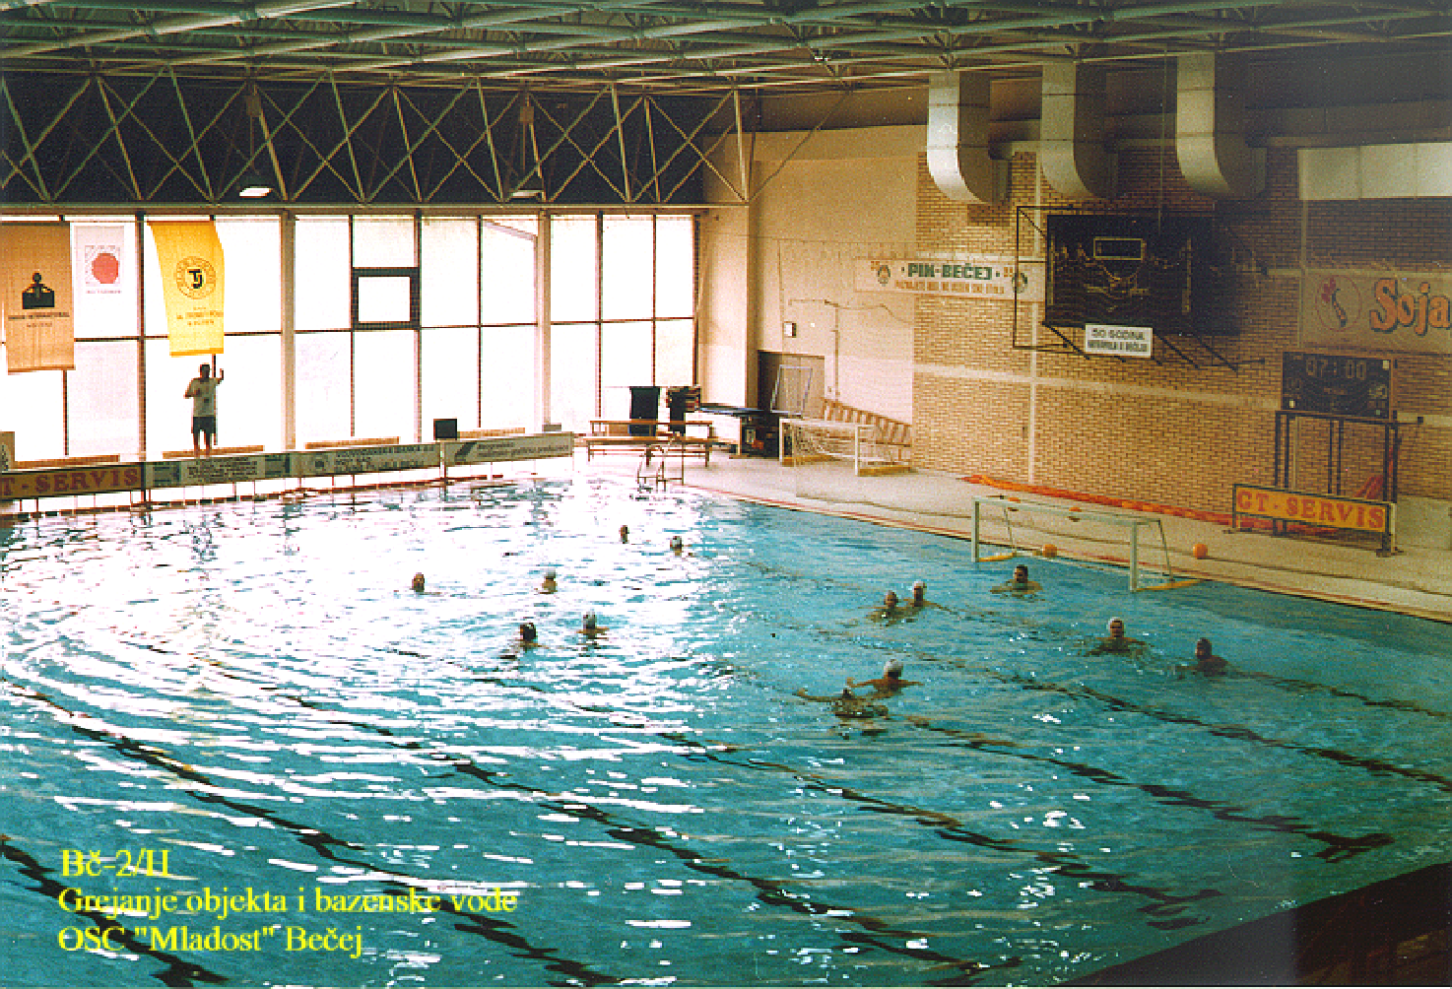
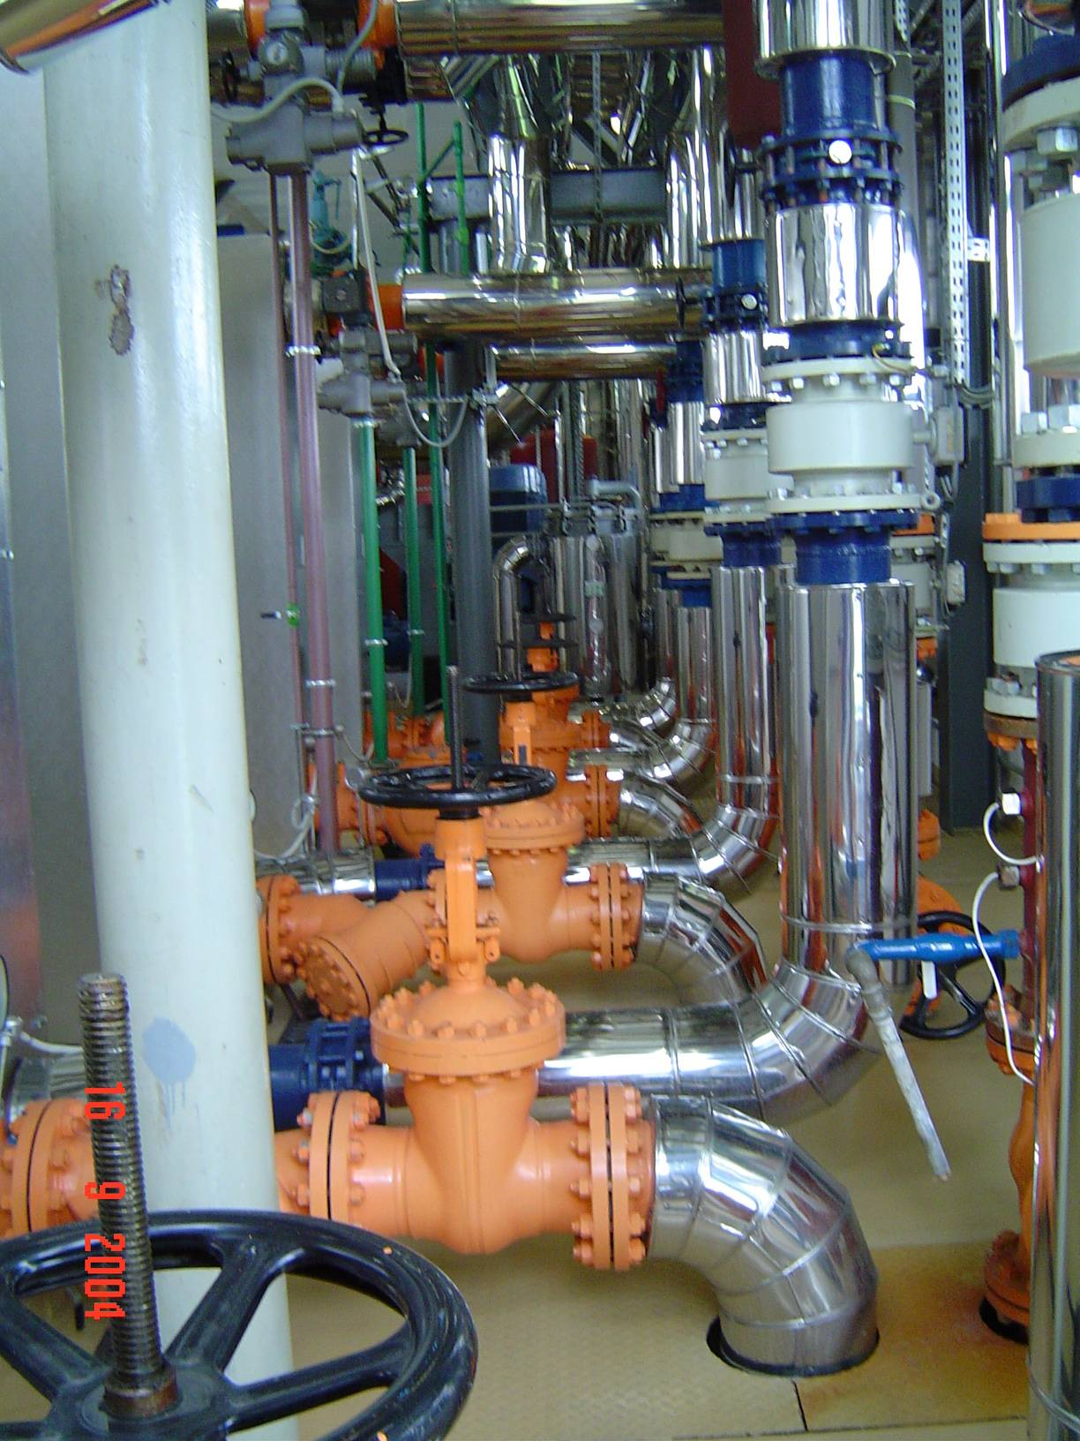
Examples of Geothermal Energy Use in Vojvodina
OSC “Mladost” Bečej
Facility heating (ventilation chambers)
Heating of domestic hot water
Heating of the swimming pool water

