Slide 1

District Heating system by GTE in Szeged, Southern Great
Plain Region, Hungary
János Szanyi –Balázs Kóbor – Tamás Medgyes
University of Szeged, Hungary
 szanyi@iif.u-szeged.hu
Geothermal Energy Days
Novi Sad, Vojvodina 22-23 May 2015

Slide 2
Outline
Geological settings
Hydrogeological background
Overwiev of the geothermal project
Financial data of the project
The cascade system
Conclusions
Notes:
The outline of my talk

Slide 3
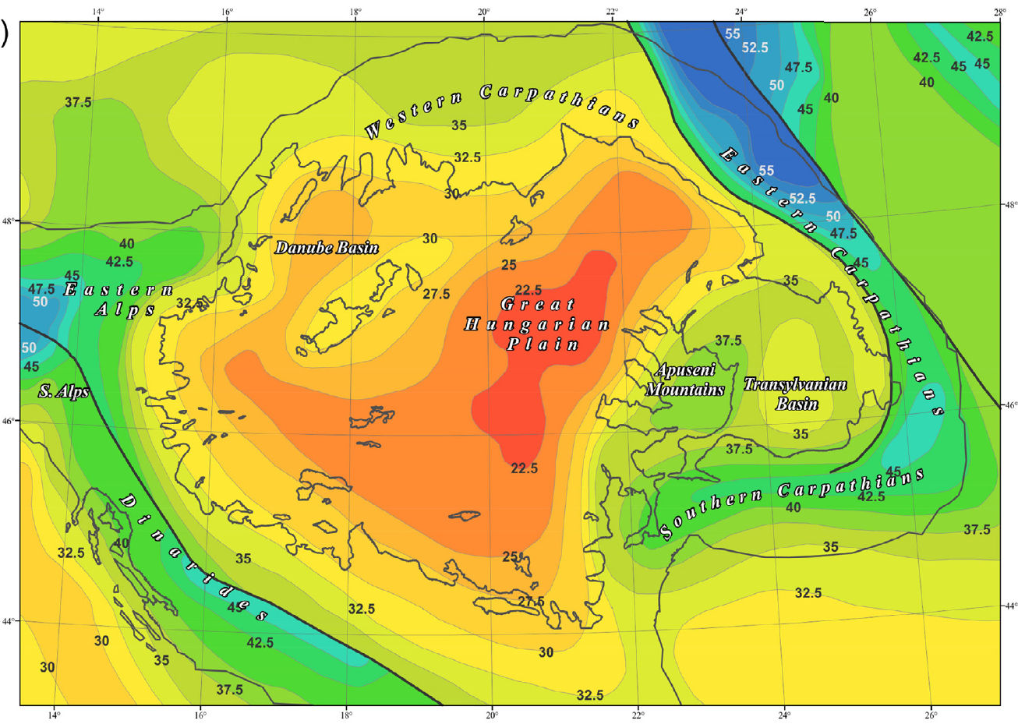

Crustal thickness map of the Pannonian basin (km)
(Horváth et al. 2014)

Slide 4

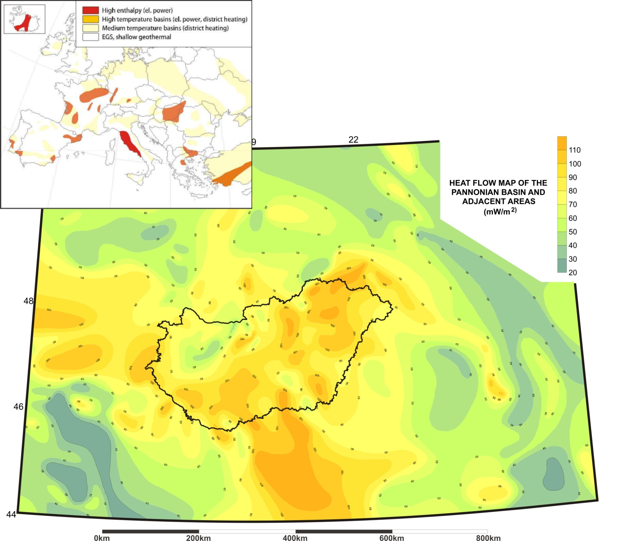
Heat flow map (mW/m²)
(based on Sanner, B., 2008)
(Dövényi, P., Horváth, F., 1988)
Szeged
Novi Sad
Notes:
Hungary has favourable geothermal conditions both potentials and perspectives, despite effect Hungary is not an active volcanic area. The average heat flow is around 100 mW/m², thanks to the thin earth crust, compared to the other parts of the continent. (22-26 km only).

Slide 5
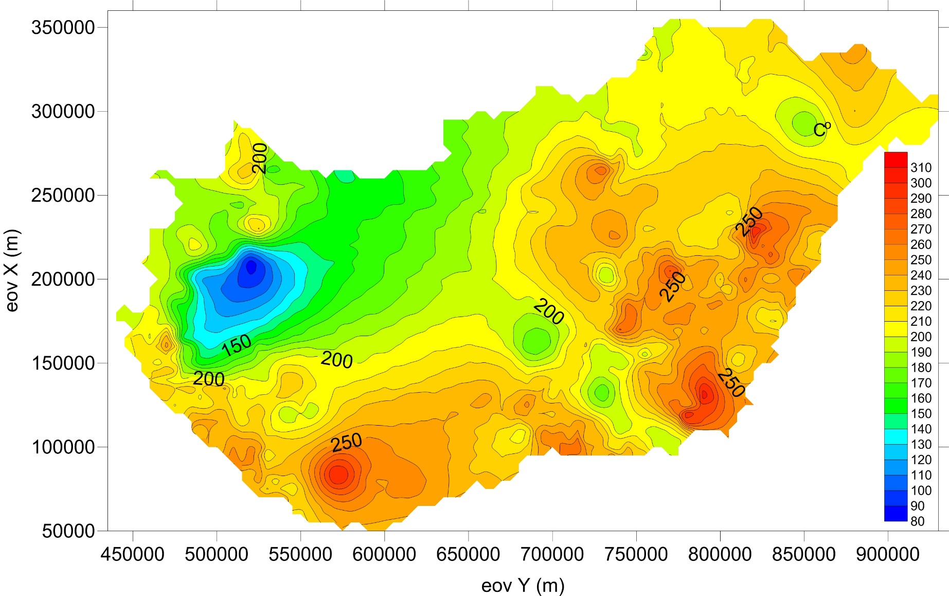
Temperature at 5000 m depth (ºC)

Slide 6
Topographic map of the basement

Slide 7
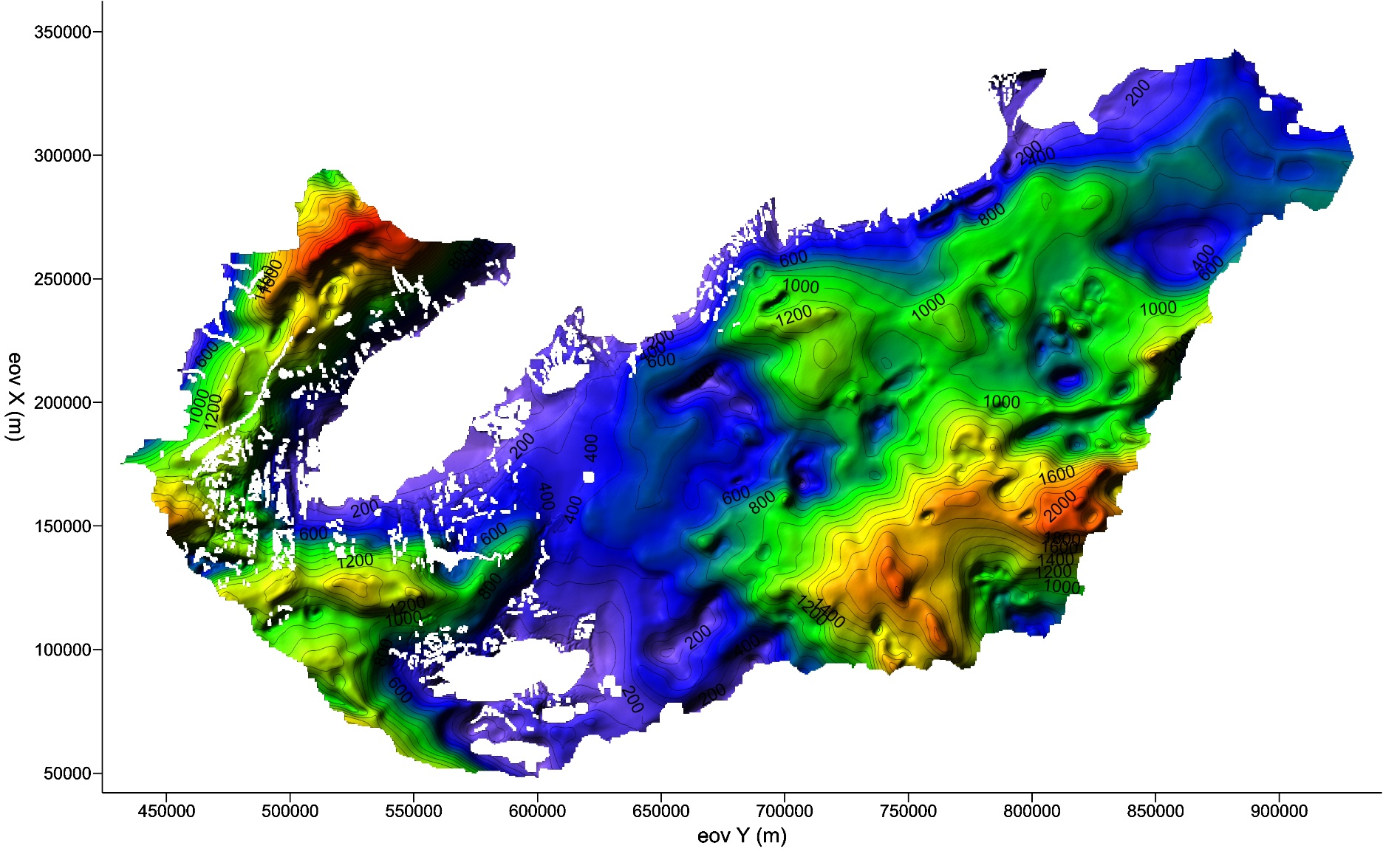
Thickness of the Upper-Pannonian strata

Slide 8
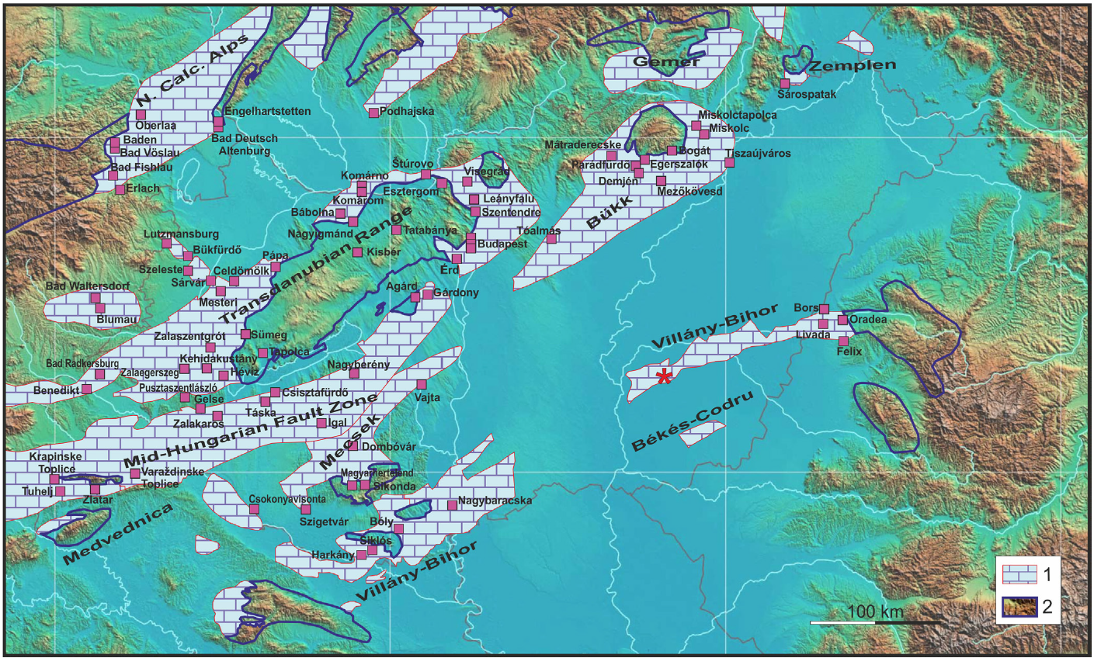
Mesozoic karstic aquifers with wells
1: reservoirs below the surface; 2: their recharge areas
(Horváth et al. 2014)

Slide 9
The licensing system
No concession zone
(water law)
2500 m
Concession zone
(mining law)

Slide 10
Pressure – elevation profile
Szeged area
pressure
elevation (m a.s.l.)
Notes:
The sedimentary layers work as an insulator, so the heat can accumulate beneath them.

Slide 11
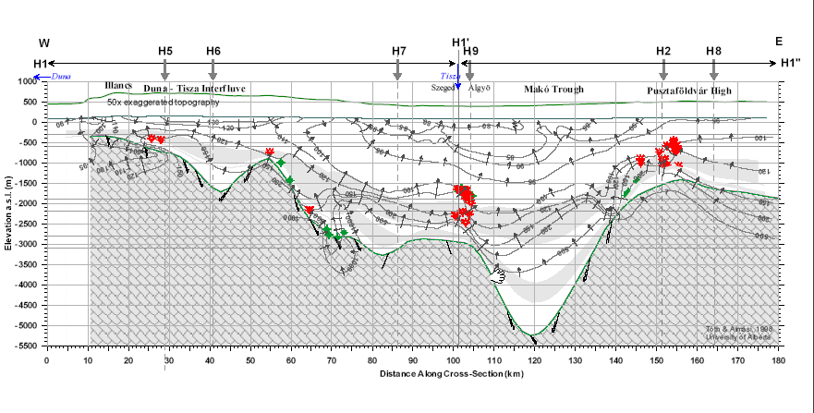
Hydrodinamical background
Tóth-Almási, 2001

Slide 12
Locations of thermal wells
220 x 200 km
Wells in sandstone
Wells in carbonate
Notes:
Groundwater production is the most widespread way of geothermal heat exploitation in Hungary. The other methods are almost negligible.
To date, more than 1400 registered deep thermal wells have been drilled in Hungary, though only 971 are in production at present. Most of them are abandoned oil and gas wells, but they also include wells drilled for thermal water exploitation purposes.

Slide 13
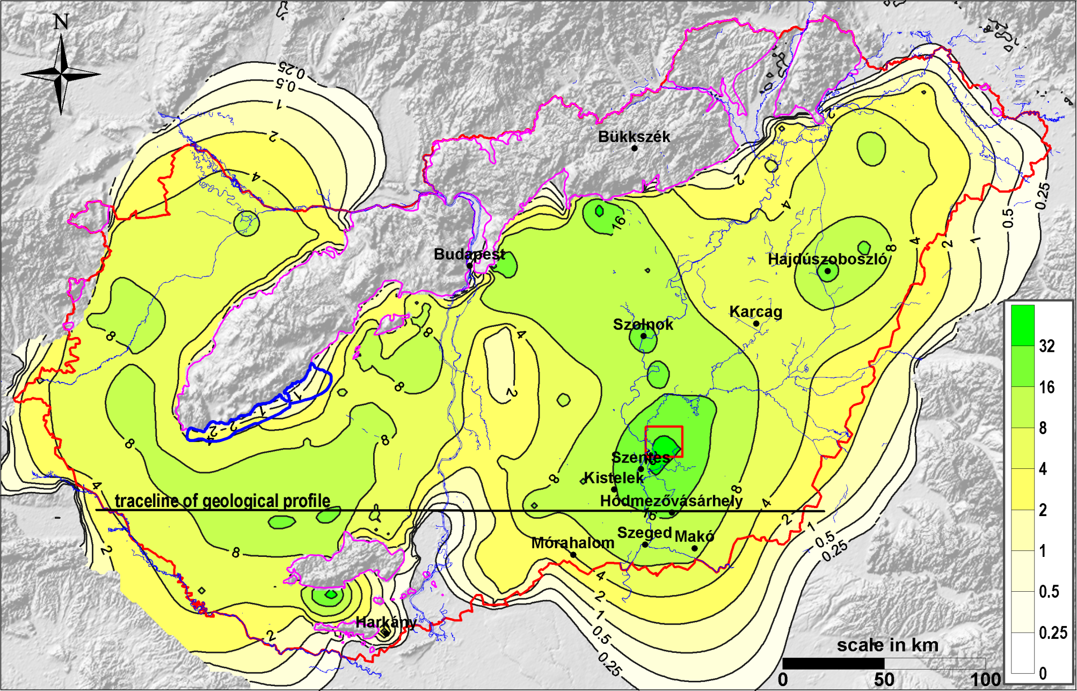
The calculated drawdown at the bottom of the Upper Pannonian sequences (Tóth, 2009)
Notes:
As a consequence of the high thermal water production the hydraulic head of the aquifers decreased by 30-35 m in the study areas. Most of the wells were free flow up to 20-50 m in primer state, but now continuous pumping of the wells is needed

Slide 14
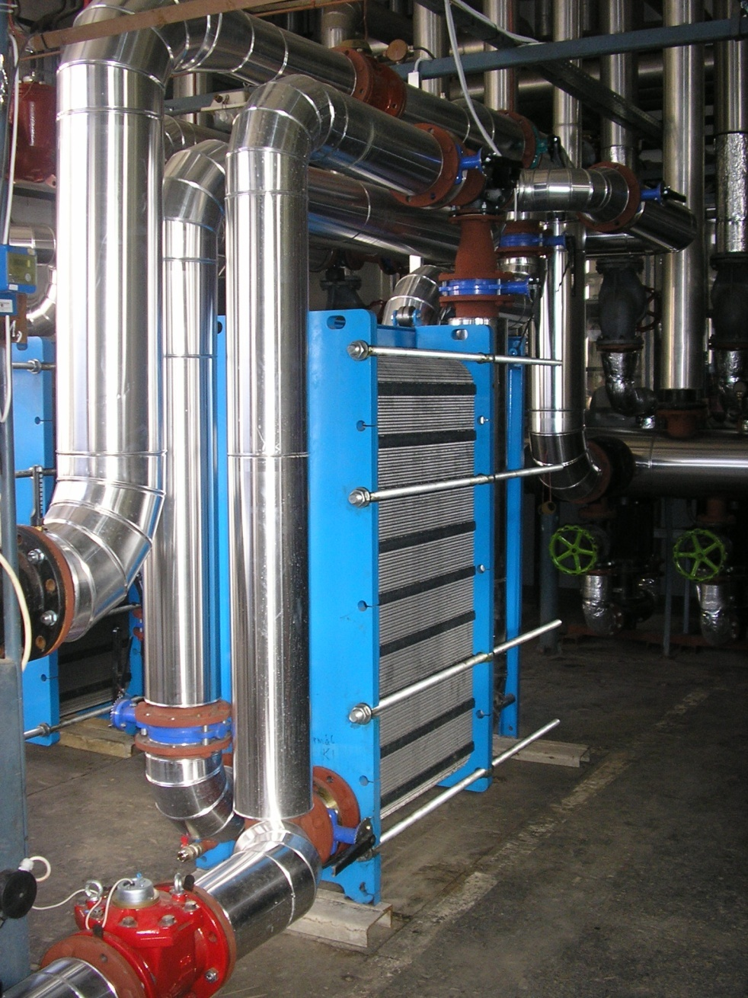
Geothermal production: Direct heat (Tóth 2009)
The annual thermal water production was around 85 Million m³. (Hungarian Geological Survey 2002)
The theoretical total thermal power capacity of these wells is 1,513 MW_{t}.
The effective utilized geothermal energy can be estimated at a level of 615 MW_{t}. This obtains an assumed load factor of 40 %.
The estimated thermal power applied in the field of:
bathing and swimming 272 MW_{t}
agricultural 212 MWt
district and space heating 119 MW_{t}
other users 12 MW_{t}
Heat exchanger in Hódmezővásárhely

Slide 15
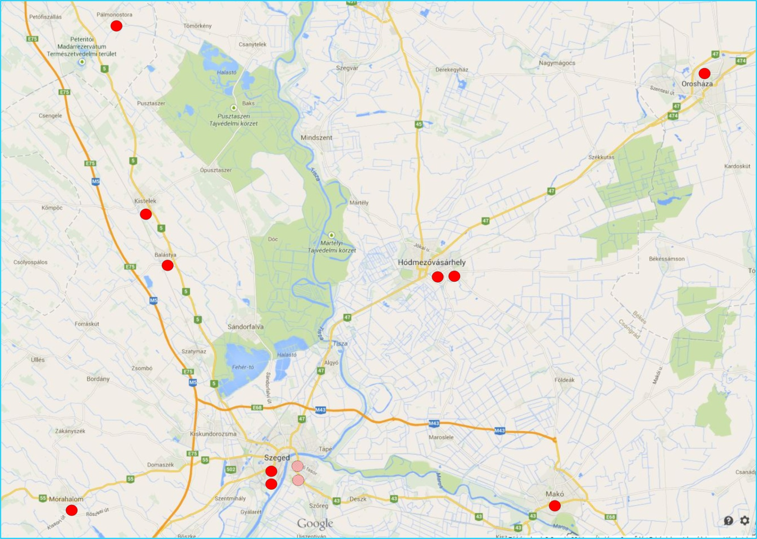
Geothermal systems with reinjection

Slide 16
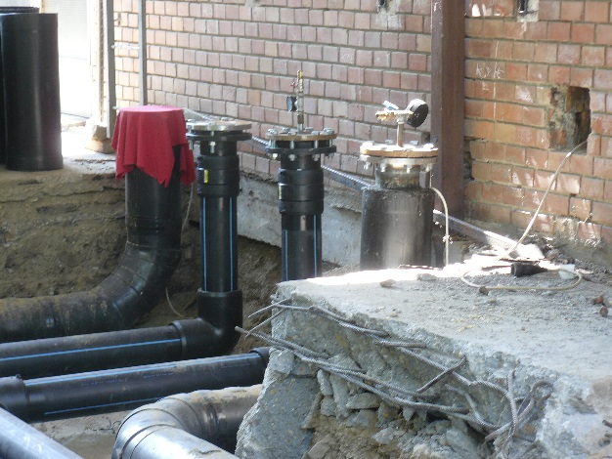
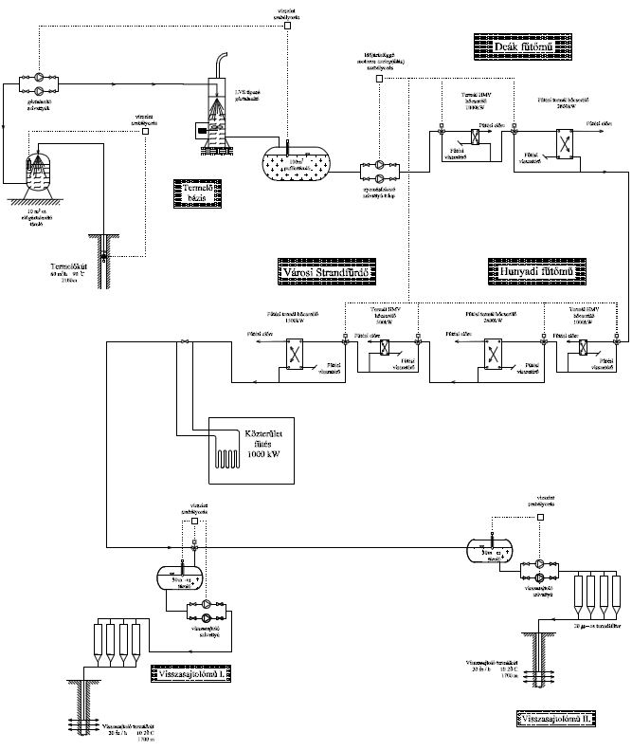
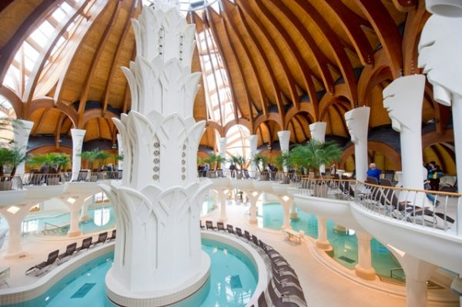
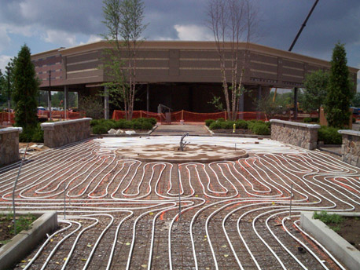
Geothermal cascade system in Makó
District heating
90/62 ºC
Spa heating
55/28 ºC
60/55 ºC
Domestic hot water
28/5 ºC
Snow melting

Slide 17
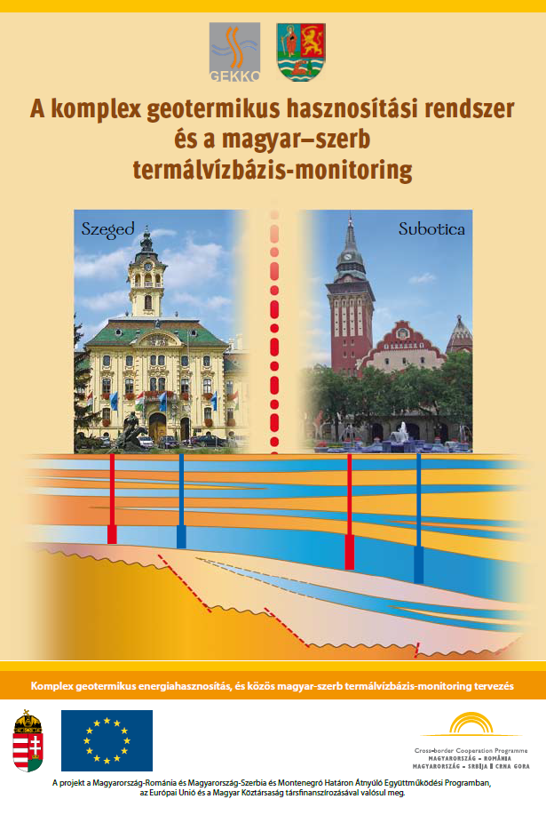
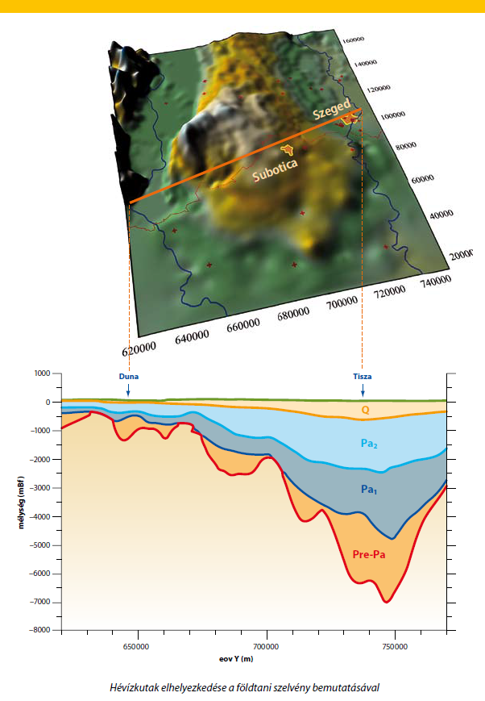
First steps of a geothermal project
Notes:
Groundwater production is the most widespread way of geothermal heat exploitation in Hungary. The other methods are almost negligible.
To date, more than 1400 registered deep thermal wells have been drilled in Hungary, though only 971 are in production at present. Most of them are abandoned oil and gas wells, but they also include wells drilled for thermal water exploitation purposes.

Slide 18
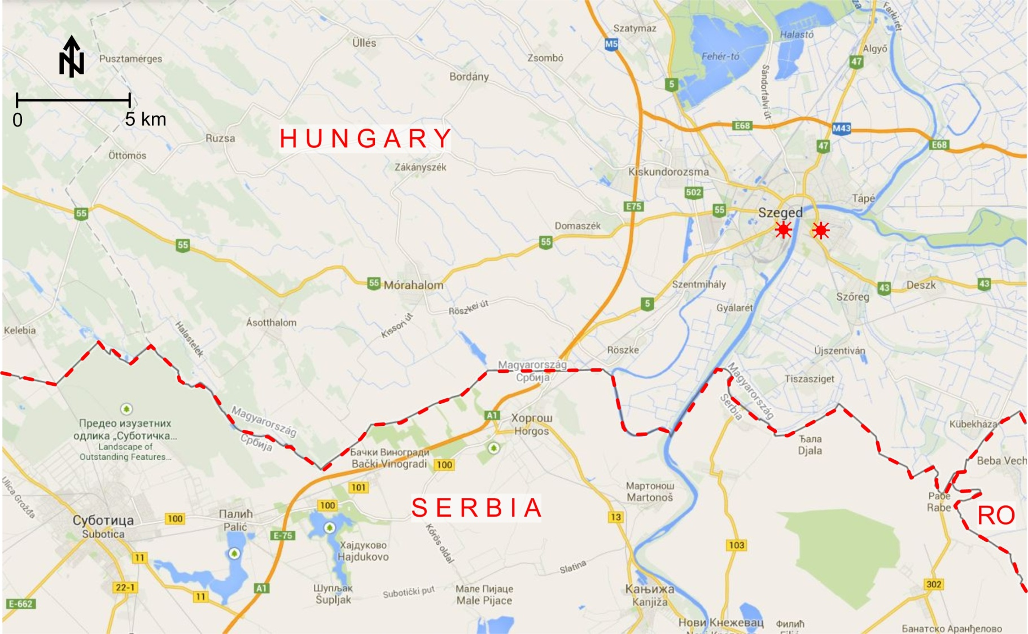
The geothermal project of the University of Szeged
Notes:
Groundwater production is the most widespread way of geothermal heat exploitation in Hungary. The other methods are almost negligible.
To date, more than 1400 registered deep thermal wells have been drilled in Hungary, though only 971 are in production at present. Most of them are abandoned oil and gas wells, but they also include wells drilled for thermal water exploitation purposes.

Slide 19
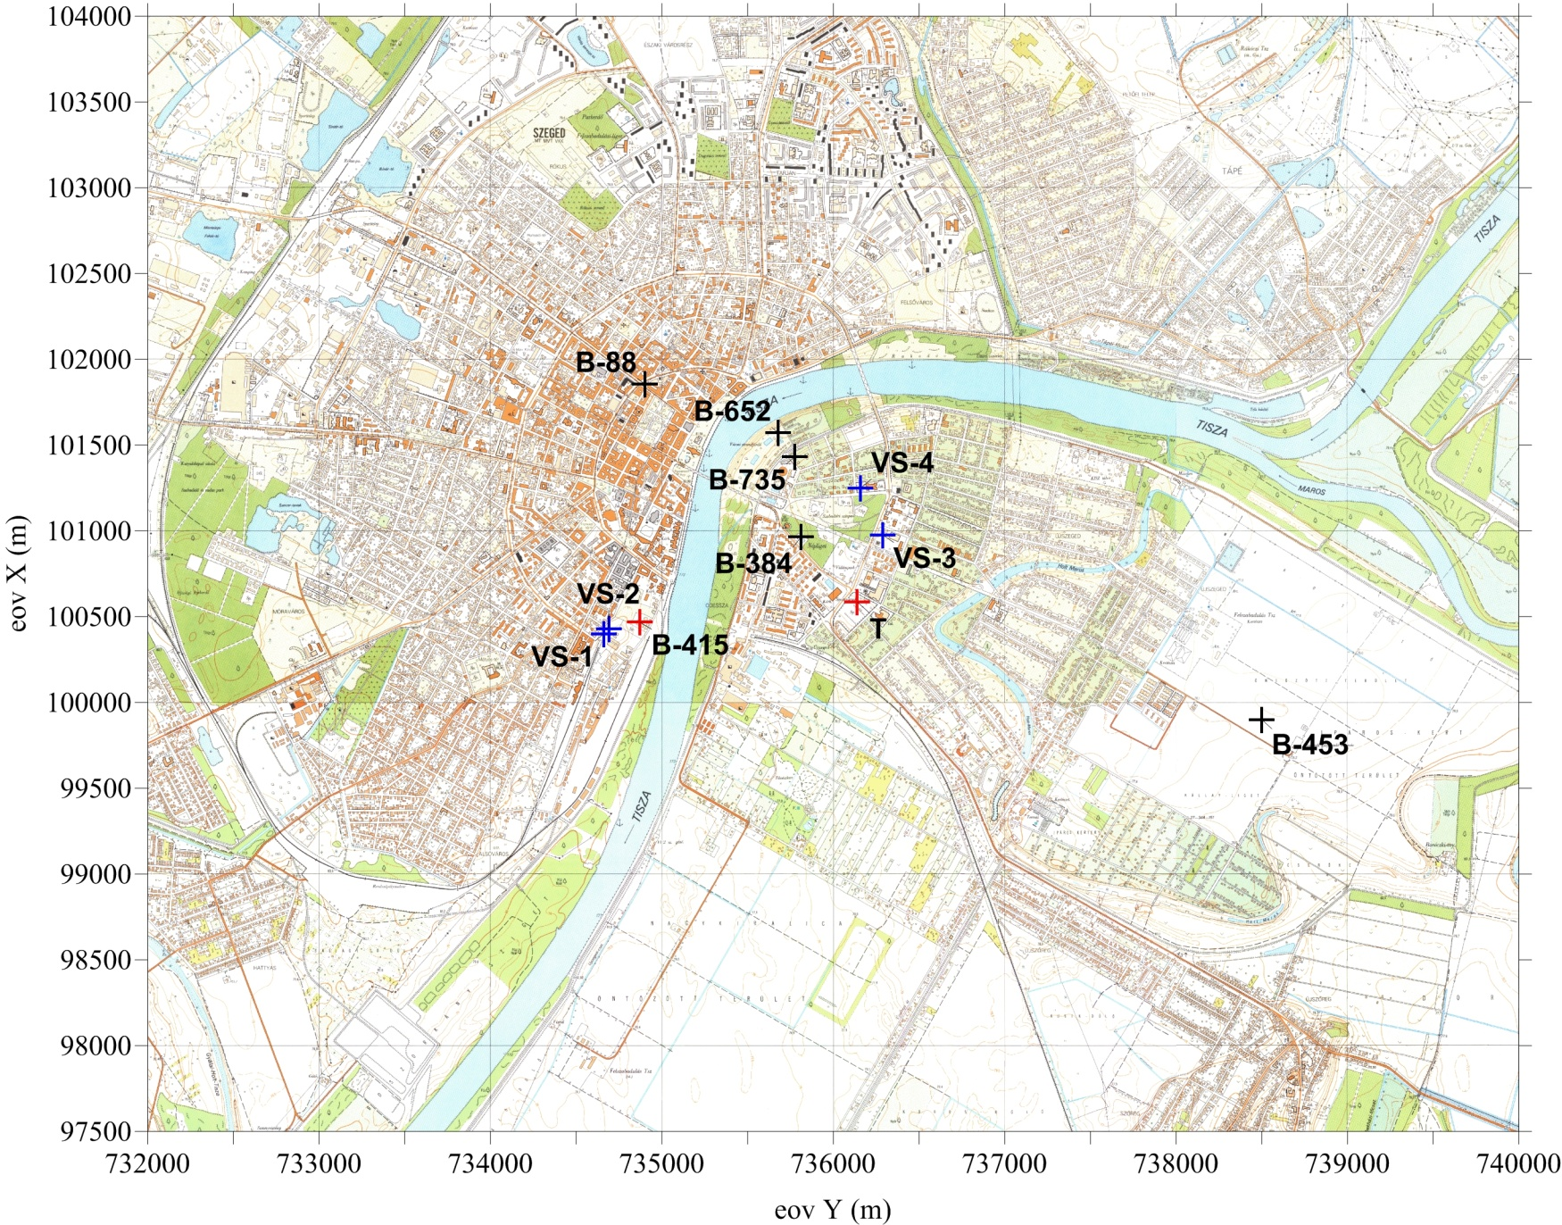
Thermal wells in Szeged
Notes:
Groundwater production is the most widespread way of geothermal heat exploitation in Hungary. The other methods are almost negligible.
To date, more than 1400 registered deep thermal wells have been drilled in Hungary, though only 971 are in production at present. Most of them are abandoned oil and gas wells, but they also include wells drilled for thermal water exploitation purposes.

Slide 20
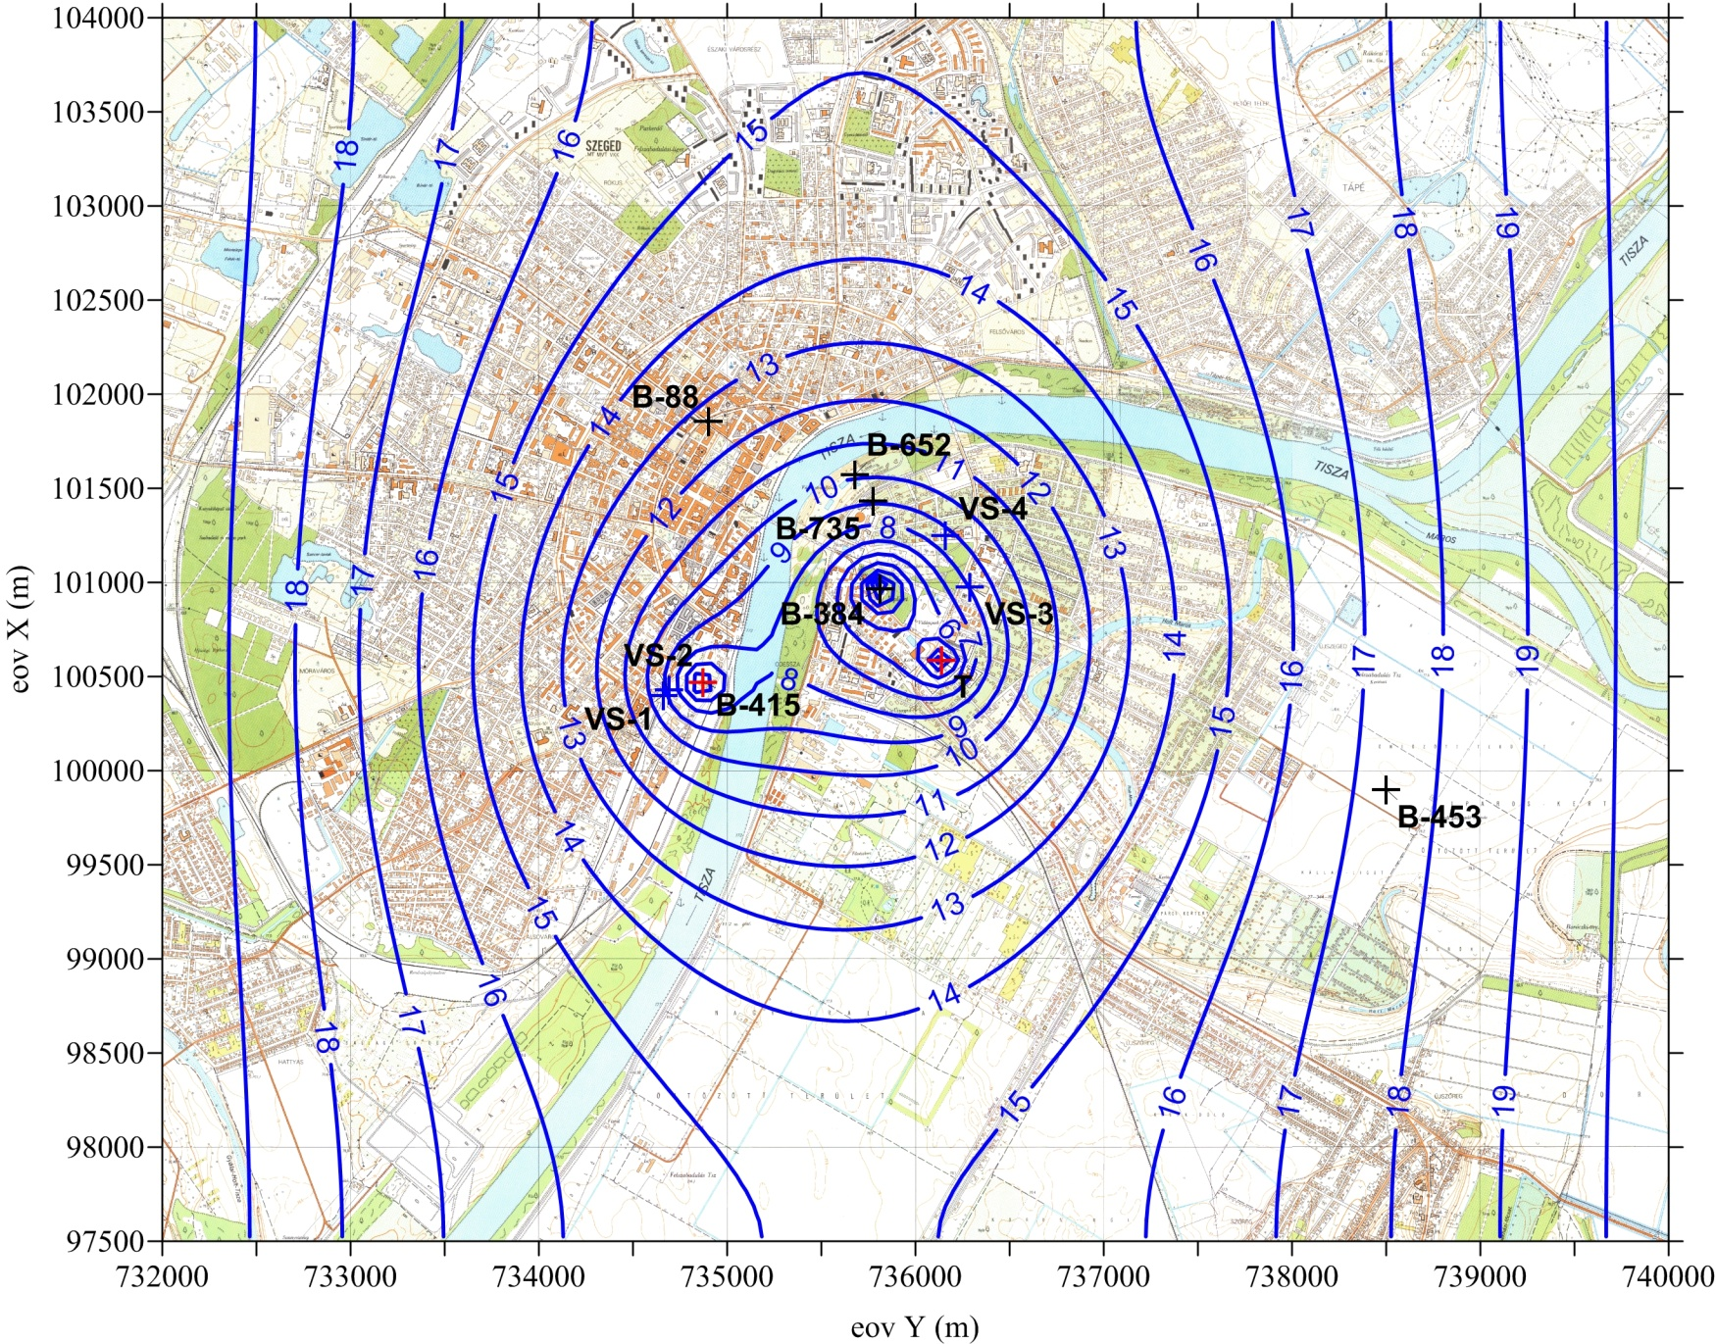
Potentiometric surface during operation
Notes:
Groundwater production is the most widespread way of geothermal heat exploitation in Hungary. The other methods are almost negligible.
To date, more than 1400 registered deep thermal wells have been drilled in Hungary, though only 971 are in production at present. Most of them are abandoned oil and gas wells, but they also include wells drilled for thermal water exploitation purposes.

Slide 21
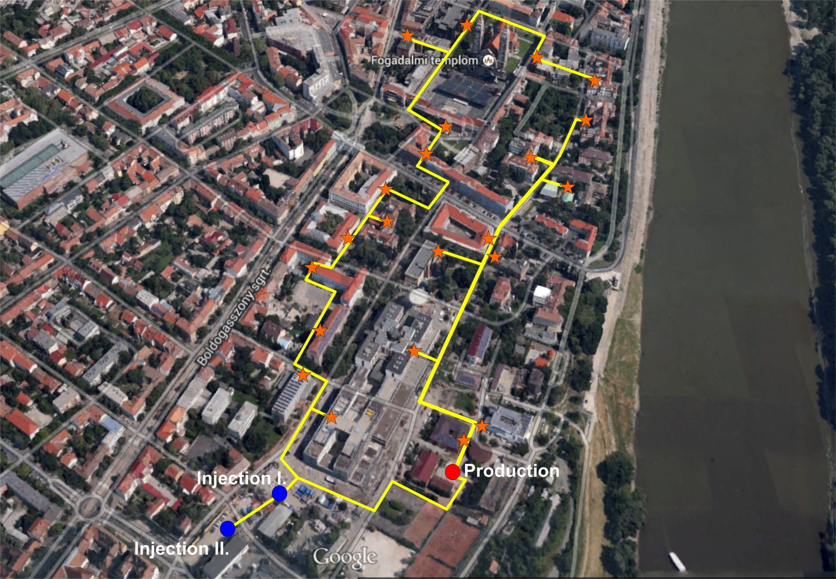
Geothermal cascade system in the city center
Investment: 6.6 million €
Yearly profit: 0.45 million €

Slide 22
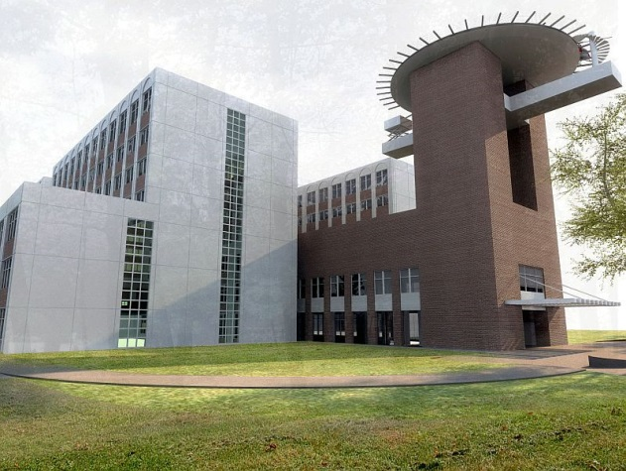
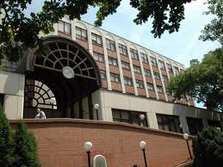
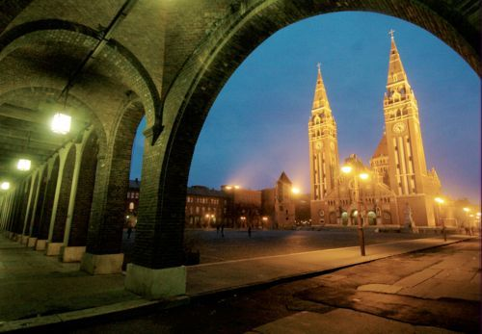
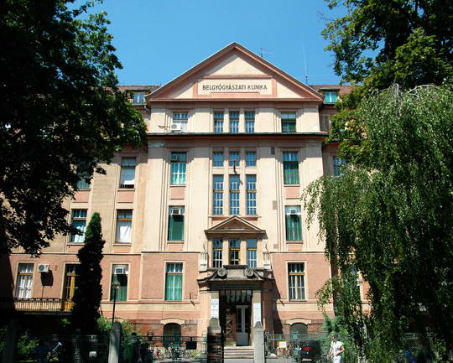
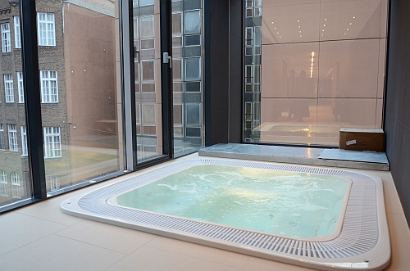
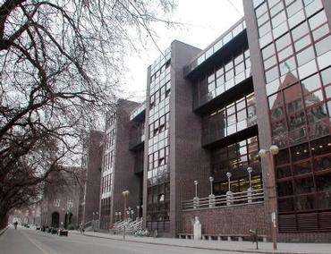
Sites of the geothermal project in the city center

Slide 23
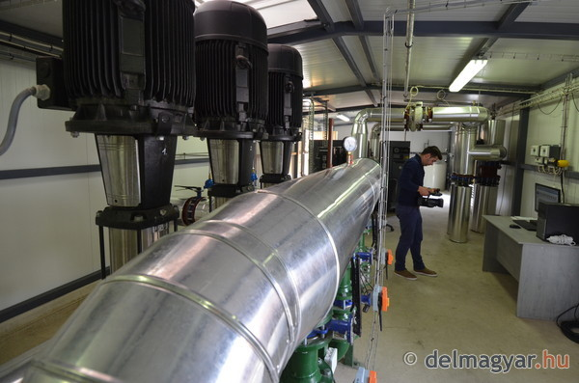

Parameters of the downtown geothermal circle
Construction of the 4.4 MW_{th} project
1 production well (1995 m)
2 injection wells (1350 m; 1750 m)
pipe line ~ 3300 m
25 new heating centres
Online PLC control system
Oucomes of the project
Produced geothermal energy: 55 239 GJ/y
Natural gas reduction: 1 800 000 m³/y
CO₂ reduction: 3 633 t/y
Spending on investment: 6 600 000 €
Investment/produced energy: 1 410 €/kW)
Specific investment of CO₂ reduction: 1 830 €/t
Maintenance cost: 280 000 €/y

Slide 24
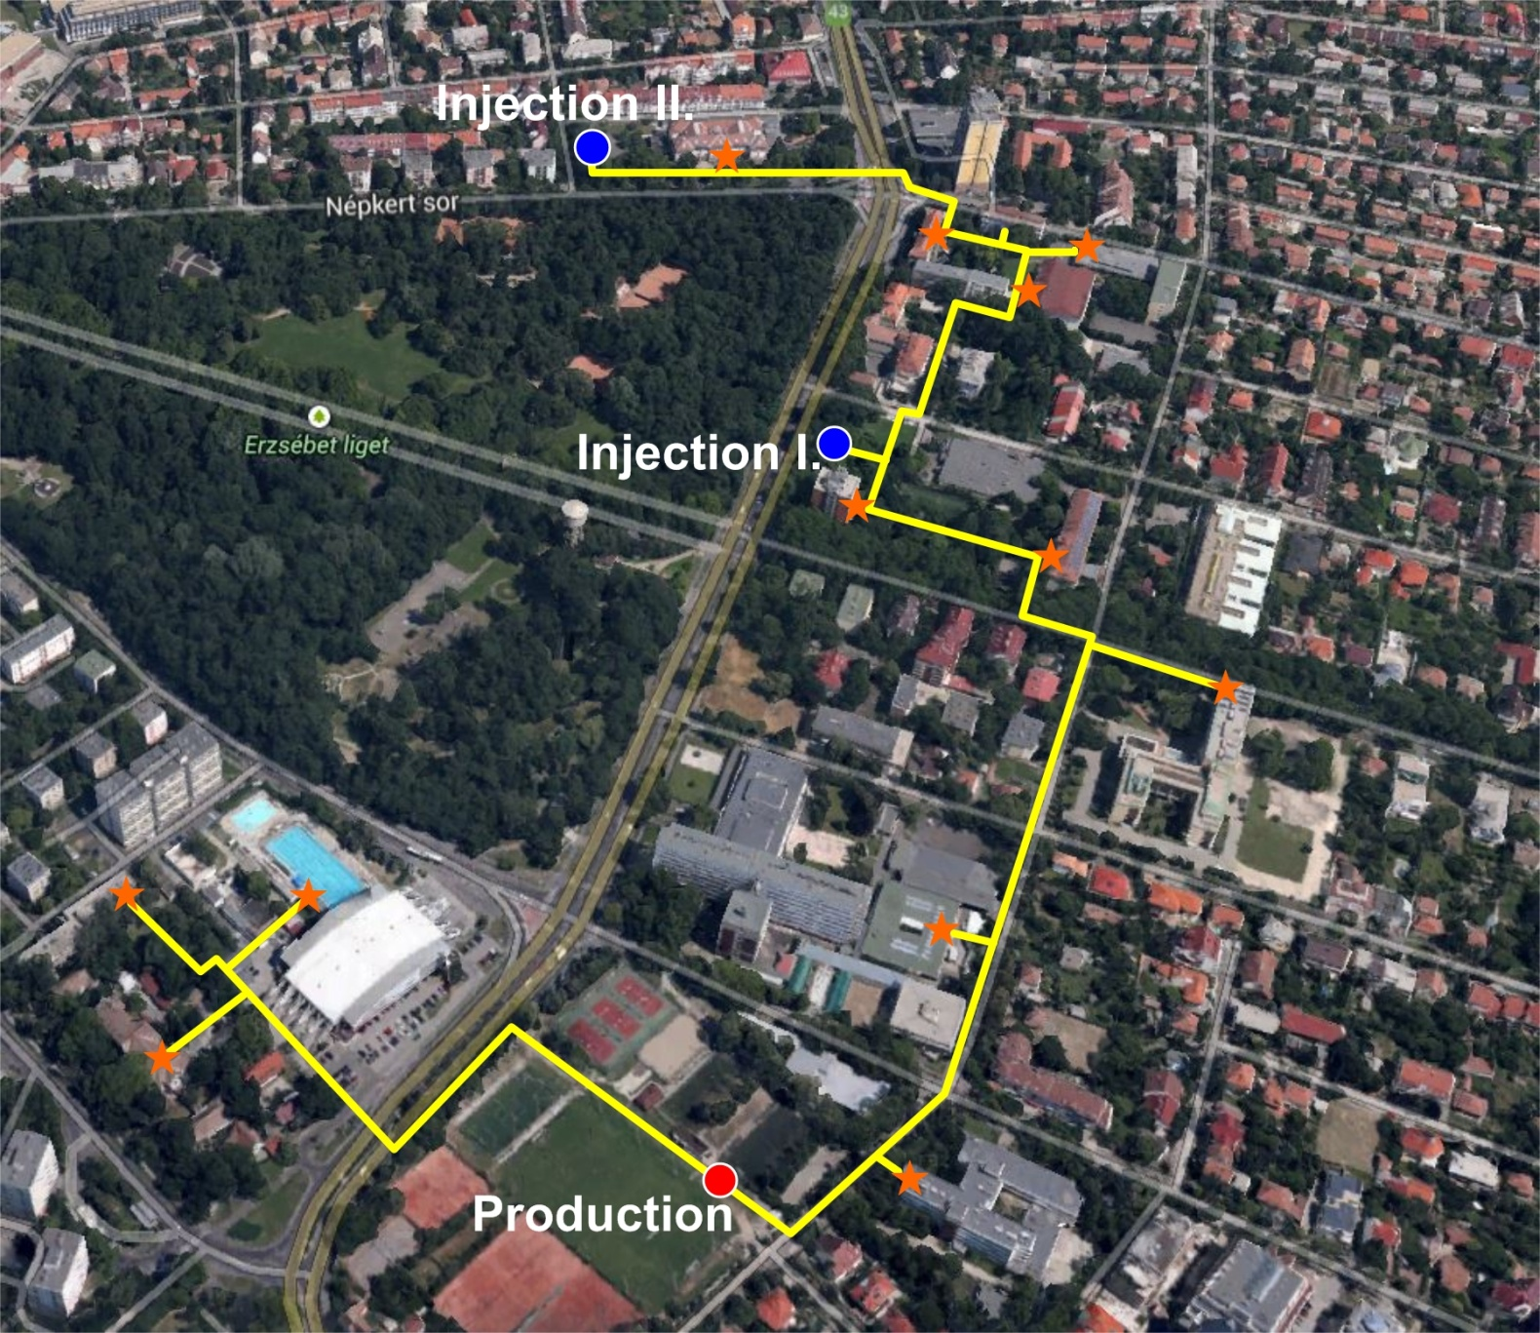
Geothermal cascade system in New-Szeged
Investment: 4.2 million €
Yearly profit: 0.37 million €

Slide 25
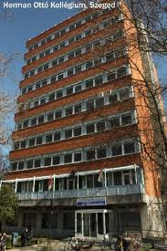
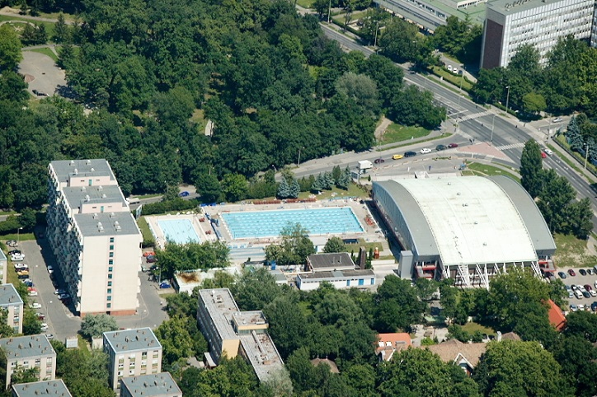
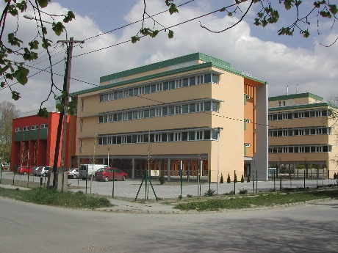
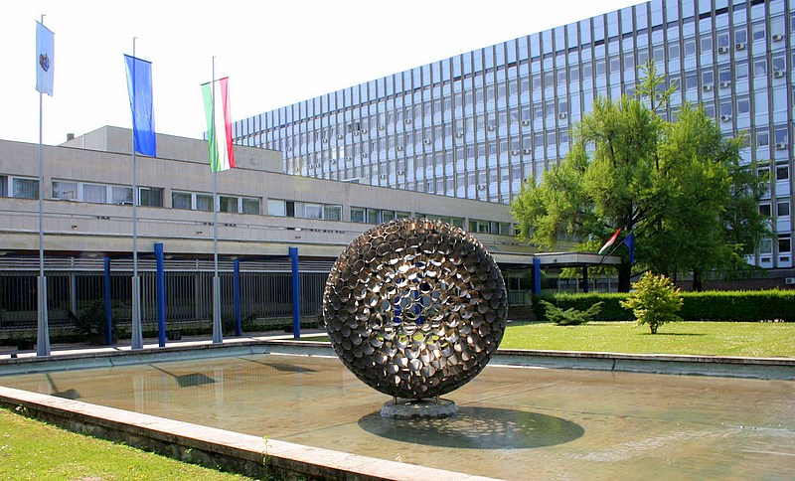
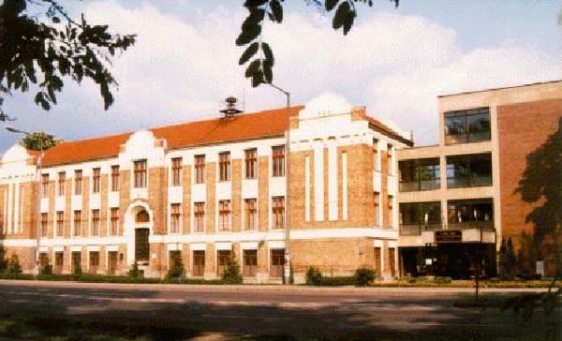
Sites of the geothermal project in New-Szeged

Slide 26
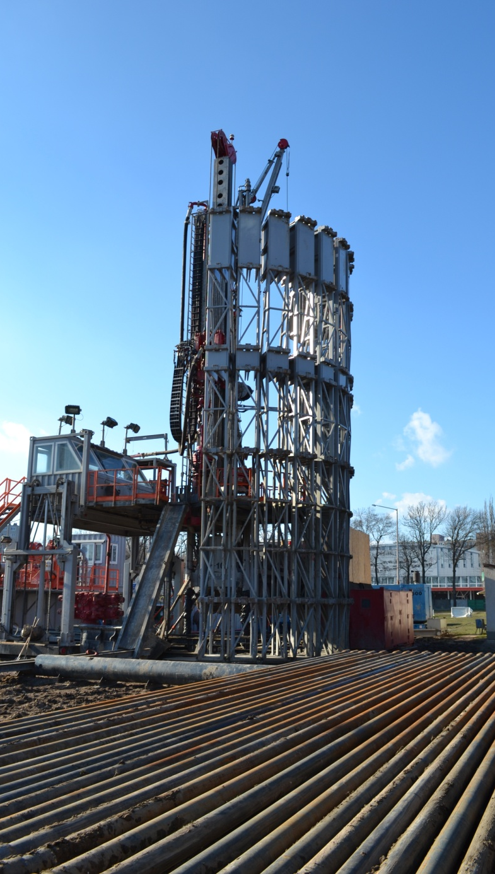
Parameters of the New-Szeged geothermal circle
Construction of the 4.5 MW_{th} project
1 production well (2000 m)
2 injection wells (1250 m; 1700 m)
pipe line ~ 4400 m
12 new heating centres
Online PLC control system
Outcomes of the project
Produced geothermal energy: 37 167 GJ/y
Natural gas reduction: 1 200 000 m³/y
CO₂ reduction: 2 343 t/y
Spending on investment: 4 200 000 €
Investment/produced energy: 860 €/kW)
Specific investment of CO₂ reduction: 1 780 €/t
Maintenance cost: 193 300 €/y

Slide 27
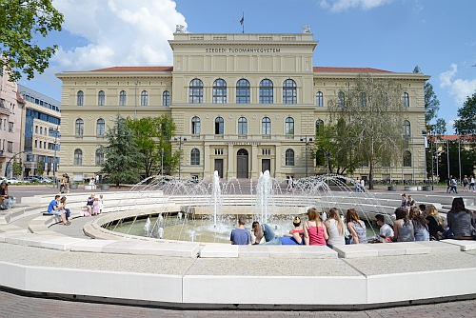
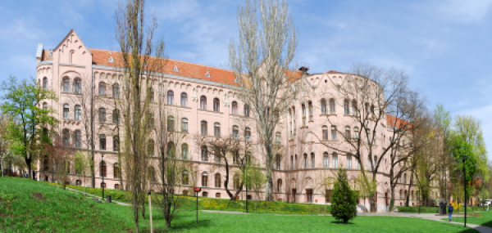
University of Szeged – Green University
In December 2014 Szeged secured a place among the 10 best European university towns on the Condé Nast Traveler website. The renowned travel magazine mentions Szeged as being the 8th best university town in Europe and the. University of Szeged as the most prestigious university of Hungary.
The greenest Hungarian university is still the university of Szeged and at the same time it even improved its „green position”: out of 360 applicants it reached 19th place on the newest world ranking list of 2014. In the European green top list the universitas on the bank of river Tisza gained 11th place.

Slide 28
Main parameters of the last geothermal projects
 | Mórahalom | Szeged University | Csongrád | Makó
Produced geothermal energy (GJ/y) | 18 000 | 86 000 | 55 931 | 67 000
Natural gas reduction (m³/y) | 482 000 | 2 900 000 | 920 000 | 2 192 000
CO2 reduction (t/y) | 1 400 | 5 900 | 1 663 | 3 847
Spending on investment (€) | 1 753 000 | 10 800 000 | 1 384 000 | 3 162 000
Investment/produced energy (€/GJ) | 97.4 | 125.6 | 24.8 | 47.2
Maintenance cost (€/y) | 138 300 | 473 000 | 187 000 | 172 000
Pay-back (y) | 10.5 | 13.5 | 5.7 | 8.1
Notes:
Up to 2500 m below ground surface concession is needed to geothermal energy exploration and exploitation from the Hungarian Office for Mining and Geology. But concession has never been published since entry into force of its legislation, that means more than one year!

Slide 29
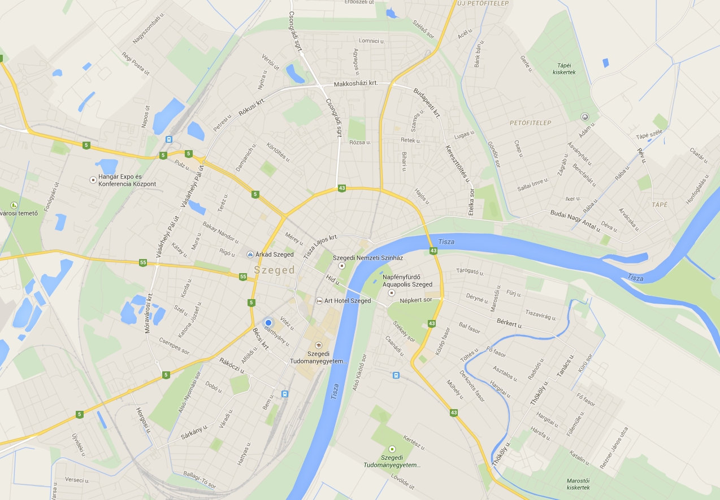
Heating stations in Szeged
District heating: 28 000 flats
Total installed heat capacity: 110 MW
The total yearly heat energy: 820 000 GJ

Slide 30
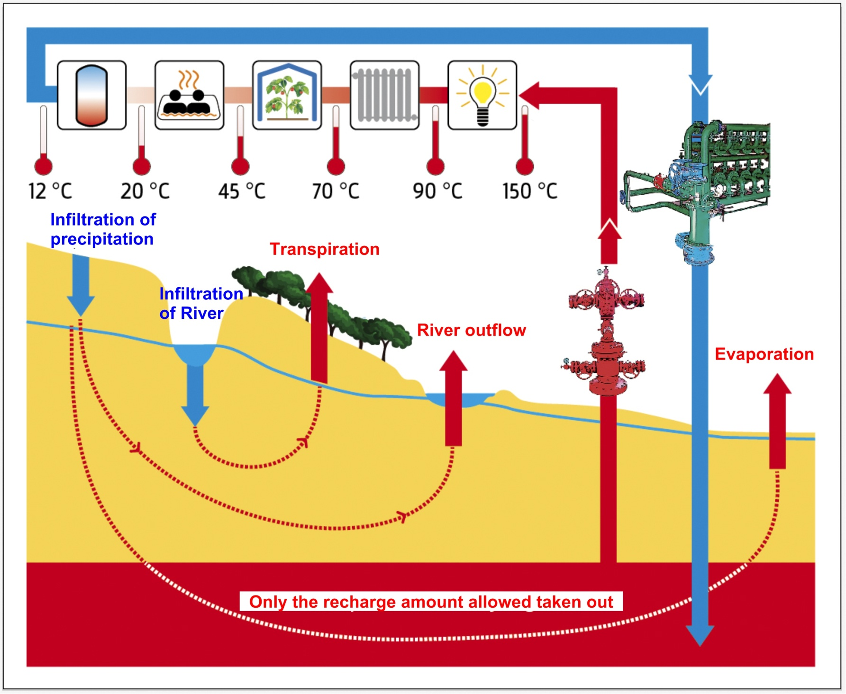
Optimal use of thermal water – Cascade system
Only the recharged amount should be taken out
Notes:
Hungary has favourable geothermal conditions both potentials and perspectives, despite effect Hungary is not an active volcanic area. The average heat flow is around 100 mW/m², thanks to the thin earth crust, compared to the other parts of the continent. (22-26 km only).

Slide 31
Most important criterions of economical
Geothermal project
Good geothermal conditions (heat and aquifer)
Appropriate heat market (sortable into cascade system)
Predictable economical climate
Stable legislation
Money, Money, Money
Notes:
Up to 2500 m below ground surface concession is needed to geothermal energy exploration and exploitation from the Hungarian Office for Mining and Geology. But concession has never been published since entry into force of its legislation, that means more than one year!

Slide 32
Conclusions
80% decrease in gas consumption at the connected buildings
Running costs 70% less than gas systems
The geothermal system serves as a demo site for higher education
Fits in the Green University idea
Good example for the cooperation of the University and the City
Sustainable system designed by researchers from the university staff

