Slide 1
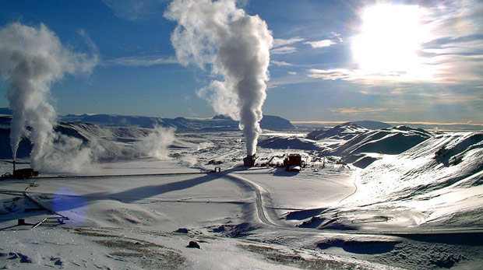

Geothermal in Turkey
Okan Tüysüz
Professor of Geology
Istanbul Technical University, Eurasia Institute of Earth Sciences
tuysuz@itu.edu.tr
2015

Slide 2

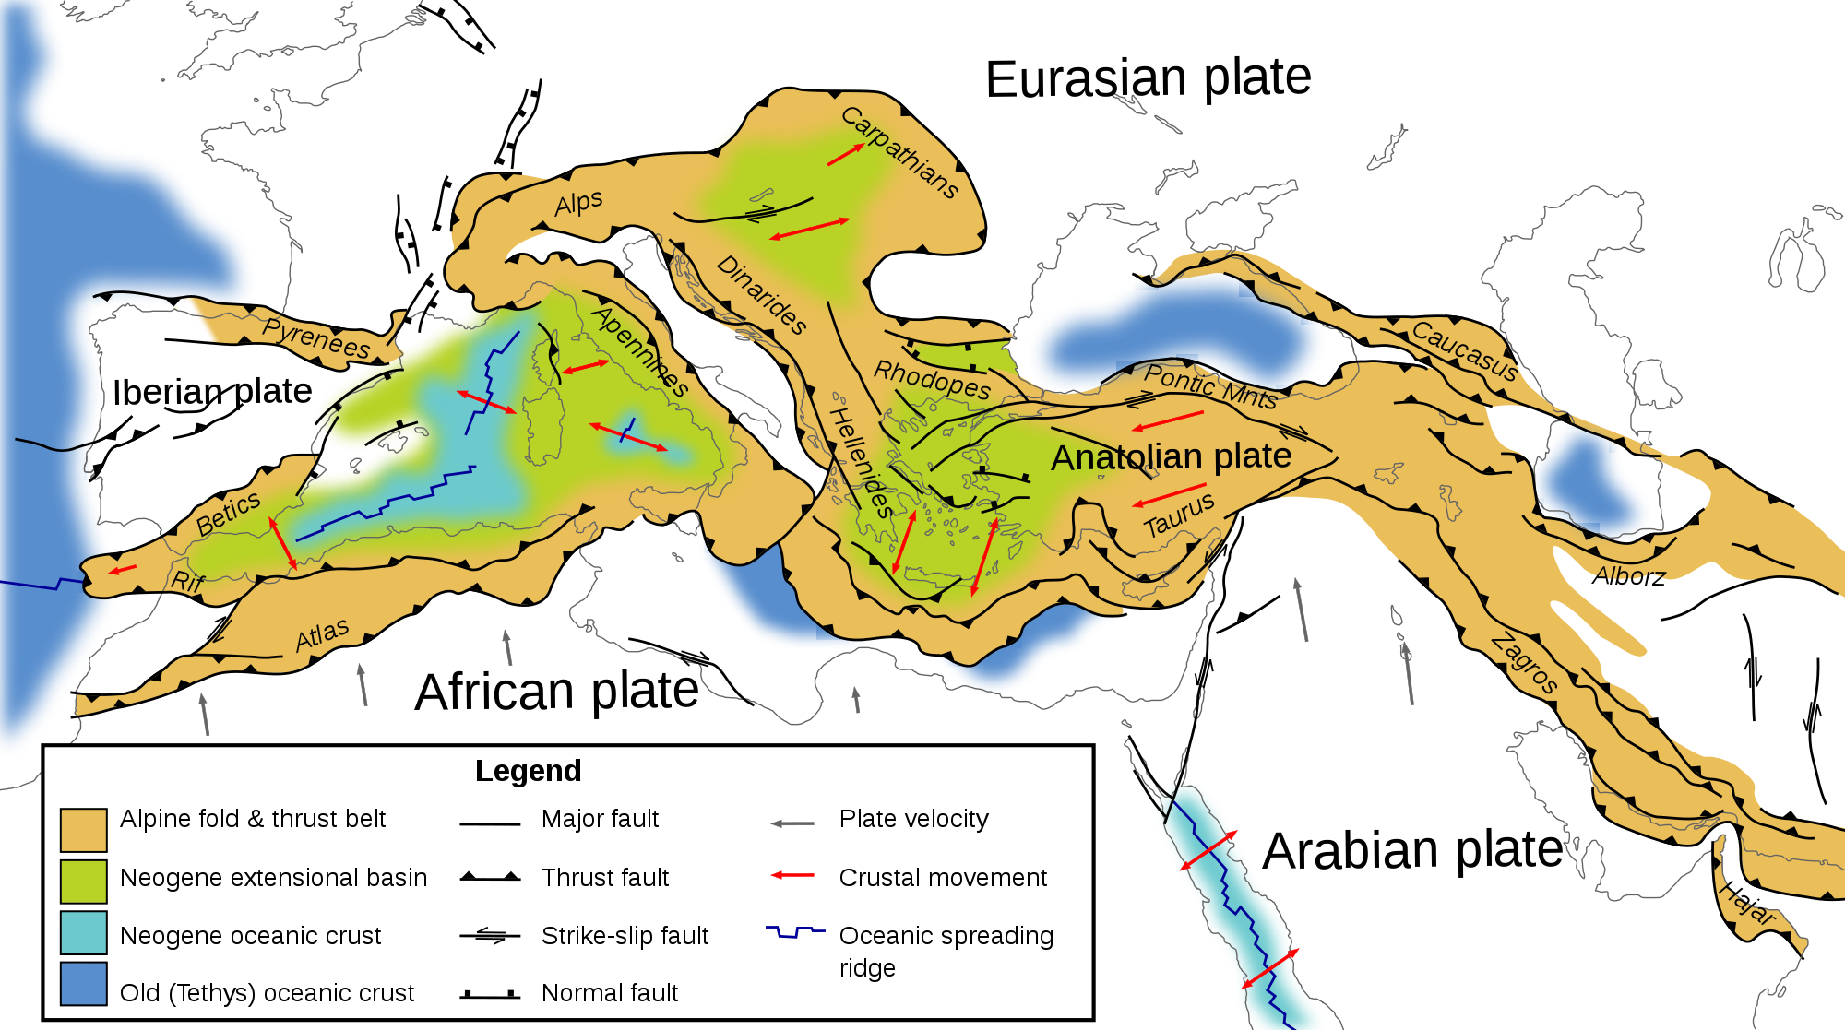
Turkey is located on the Alpine-Himalayan Orogenic Belt, one of the tectonically most active regions of the World
About 11 Ma Tethys Ocean closed and the Arabian and Anatolian plates collided along the Bitlis-Zagros suture. This collision marks the beginning of active tectonic (Neo-Tectonic) period of Anatolian Peninsula.

Slide 3
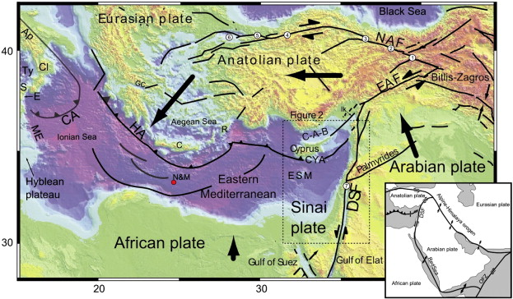
NEOTECTONIC PERIOD
During the neotectonic period, the Arabian Peninsula continued to move northward along the Dead Sea Fault and created a compressional tectonic regime in the Eastern Anatolia.
This compressional regime resulted in crustal thickening and uplifting between 11 and 5 Ma
Compression reached to a peak about 5 Ma and then Anatolian Plate start to escape westward along two transform faults

Slide 4
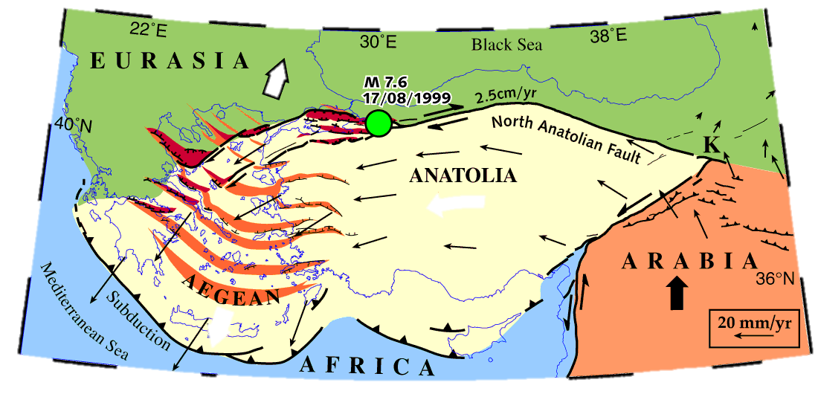
In the Aegean region, the African Plate subduct beneath the Anatolian Plate
Back-arc extensional regime created by this subduction caused enlargement of the Western Anatolia in N-S direction about 70% during the neotectonic period
Aegean extension also pulls the Anatolian Plate to the west and facilitates its westward extrusion

Slide 5
The Arabian plate is still moving northward at a rate of 15-18 mm/y
The Anatolian block escapes to the east and rotates anticlockwise
These movements resulted in extensive crustal faults, thinned or thickened continental crust and active magmatism, all of which increase geothermal gradient

Slide 6
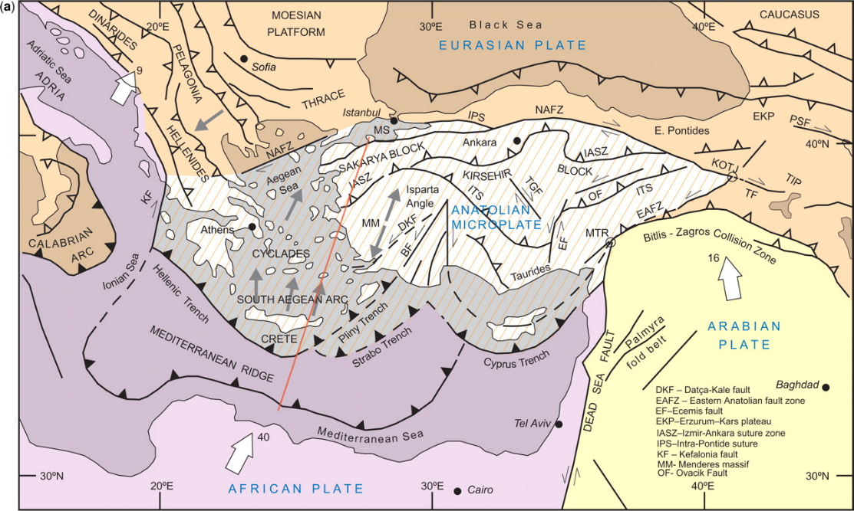
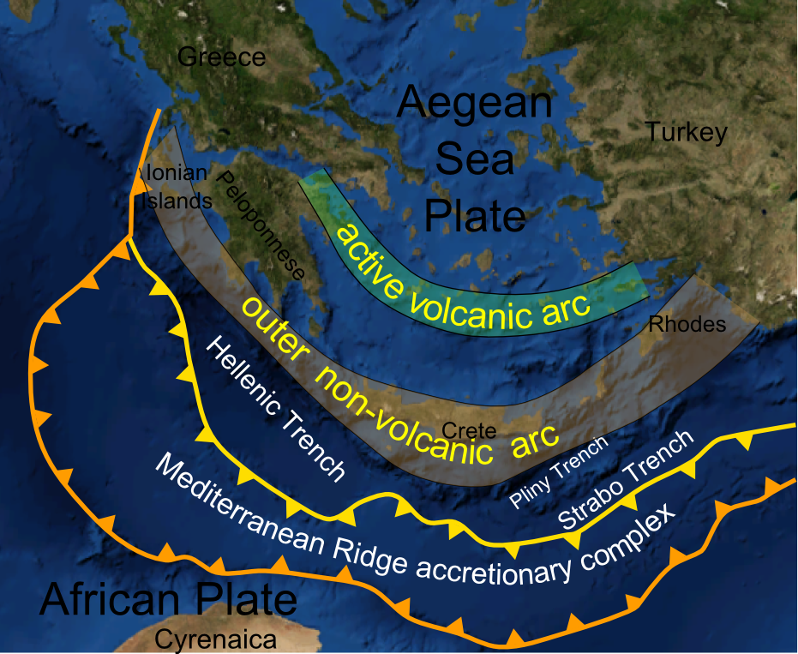
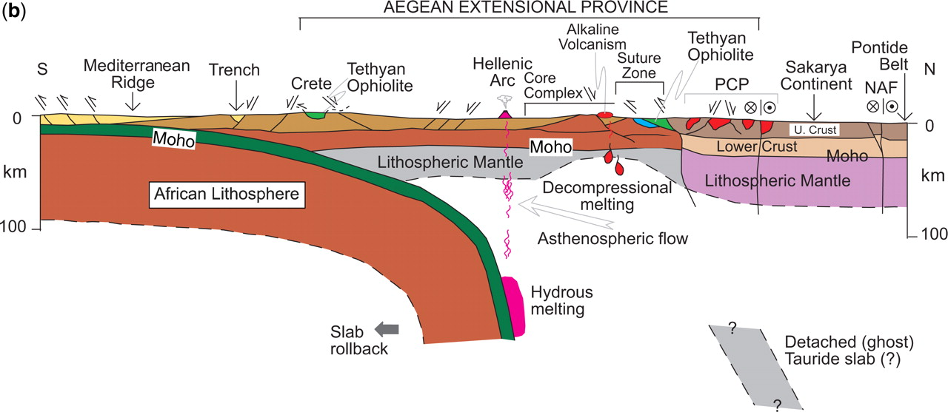
Western Anatolian Extensional Province
Back-arc extension and exhumation
Active magmatism
Horsts and grabens, cross grabens
Thinned continental crust
Dilek and Altunkaynak, 2009

Slide 7
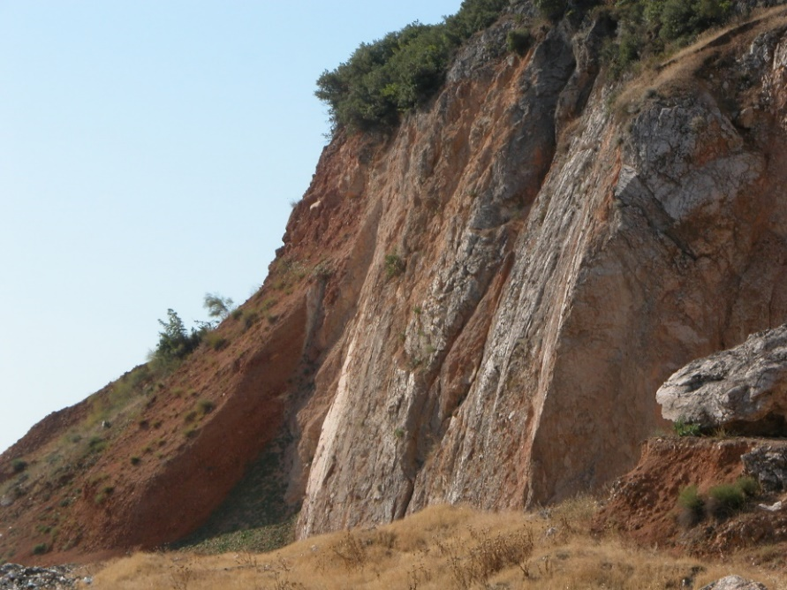

Western Anatolian Extensional Province
One of the most seismically active and rapidly extending regions of the world (>30 mm/y).
E–, NNE-, and NNW- trending active grabens
Highest geothermal gradient
Most important geothermal area of Turkey

Slide 8
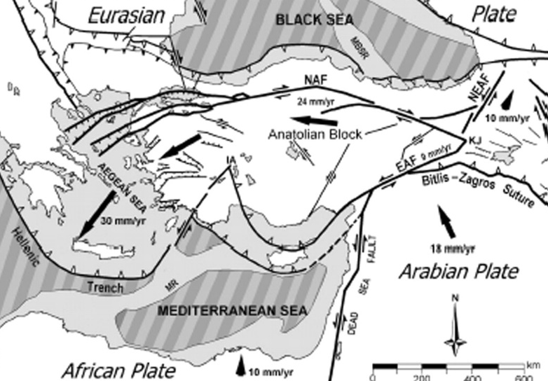
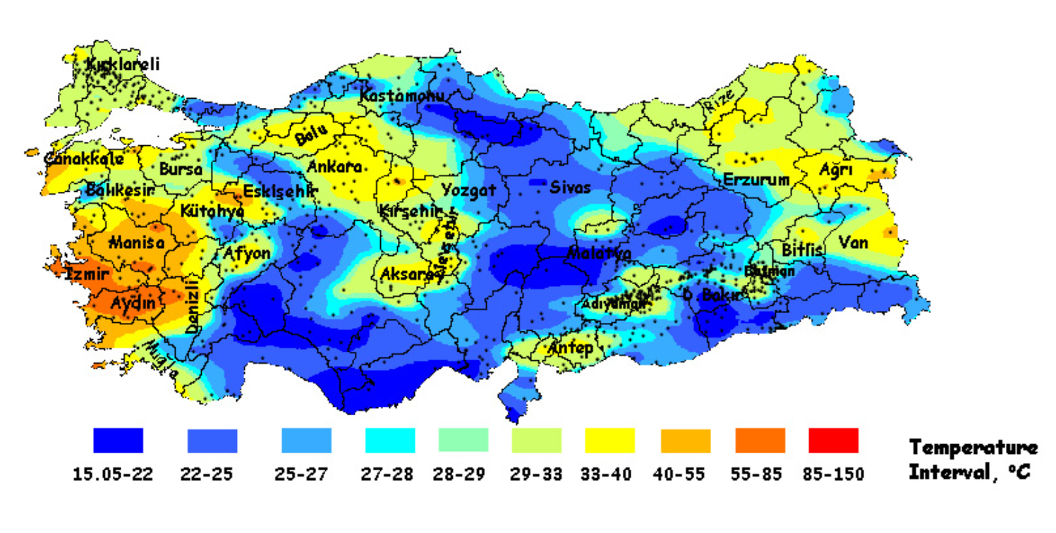
Tectonics and Magmatism Control Crustal Temperature
Başel et al., 2010

Slide 9
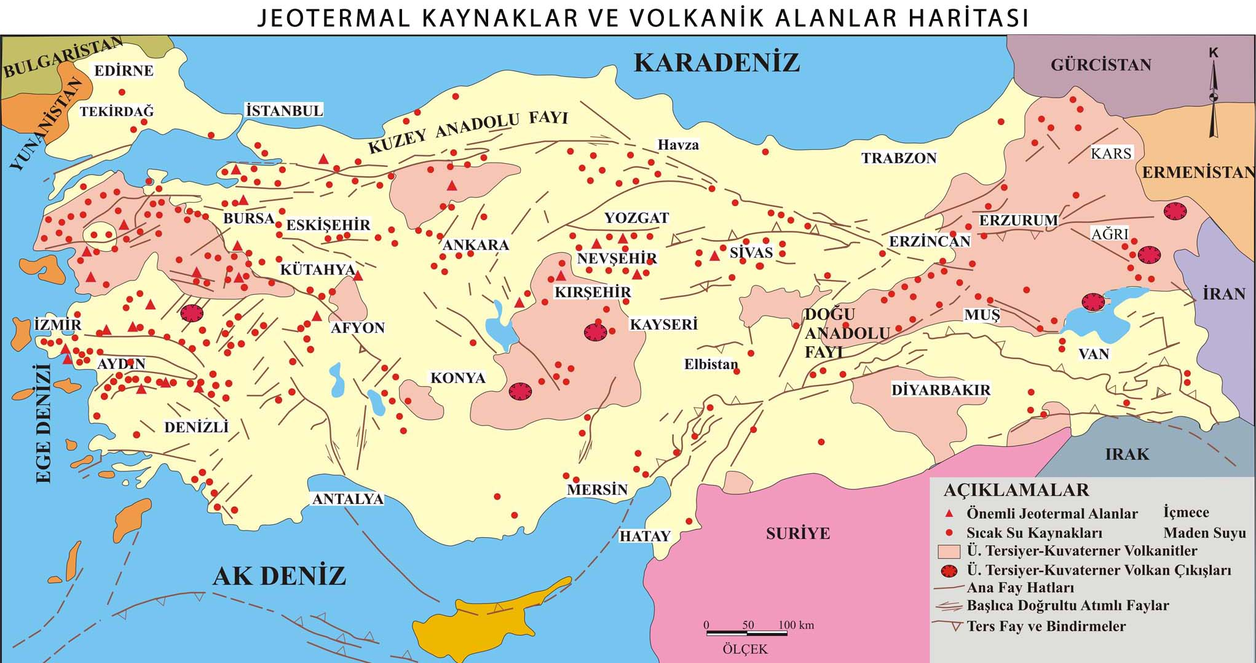
Geothermal Sources of Turkey
Close relationships with the active tectonics and magmatism

Slide 10
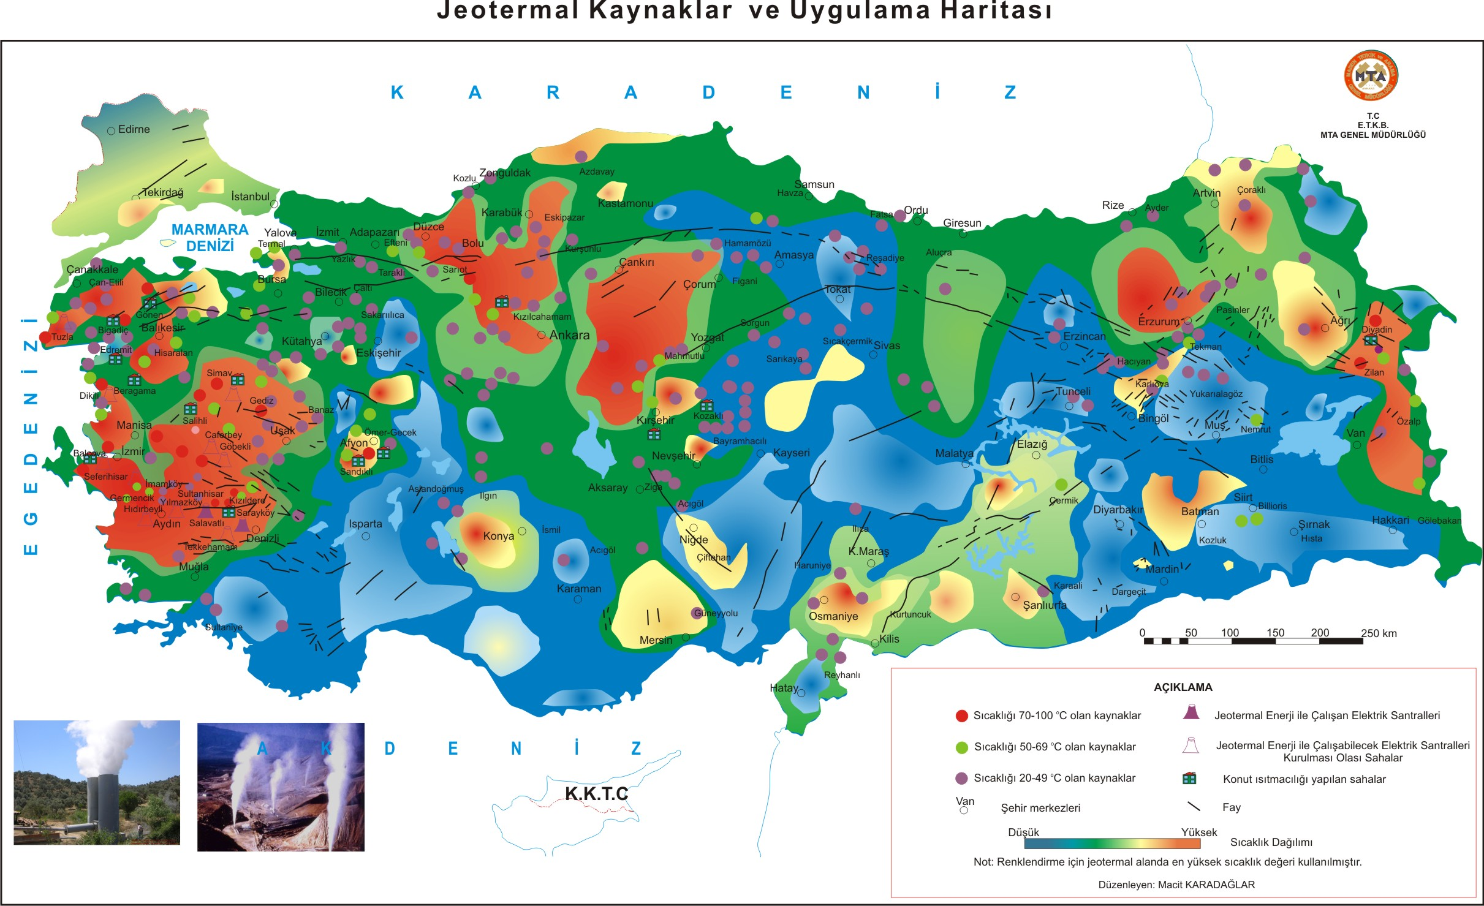

Slide 11
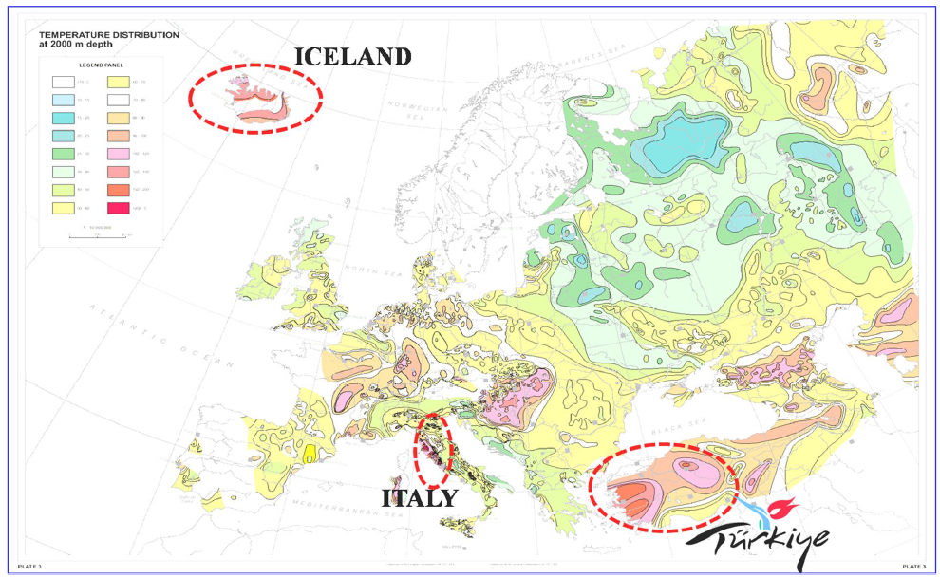
Turkey is one of the richest countries in geothermal potential

Slide 12
First Geothermal applications in Turkey
The ﬁrst
  geothermal well in 1963
  space heating in 1964
  detailed geological, geochemical, and geophysical studies in 1966
  pilot power plant in 1974
  downhole heat exchanger system in 1983
  greenhouse heating system in 1985
  liquid CO₂ and dry ice production 1986
  geothermal district heating in 1987

Slide 13
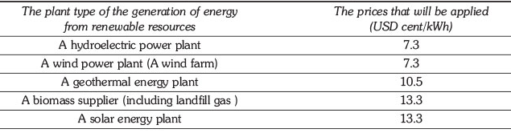
Acceleration of Geothermal Utilization in Turkey
Laws
  Use the Renewable Energy Resources for Electricity Production (2005)
  Geothermal Resources and Natural Mineral Waters and its Implementation Regulation ( 2007)
accelerated utilization of renewable energies
The geothermal law covers geothermal activities in all aspects (exploration, drilling, production and utilization) since 2009.
The law gives the prices of electricity as incentives for different renewable energy resources.
The produced geothermal electricity received a price of 10.5 USD cent/kWh.

Slide 14
Renewables in Turkey
Purchase guarantee and guaranteed feed price,
Use of forested land and state-owned land to construct a renewable energy plant,
99% reduction in the license application fees,
Exemption from annual license fee payments,
Ability to purchase electricity from private wholesale and generation companies,
Promote the manufacturing of renewable energy plant equipment in Turkey,
Priority for system connection,
Purchasing priority,
Eligible consumers (>25000 kWh/year),
Renewable energy plant investments up to 500kW and micro-cogeneration plant investments are exempt from license grid, and company establishment requirements
Additional revenue generation for renewable power projects exists in Turkey through voluntary or verified emission reduction credits

Slide 15
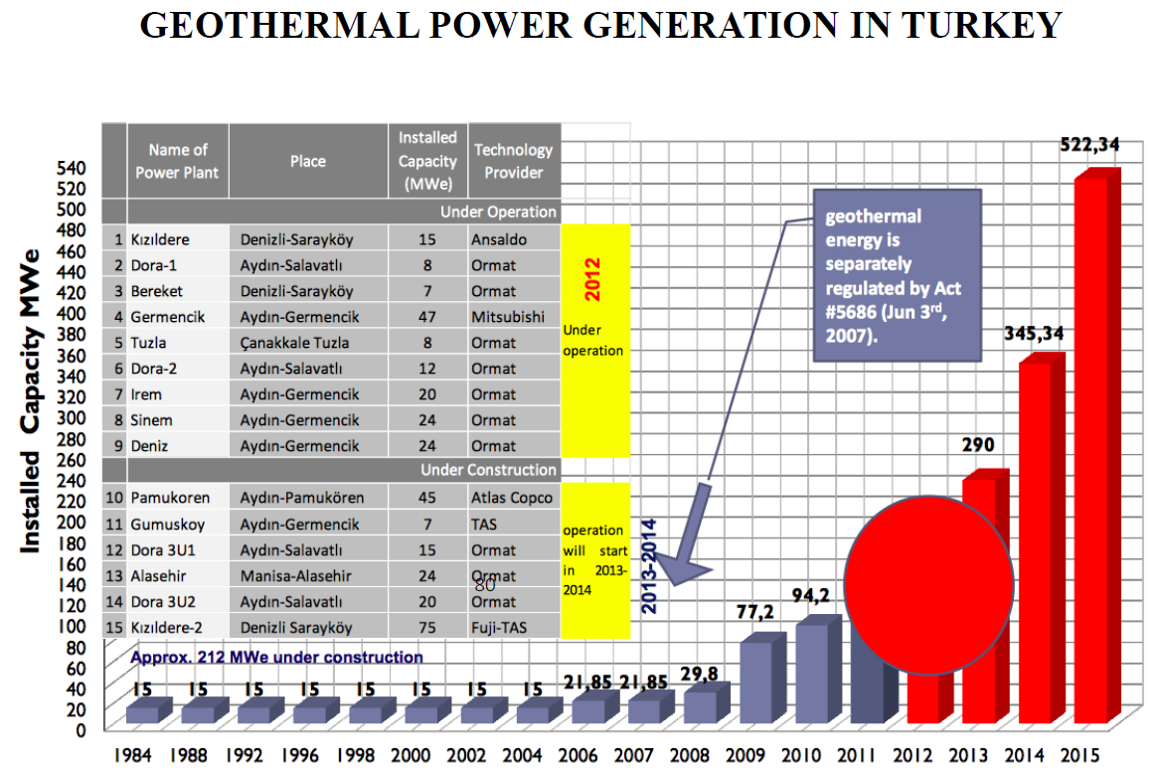
Laws and Regulations Increased Geothermal Utilization After 2007
Kaya, 2015

Slide 16
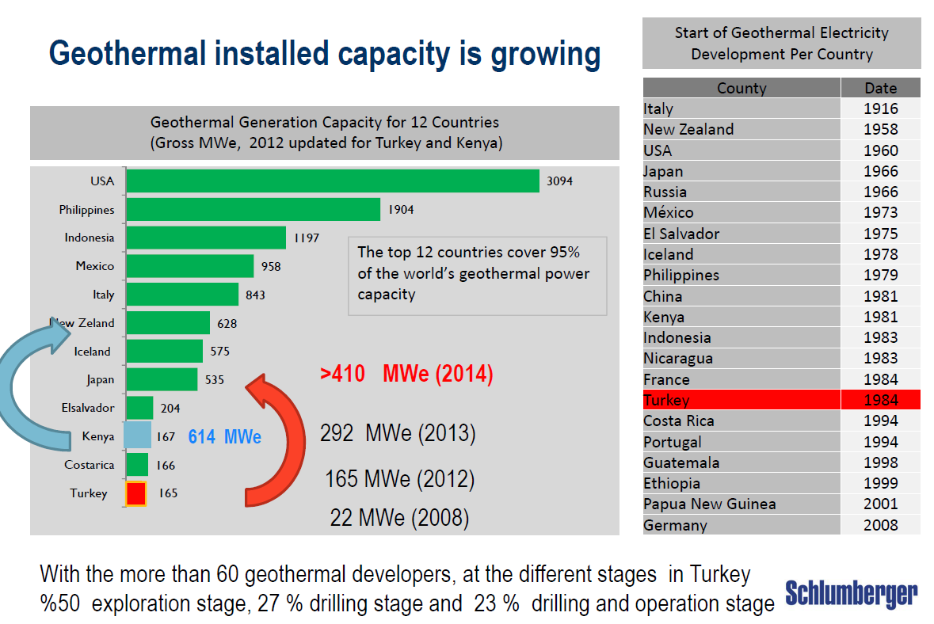
Kaya, 2015

Slide 17
PRESENT SITUATION
Discovered 227 geothermal fields at the economic scale
2,000 hot and mineral water resources, which have the temperatures ranging from 20 to 287°C.
1,200 geothermal exploratory, production and reinjection wells
Estimated geothermal potential is 31,500 MWt but can increase up to 60,000 MWt
The installed geothermal heat capacity is 2,880 MWt for direct-use and 410 MWe for power production
Liquid carbon dioxide and dry ice production 240,000 tons/year.
Total geothermal technical and economical electricity production potential (hydrothermal, 0-3 km) 2,000 MWe (16 Billion kWh/year)
The total geothermal theoretical electricity potential of Turkey (hydrothermal, 0-3 km) 4,500 MWe.
The targeted geothermal electricity production 1,500 MWe for 2023

Slide 18
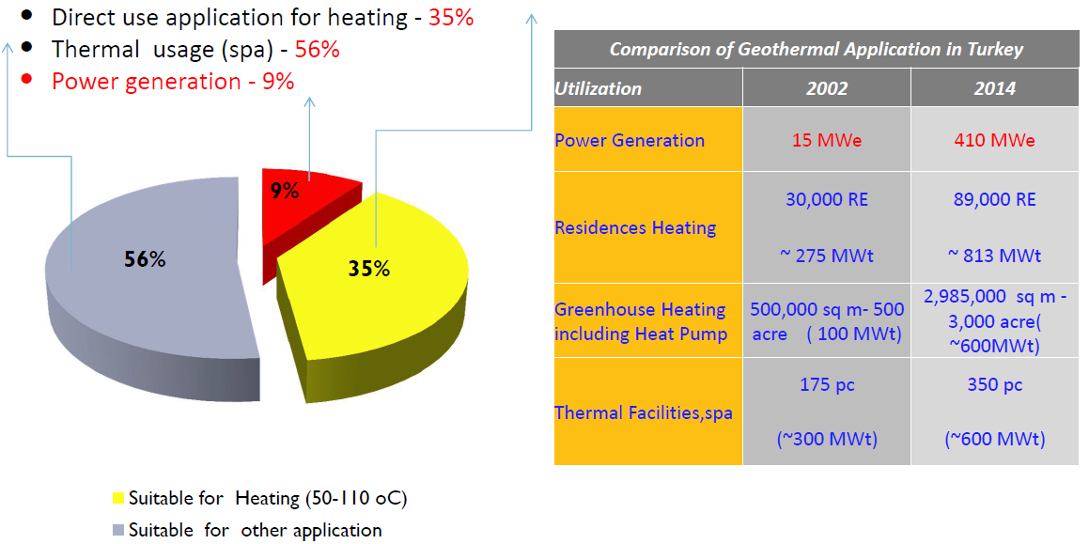
Much of Turkey’s geothermal sources are of relatively low enthalpy that is not suitable for electricity production but is still useful for direct heating applications.
Kaya, 2015

Slide 19
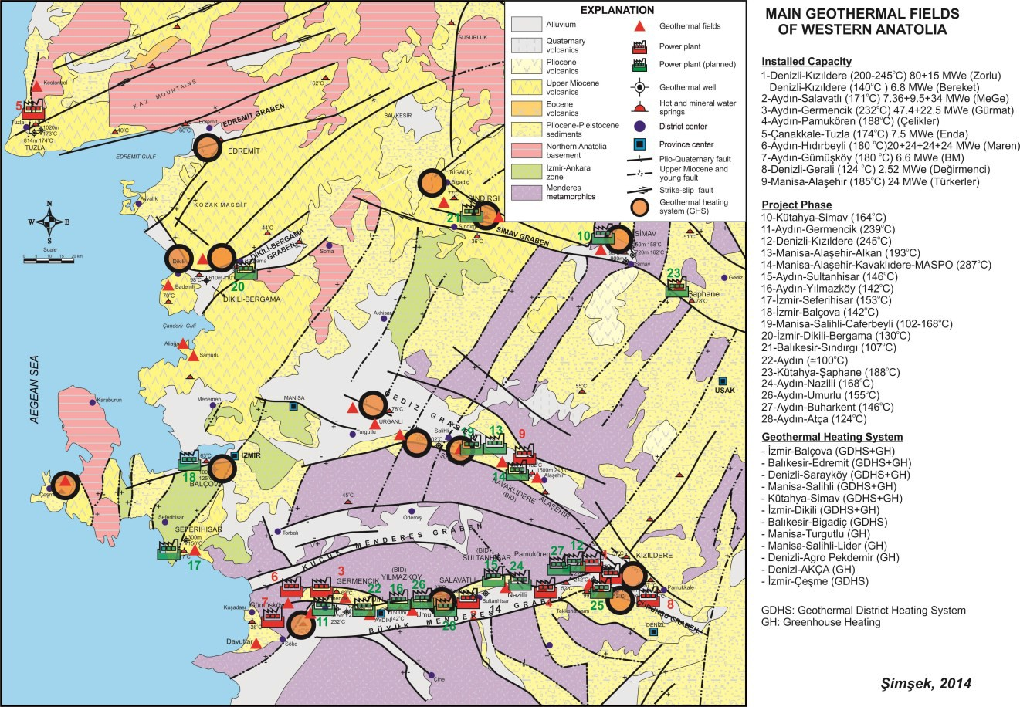
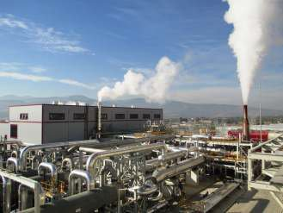
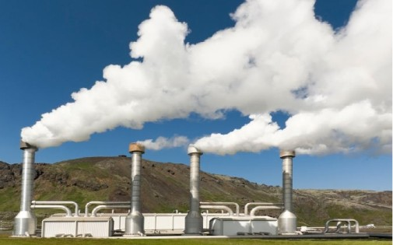
High Temperature Applications
18 operating geothermal power plants at 9 geothermal fields, which have a total installed capacity of 410 Mwe
Estimated total projected geothermal electricity use will be 1,077 MWe in the year 2020.

Slide 20
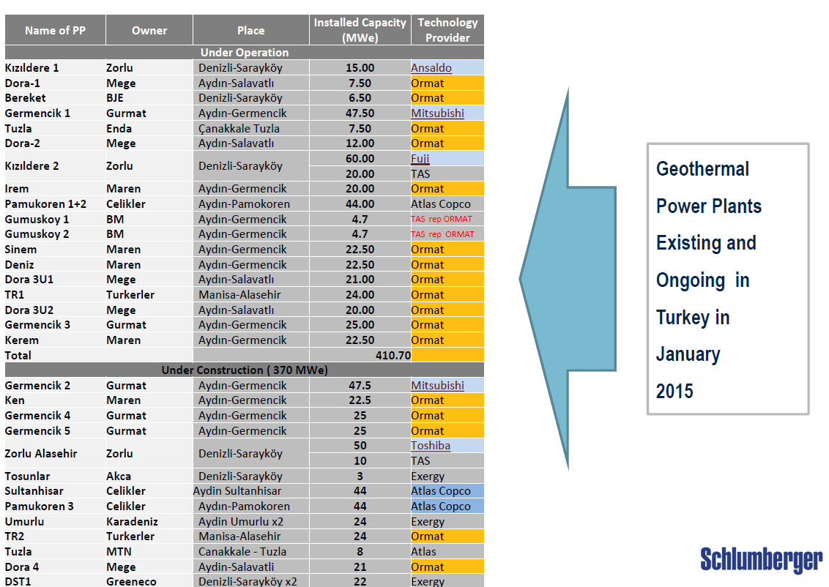
Kaya, 2015

Slide 21
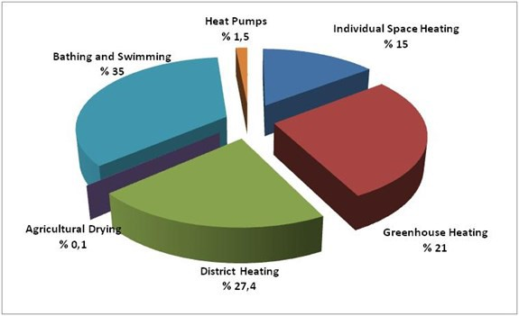
Low Temparature Applications
Low temperature (40-45°C) geothermal waters are used for space heating without heat pumps
813 MWt district heating (equals to the heat requirement of nearly 90,000 residences equivalance in 16 cities),
420 MWt for individual space heating (mostly thermal facilities and hotels),
612 MWt for greenhouse heating (nearly 3 million m2),
1,005 MWt for balneological use (400 thermal facilities and spas),
1.5 MWt for agricultural drying
42.8 MWt Geothermal heat pump applications

Slide 22
Key elements of successful geothermal development
Availability of sufficiently accurate geothermal resource data and other relevant information
Effective and dedicated institutions
Supportive policies and regulations
Access to suitable financing for the project developer
ESMAP – Geothermal Handbook (2014)

Slide 23
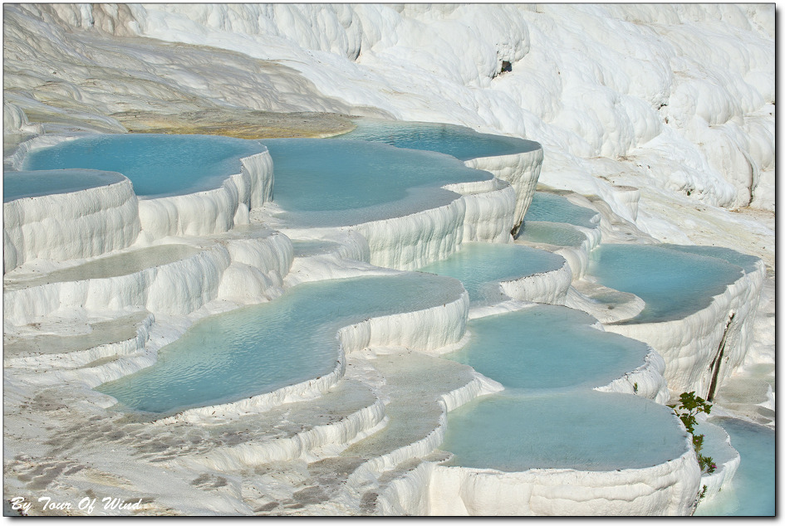
Thanks for your attention…

